Slide 1
Complex Economic Consequence Analysis to Protect the Maritime Infrastructure
Dennis Egan (Rutgers), Christie Nelson (Rutgers), Fred Roberts (Rutgers), Adam Rose (USC), Andrew Tucci (USCG, ret.), Ryan Whytlaw (Rutgers)
1

Slide 2
Project Overview
The Marine Transportation System (MTS) is vital part of U.S. supply chain.
MTS is vulnerable to many types of disruptions.
  Natural disasters, oil spills, cyber attacks, accidents, social and political disruptions
While MTS can overcome single disruptions, multiple disruptions can overwhelm it (e.g., COVID + ship blocking Suez Canal; economic resurgence + shortage of truckers).
There has been little analysis of cascading impacts of multiple disruptions, building on each other in complex ways.
Notes:
Add summary of project

Slide 3
Project Overview
Modeling multiple vector disruptions can help policy makers, business leaders, others anticipate, plan for, mitigate, recover from them.
We are working with team of government and private sector stakeholders to better understand cascading consequences of multiple disruptions and to develop a decision-support software tool to aid them.
The project goals are to:
  Identify and investigate different threats and disruptions they may cause.
  Identify plausible examples of complex disruptions.
  Identify and study pre- and post-incident mitigation and resilience strategies.
Notes:
Add summary of project

Slide 4
Project Overview
Goal is to transform the analysis into a user-friendly decision-support tool for use by Coast Guard and others to improve risk management.
Research extends CREATE’s Economic Consequence Analysis Tool E-CAT and its extensions.
Tool in development (Complex Maritime Economic Consequence Analysis Tool – MCAT) will be applied to complex disruption examples the project will develop.
The project will provide Coast Guard and other stakeholders with tools to understand potential disruptions and their impacts, potentially important countermeasures, and to aid in strategic planning and resource allocation.
Notes:
Add summary of project

Slide 5
Scenario Building: Developing Example Disruptions
The number of possible disruptions is large. Disruptions can vary by type, severity, and the geo-spatial and time period over which they occur.
Started with simple examples, adding input from stakeholders/SMEs.
Natural Disasters | Technological Accidents | Cyber and Extreme Threats | Trade Issues
hurricanes | oil spill | cyber attacks to port/vessels | tariffs/trade war
earthquakes/ tsunami | vessel grounding/fire in port/channel | GPS/AIS disruptions | labor/management dispute
storm surge/sea level rise | damage to bridges and port infrastructure | sustained security threat/incident | specialized marine fuel shortages
infectious disease | sustained power outages | radiological risks (e.g., Fukushima scenario) | truck, chassis, or container shortages
When “simple” disruptions occur together, along a common supply chain, they become “complex” and may have surprising consequences or require novel mitigation approaches.

Slide 6
Scenario Building: Develop Complex Disruption Examples
Developed example complex disruptions and list of potential impacts of complex disruptions
SME knowledge exchange process: Interviews
Identify plausible test case complex disruption
Develop detailed complex disruptions to analyze in detail
Project Overview:
  Developed examples of single and complex disruptions and identified their impacts – from literature and Advisory Board discussions
  SME knowledge exchange process: Identified SMEs, expand list of examples and impacts
  Obtain estimates of relevant parameters for each complex disruption chosen; allow range of values, allowing for several variants of the scenario.
  Feed results into the MCAT tool-building component of the project.
6

Slide 7
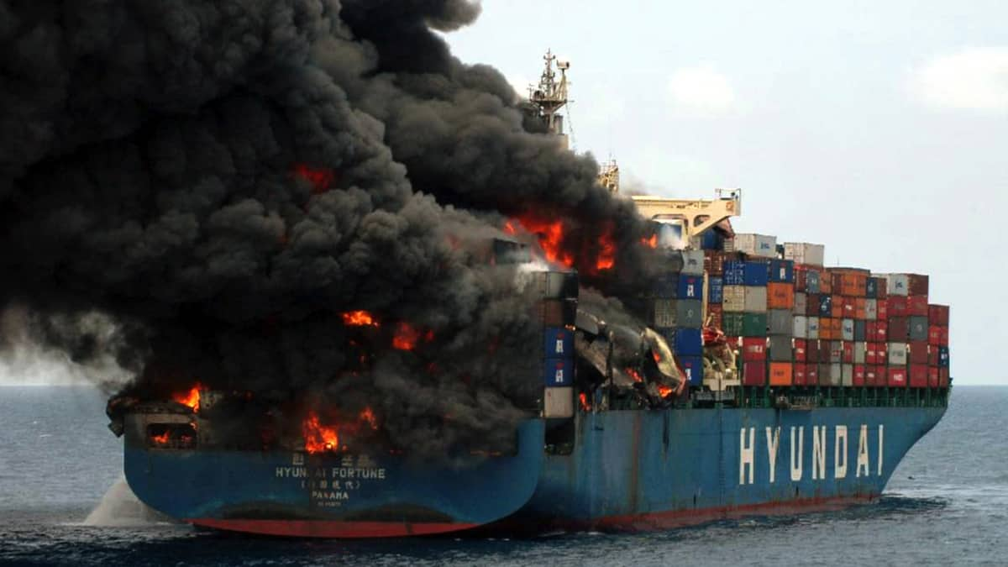
Our NY/NJ Scenario
Background Scenario: Increased dwell time for containers
A combination of truck driver, chassis, and warehouse shortages has significantly increased terminal dwell time of containers in the NY/NJ area.
Initial Disruption: Container ship fire and blockage of the Kill van Kull
Ship carrying fireworks & industrial chemicals catches fire in the KVK; smoke from burning chemicals affects surrounding area. Escort tug loses connection; vessel runs aground. 4 days to extinguish fire and tow vessel to safety; 4 more days of daytime, one-way traffic on KVK.
Secondary Disruption: Malware impacts to terminal operating systems
Malware affects terminal OS at Port Newark-Elizabeth, affecting ability to track status, location, destination of containers, and further increases terminal dwell time issues resulting from background scenario. Other terminals take their systems offline for 24 hours to ensure that the malware has not affected them. Occasional rechecks slow down operations for another week.
Notes:
Add summary of project

Slide 8
Our West Coast Scenario
Background Scenario: Labor dispute
  Labor dispute at POLA/LB leads to cargo diversions, ocean shipping spot rates almost $9K/40ft container (vs. 5-yr average of ~$3,500), and a wait time as high as 26 days.
  Initial Disruption: Wildfires and power loss
  Wildfires damage transmission lines and substations servicing the port area leading to 3 days of blackouts/brownouts in the port area; 2 more days for full power to be restored.
  Secondary Disruption: Sustained security requirements
  Two days after power is restored, a bomb explodes in a container at POLA/LB, damaging cranes. Threats of further explosions lead to MARSEC 2 conditions for the port area for all West Coast ports for one week. Workers reluctant to work until safety is assured. Debris clearing takes 3 days,but replacing cranes much longer.
Notes:
Add summary of project

Slide 9

Complex Future Disruptions
We want to avoid focusing exclusively on past and current disruptions.
What are the risk factors that will be relevant in 5-10 years?
How can we make this useful for future planning?
There is great interest in disruptions involving low- and no-carbon fuels.
There is major concern about transporting boatloads of electrical vehicles and the inability of standard firefighting methods to fight an EV fire on a vessel.
Image credit: Wikimedia Commons
Notes:
Add summary of project

Slide 10
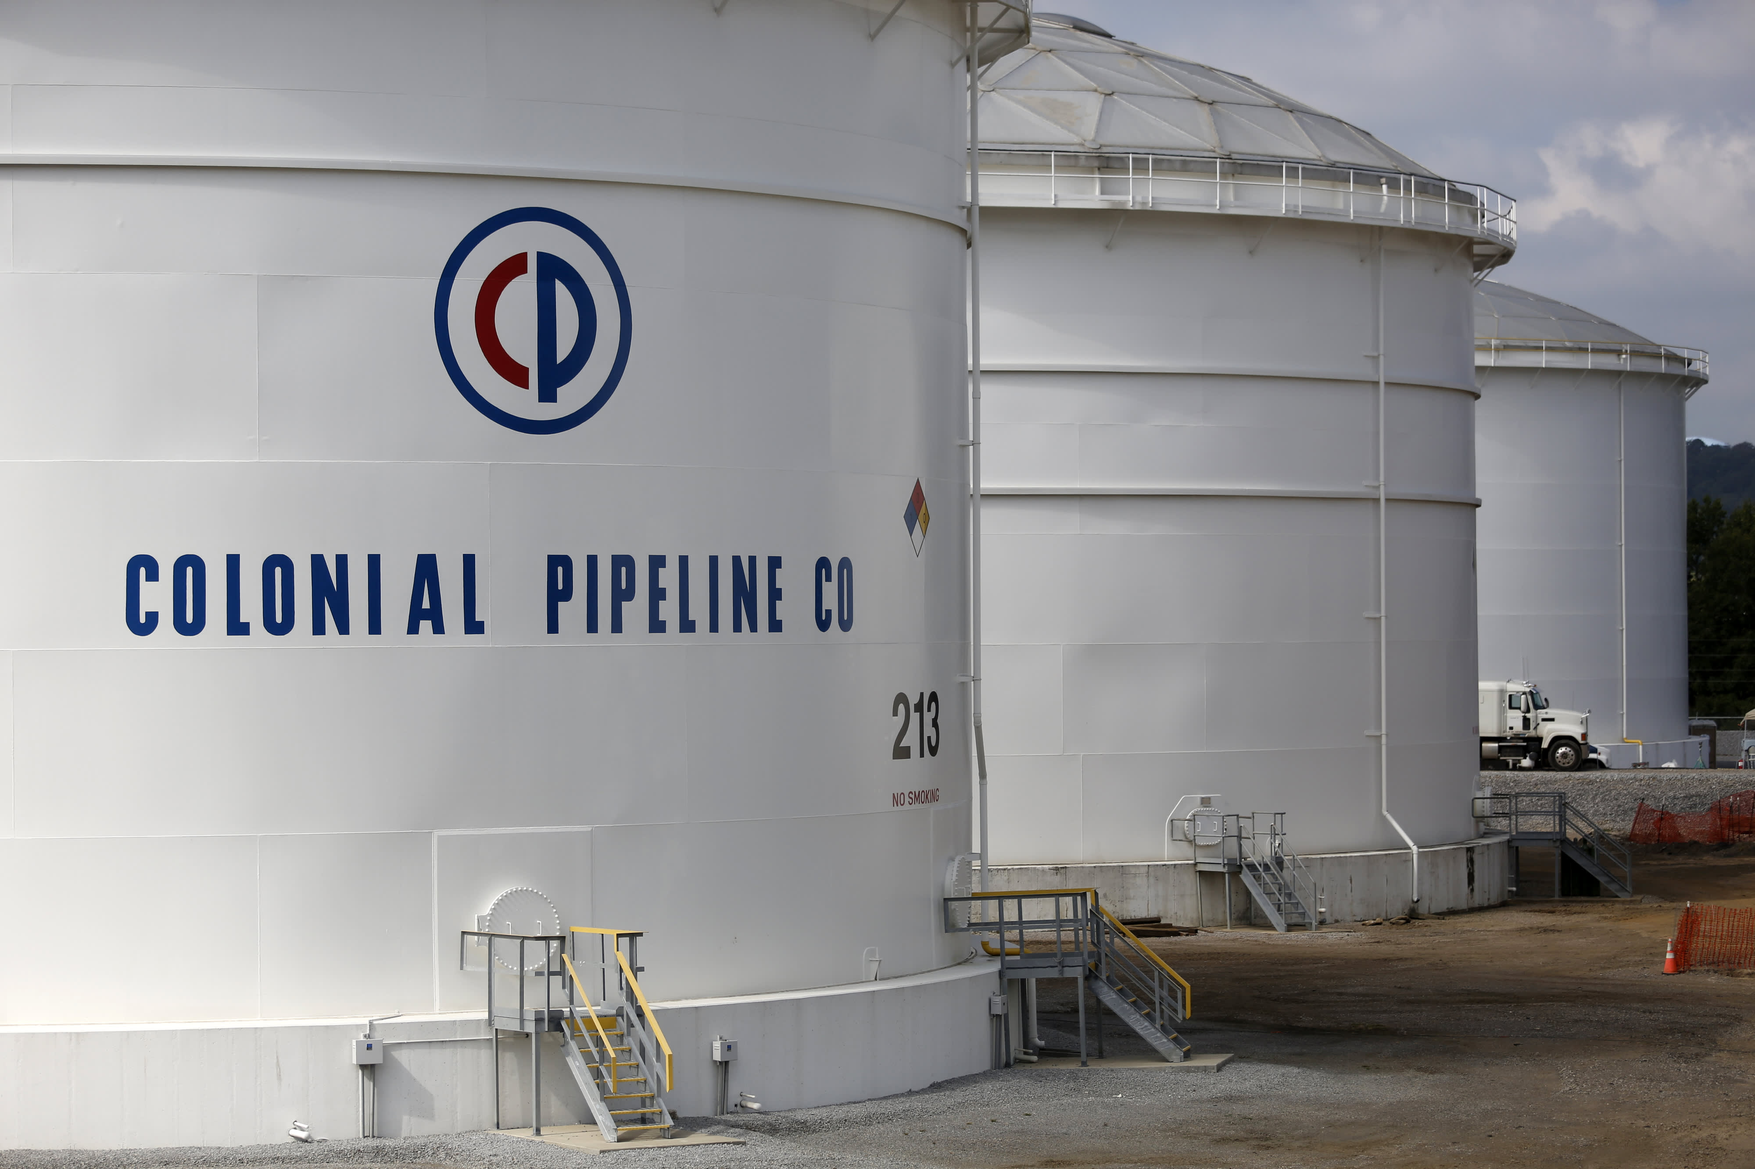
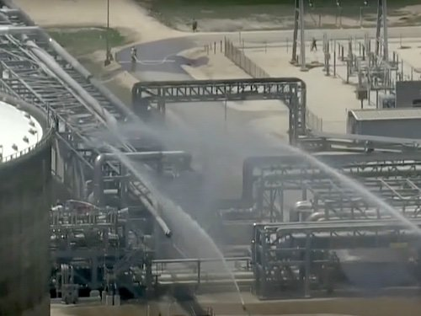
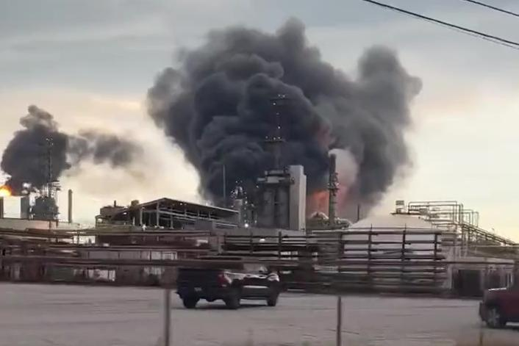
Energy Disruptions
There have been several significant energy transportation disruptions in the past two years
These overlapped with one another, or with background conditions that equated to “complex disruptions”
We are analyzing these events to better understand their impacts, and how different circumstances might have led to different consequences.
Image credit: open media sources used under the Fair Use Section 107 of the Copyright Act 1976 for research purposes
Notes:
Add summary of project

Slide 11
Economic Consequence Analysis
Our MCAT tool is based on the GTAP Model: a multi-region, multi-sector, computable general equilibrium model.
(models the economy as a set of interrelated supply chains).
Physical ramifications of disasters represent direct shocks to the model; the model then calculates indirect impacts across sectors and countries/regions.
Able to incorporate the effects of mitigation and resilience tactics.
Refining application to grain and metal export disruptions from Ukraine War.
Developing a methodology for cascading and compounding disasters.
Statistical analyses will be performed on simulation results.
11

Slide 12

CREATE Economic Consequence Analysis Framework
Disaster
Event Scenario
Loss of Life
Direct Economic Impacts
Direct
Remediation
Costs
Resilience
Adjustments
Mitigation
Costs
Behavioral
Linkages
Ordinary Indirect
Economic Impacts
Spillover
Effects
Total Economic
Impacts

Slide 13
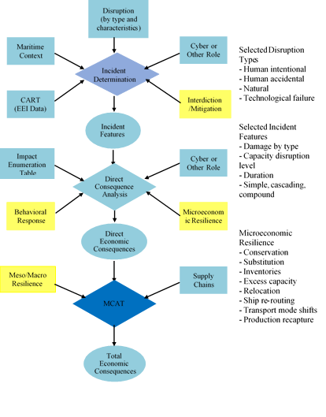
Operation of the MCAT Modeling System
13

Slide 14
MCAT Modeling/Economics: Economic Impacts of the Ukraine War
Tested out our preliminary ideas for the MCAT tool to study economic impacts of the Ukraine War.
Ukraine War is already having an impact on global markets for major commodities
  Grains, Metals, Energy products
14

Slide 15
MCAT Modeling/Economics: Economic Impacts of the Ukraine War
Grains:
  In 2021, 11.4% of global corn exports and 8.5% of global wheat exports originated from Ukraine.
  In 2021, 13.1% of global wheat exports originated from Russia.
  Prior to the War, in excess of 90% of Ukrainian agricultural exports were shipped from the country’s Black Sea ports – up until very recently, impossible.
  Possibility of moving goods by river barge, rail, or truck is limited.
  Moreover, Russian troops have controlled over 20% of the agricultural land in Ukraine.
  Black Sea Agreement helps clear backlog grains stuck in the ports and storage.
Concerns about access to Russian platinum and other critical minerals
  In 2021, Russia was the fourth-largest exporter of unwrought or semi-manufactured platinum and other precious metals.
  Metals are at the front-end of long-supply-chain linkages.
  Leading to key manufactured goods such as pig iron, unfinished steel, steel products and catalytic converters for automobiles.
15

Slide 16
Grain and Metal Export Disruptions from Ukraine and Russia for One Year (in millions $)
 | Ukraine | Russia | Combined
Grains and Crops | 4,482 | 732 | 5,214
Minerals | 524 | 396 | 919
Vegetable Oils and Fats | 2,198 | 824 | 3,022
Metals and Metal Products | 1 | 2,397 | 2,398
Ferrous Metals | 4,275 | 2,260 | 6,535
Total | 11,480 | 6,607 | 18,088

Slide 17
Conclusions from MCAT Economic Modeling
Key Findings
Ukrainian economy is estimated to experience the most negative impacts, with a real GDP reduction of 2.6 billion or 1.97% in the first year.
Russian economy is estimated to lose only about $300 million in GDP from the export shock to grains and metals alone (0.15%), but $559 million when combined with the Ukrainian exports shock due to interactive effects.
US economy is relatively unscathed, and may experience a slight uptick by serving as substitute.
Other countries/regions, such as China, Rest of Asia, Africa, and NATO (other than the U.S. and Canada) are estimated to experience relatively significant reductions in GDP (largest is Rest of Asia at $567 million).
Future Research
Estimate impacts for longer period – impacts will be smaller in second year as Russia, Ukraine and other countries adjust
Factor in compound disasters: supply-chain bottlenecks, tariffs, COVID, etc.
Rose, A., Z. Chen and D. Wei. 2022. “The Economic Impacts of Russia-Ukraine War Export Disruptions of Grains and Metals,” CREATE, USC.
17

Slide 18
Mitigations/Resilience Tactics
Another key component of the project is to identify pre-disruption mitigations and post-disruption resilience tactics.
To feed the decision support software, we need to be able to give for each mitigation and resilience tactic a rough estimate of
  Length of time to implement
  Cost
  Reduction in impact of the disruption it is aimed at
We are dividing mitigations/resilience tactics into short-term and long-term (leaving the definitions of S-T and L-T somewhat vague)
Notes:
Add summary of project

Slide 19
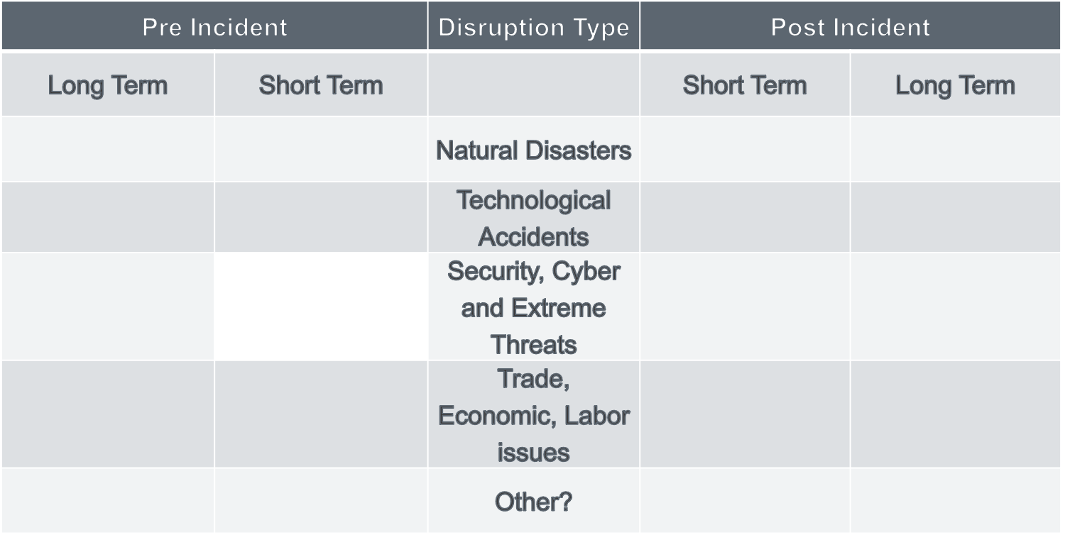
Asking SMEs: What are Example Successful Mitigation and Resilience Tactics You Have Seen?
Training and exercises
Infrastructure improvements
More warehouse capacity
Early ship rerouting
Specialized skills recruiting
Better port/vessel coordination
Regulatory changes
Economic incentives
Emergency funding/hiring
Waterway survey/soundings
Regulatory relief
Better agency coordination
Ship rerouting/slow steaming
Infrastructure improvements
Coordination with shippers, cargo owners
Notes:
Add summary of project

Slide 20
Asking SMEs: What Potential Mitigation and Resilience Tactics Would You Like to See?
What Factors Might Make them Feasible or Infeasible?
Short term funding/grants
Multi-year funding/grants
Legal or regulatory constraints
Labor/Management contracts
Tax and insurance incentives
Environmental Objectives
Competition
Technology challenges
Notes:
Add summary of project

Slide 21
Short Term Pre-disruption Mitigations
(possible examples)
Protocols
  Radiological Workforce Training and Development
  Cybersecurity, emergency management, logistic managers
b. “Just in Case” approach to inventory management
c. Planning, Exercises, and Coordination
  With MTS players (AMSC, Harbor Safety, etc.)
  With non-MTS supply chain partners (rail, cargo owners)
  Supply chain simulations (port level, regional, international, find the breaking points)
d. Advance Ship Re-routing – e.g., in case of known or expected disruptions
  Revising port schedules, speed, or other factors
  Is rerouting done to minimize vessel costs, or minimize overall disruption?
  Coordination with port, truck, rail, cargo owners
e. Novel Contingency Preparedness
  PPE stockpiles & testing events
21

Slide 22
Long-term Pre-disruption Mitigations
(possible examples)
Cybersecurity
  Improved staffing & system upgrades
  Required, periodic 3rd party evaluation
  All supply chain elements
b. Information sharing requirements & systems
  Ship arrivals/departures
  Cargo information
  Truck and rail operators included
c. Infrastructure improvements
  Transportation: docks, bridges, roads, railways, ports
  Power grid upgrades
  Electrification/automation in the ports
d. Climate Change Mitigations
  Reduce flood/storm surge risks
  Alternative Fuel availability
  Carbon neutral and resilient systems
e. Continuity of Business Planning
f. Legal, regulatory, and policy changes
g. Federal, state, local/port authority levels
  Cyber
  Environmental
  Workforce safety
  Hazmat cargo
h. Labor agreements
i. Insurance and tax incentives for resilience investments
j. Strategic investments in ports, transportation, and manufacturing
22

Slide 23
Post-disruption Resilience Tactics
(possible examples, short and long term)
  a. Traffic diversion
  b. Communication protocols/information sharing
  c. Rerouting
  Skipping port calls
  Reversing order of port calls
  Speed adjustments
  d. Waiving regulations
  Allowing ships to use their own power when shore power is not available
e. Using excess capacity
f. Conserving on critical inputs
g. Substitution for critical inputs
h. Recapture of lost activity
23

Slide 24
Next Steps & Takeaways
  Continue dialogue with stakeholders
  Continue interviews to help flesh out impacts of specific to be developed scenarios
  Continue to track and investigate Ukraine war impacts
  Continue development of MCAT modeling tool
  Some Takeaways:
  Multiple, small disruptions, which individually might be inconsequential, can add up in unexpected ways, or aggravate larger disruptions.
  The economic consequences to downstream businesses (e.g. retailers and others outside port areas) are not well recognized or measured.
  Future risks include climate change factors such as sea level rise and extreme temperatures that ports are already trying to deal with.
24

Slide 25
Grant Acknowledgment
The material in this presentation is based upon work supported by the U.S. Department of Homeland Security under Grant Award Number, 17STQAC00001-03-03."
Disclaimer. The views and conclusions contained in this document are those of the authors and should not be interpreted as necessarily representing the official policies, either expressed or implied, of the U.S. Department of Homeland Security.
25

