Slide 1
Modeling the Impact of Complex, Multi-Vector Disruptions to the Marine Transportation System (MCAT)
PI: Fred Roberts
Rutgers University
PI: Adam Rose
USC
February 15, 2023

Slide 2
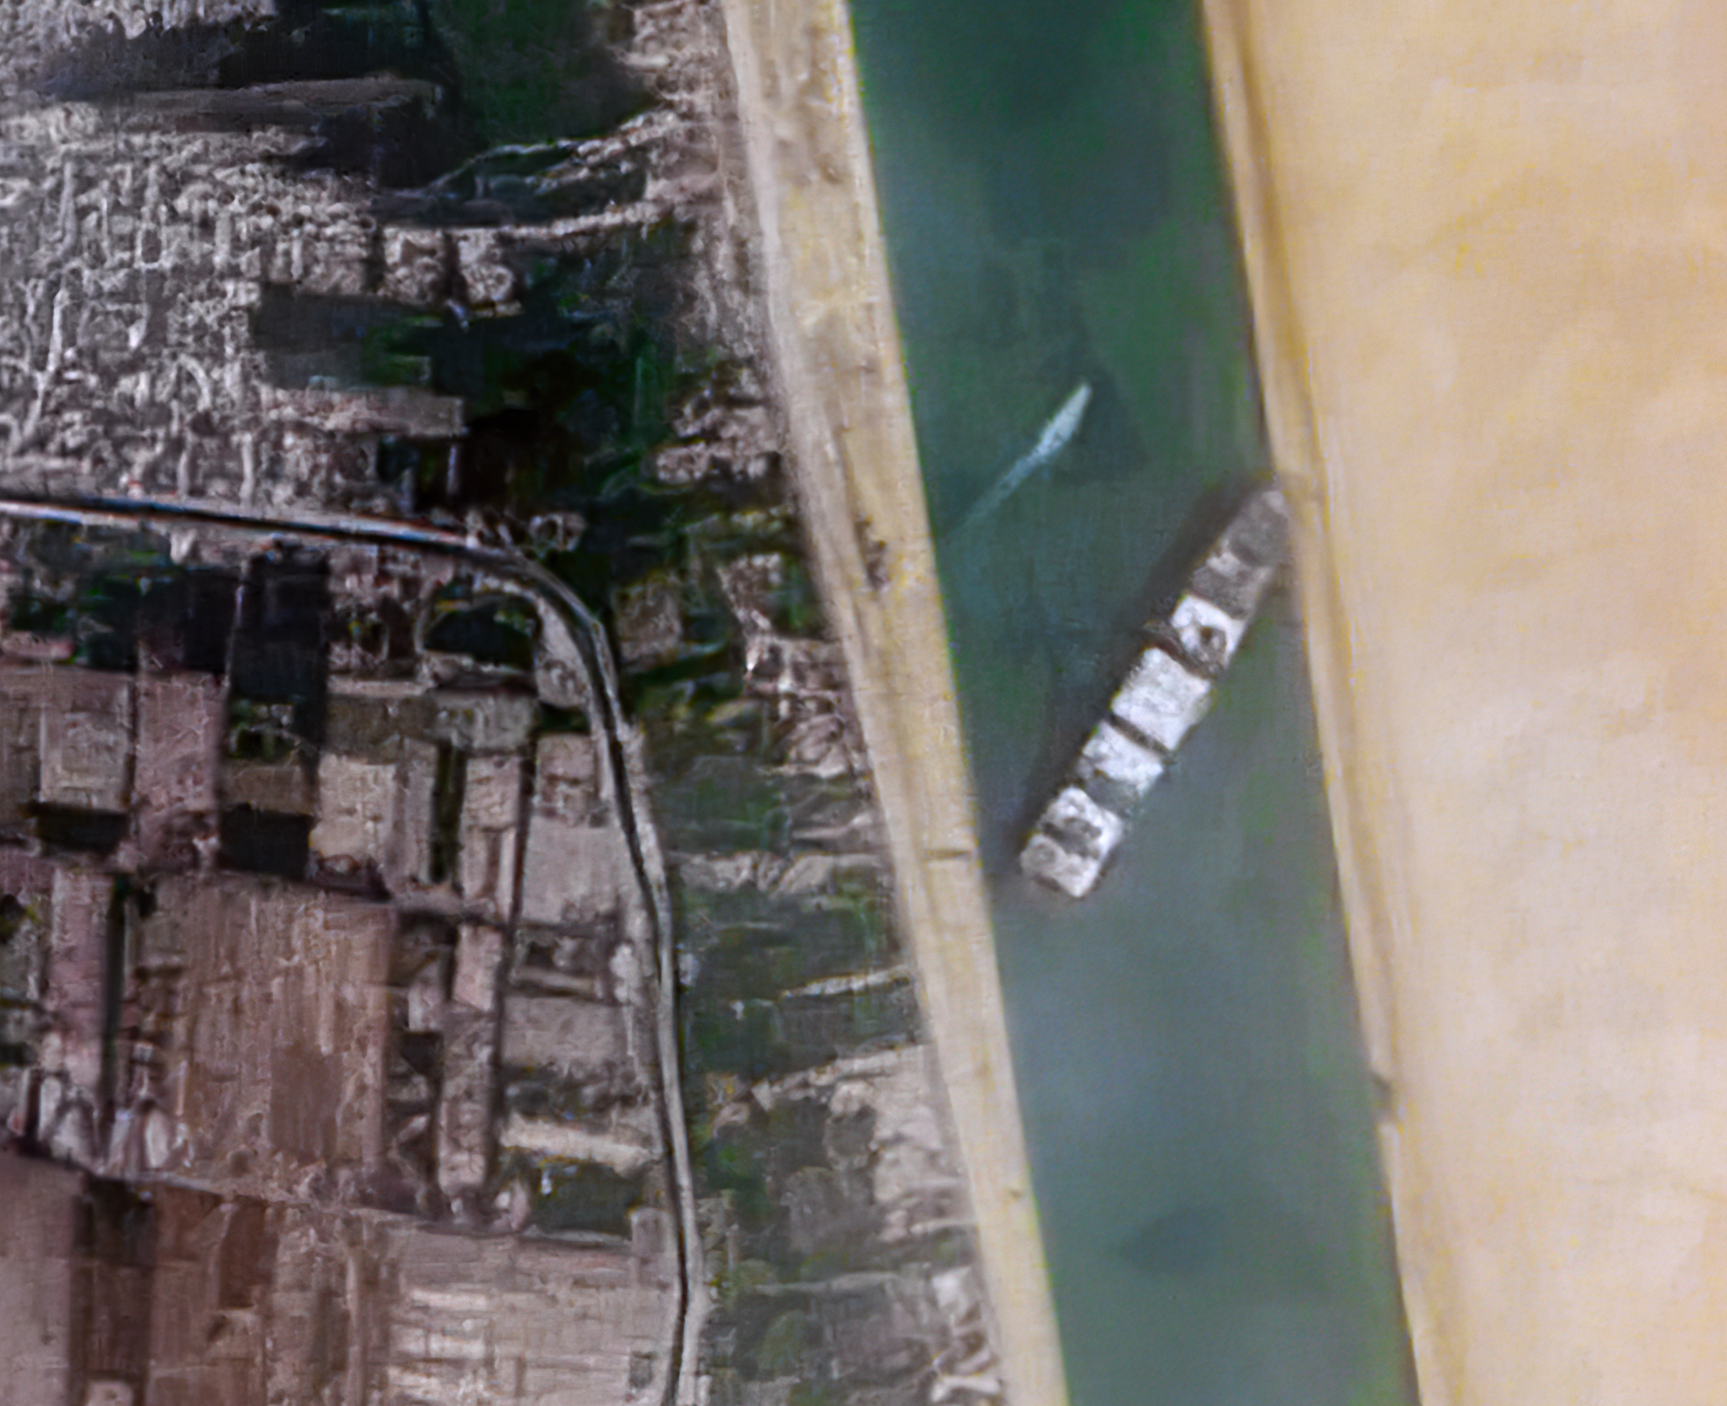
Project Overview
The Marine Transportation System (MTS) is a vital part of the nation’s supply chain. The vast majority of U.S. overseas trade is carried by the MTS, and this, in turn, plays a major role in the nation’s GDP and overall prosperity.
While the MTS is resilient, multiple disruptions can have unexpected impacts.
We know little about how these disruptions interact and how they impact downstream businesses dependent on a smooth functioning MTS.
Modeling multiple vector disruptions and identifying potential countermeasures can help policy makers, business leaders, and others anticipate, plan for, mitigate, recover from them.
We are identifying plausible complex disruptions, possible countermeasures, and building a decision-support tool called MCAT for use by the Coast Guard and others to improve risk management.
The Ever Given wedged in the Suez Canal, blocking traffic in both directions. Credit: Contains modified Copernicus Sentinel data 2021, CC BY 2.0, via Wikimedia Commons
Complex disruption: COVID + ship blocking Suez Canal
Notes:
Add summary of project

Slide 3
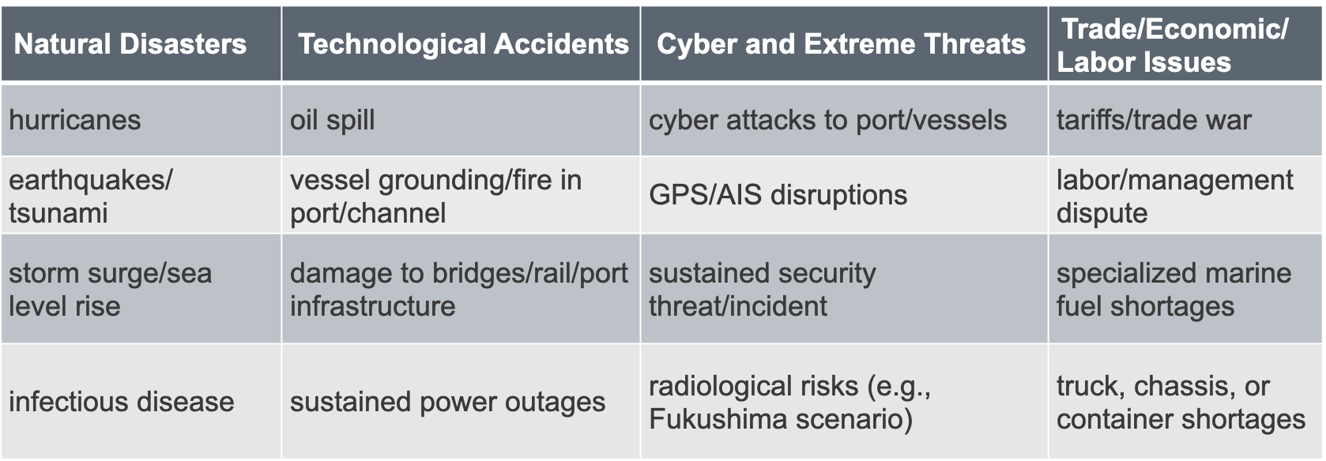
“Simple” Disruptions
(not comprehensive)
When “simple” disruptions occur together, along a common supply chain, they become “complex” and may have surprising consequences or require novel mitigation approaches.

Slide 4
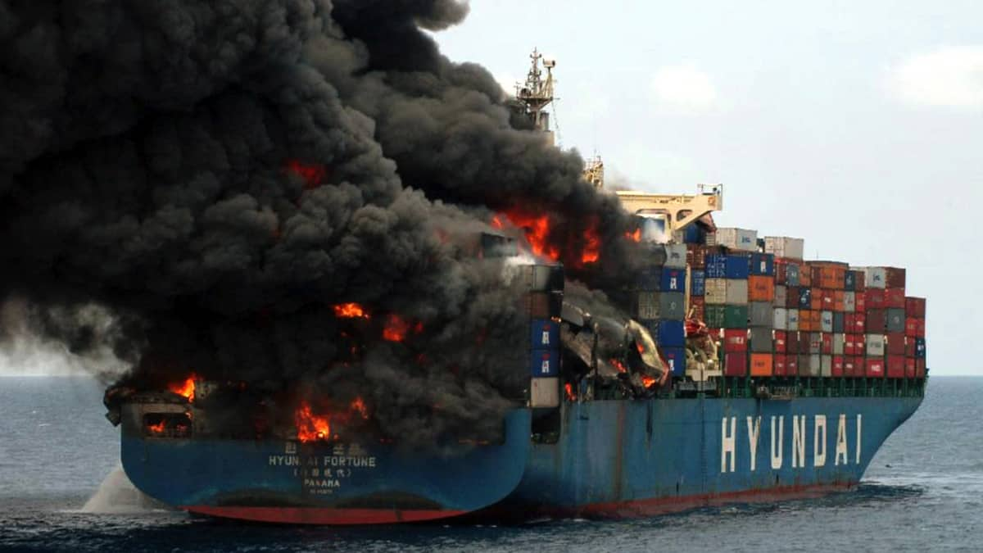
Complex Disruption Example: NY/NJ (KVK) Scenario
Background Scenario: Increased dwell time for containers
A combination of truck driver, chassis, and warehouse shortages has significantly increased terminal dwell time of containers in the NY/NJ area.
Initial Disruption: Container ship fire and blockage of the Kill van Kull
Ship carrying fireworks & industrial chemicals catches fire in the KVK; smoke from burning chemicals affects surrounding area. Escort tug loses connection; vessel runs aground. 4 days to extinguish fire and tow vessel to safety; 4 more days of daytime, one-way traffic on KVK.
Secondary Disruption: Malware impacts to terminal operating systems
Malware affects terminal OS at Port Newark-Elizabeth, affecting ability to track status, location, destination of containers, and further increases terminal dwell time issues resulting from background scenario. Other terminals take their systems offline for 24 hours to ensure that the malware has not affected them. Occasional rechecks slow down operations for another week.
Notes:
Add summary of project

Slide 5
Port of NY/NJ Complex Disruption: Kill van Kull Blockage: Stakeholder Engagement
Detailed input for KVK disruption from USCG Sector NY and Port Authority of NY/NJ.
USCG planned an exercise on just such a blockage and we were included.
Port Authority convened a panel of SMEs to help us develop the scenario.
Our report on this scenario and results of MCAT modeling to be shared with USCG Sector NY and Port Authority of NY/NJ and our input should help shape the post-exercise planning.
Notes:
Add summary of project

Slide 6
Complex Disruption Example: West Coast Scenario
Background Scenario: Labor dispute
  Labor dispute at Port of LA/Long Beach leads to cargo diversions, increasing shipping spot rates and a wait time as high as 26 days.
  Initial Disruption: Wildfires and power loss
  Wildfires damage transmission lines and substations servicing the port area leading to 3 days of blackouts/brownouts in the port area; 2 more days for full power to be restored.
  Secondary Disruption: Sustained security requirements
  Two days after power is restored, a bomb explodes in a container at POLA/LB, damaging cranes. Threats of further explosions lead to MARSEC 2 conditions for the port area for all West Coast ports for one week. Workers reluctant to work until safety is assured. Debris clearing takes 3 days, but replacing cranes much longer.
Notes:
Add summary of project

Slide 7
West Coast Complex Disruption:
Stakeholder Engagement
Detailed discussion of West Coast disruption with Director of Security Services at Port of Long Beach
They are very concerned with exactly this scenario
USCG Sector Los Angeles-Long Beach plans exercise on sustained loss of electrical power; we are invited to participate
Our report on this scenario and results of MCAT modeling to be shared with POLA-POLB partners and USCG as input to their planning.
Notes:
Add summary of project

Slide 8
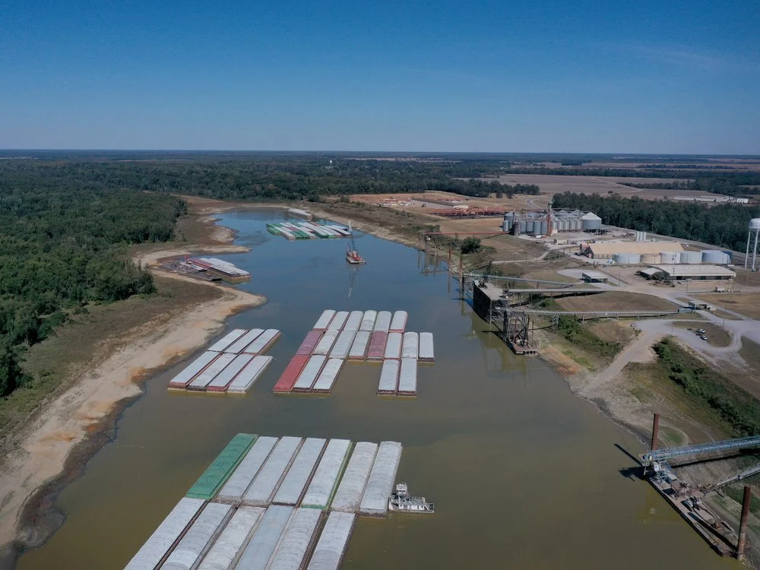
Food and Fertilizer Disruptions
Background Scenario:
Increasing demand worldwide for food as a result of Ukraine War.
Already high demand for corn and fertilizer due to ethanol and other needs.
Primary Disruption:
Hot, dry summer disrupting Western Rivers, leaves river levels below their 2022 record
by several feet, especially the lower Mississippi River from Memphis to New Orleans.
Barge trains are shorter, barge loads are lighter.
Affects shipments of fertilizer on the rivers.
Secondary Disruption:
Lock and dam failure just before fertilizer is needed for Spring planting.
Alternative: Fertilizer production facility accident just before fertilizer is needed for Spring planting.

Slide 9
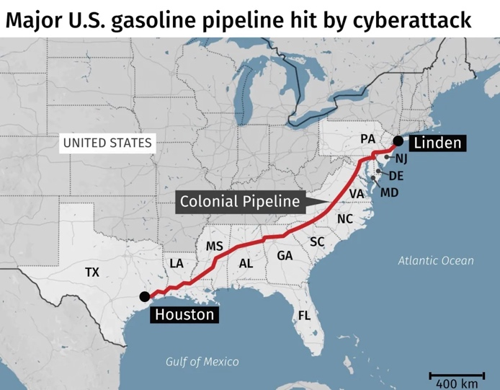
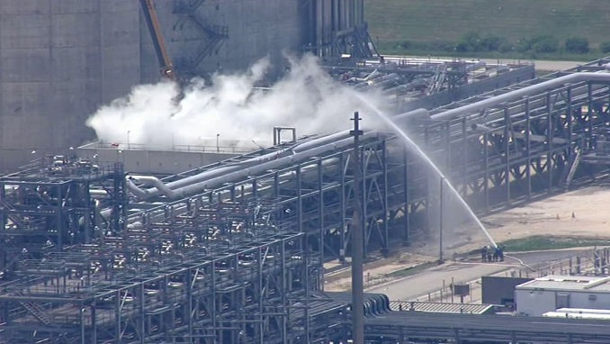
Energy Disruptions Scenarios
(based on actual events)
High energy prices due to Ukraine invasion, OPEC, emergence from pandemic
Colonial Pipeline Cyber Attack (May 2021)
Explosion at LNG Export facility (June 2022)
Loss of ~ 1 million bpd refining capacity in U.S., primarily due to individual business decisions (2021-2022)
Nord Stream LNG Pipeline attack (Sep 2022)
Estimate combined impact of these and plausible future disruptions.

Slide 10

Complex Future Disruptions
What are the risk factors that will be relevant in 5-10 years?
  EV fire risks on ships and in ports
  Climate Change – storms, sea level rise, heat threats
  Governance and Deceptive Shipping Practices
  Cyber, AI, autonomous vessels and facilities
  New fuel risks (firefighting, salvage, availability)
How can we make this useful for future planning?
Image credit: Wikimedia Commons
Notes:
Add summary of project

Slide 11
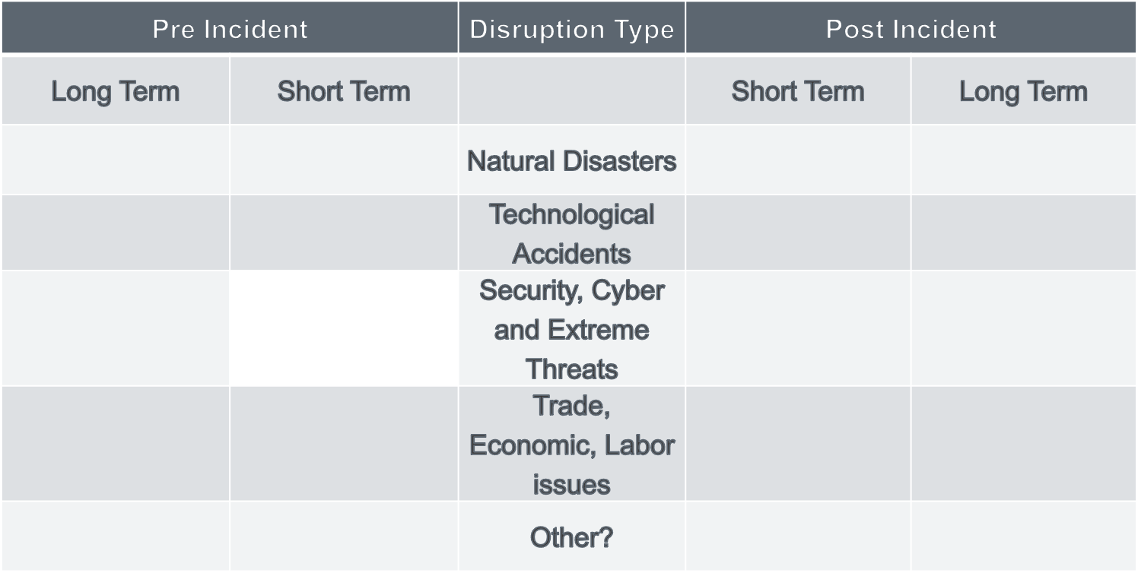
What are Possible Mitigation and Resilience Tactics?
Asking SMEs to help
Start with simple disruptions
Distinguish pre-disruption/post-disruption
Distinguish long term and short term
Emergency funding/hiring
Waterway survey/soundings
Regulatory relief
Better agency coordination
Ship rerouting/slow steaming
Coordination with shippers, cargo owners
Short term funding/grants
Multi-year funding/grants
Legal or regulatory constraints
Environmental Objectives
Competition
Technology challenges
Training and exercises
Infrastructure improvements
More warehouse capacity
Early ship rerouting
Specialized skills recruiting
Better port/vessel coordination
Regulatory changes
Economic incentives
Labor/Management contracts
Tax and insurance incentives
Notes:
Add summary of project

Slide 12
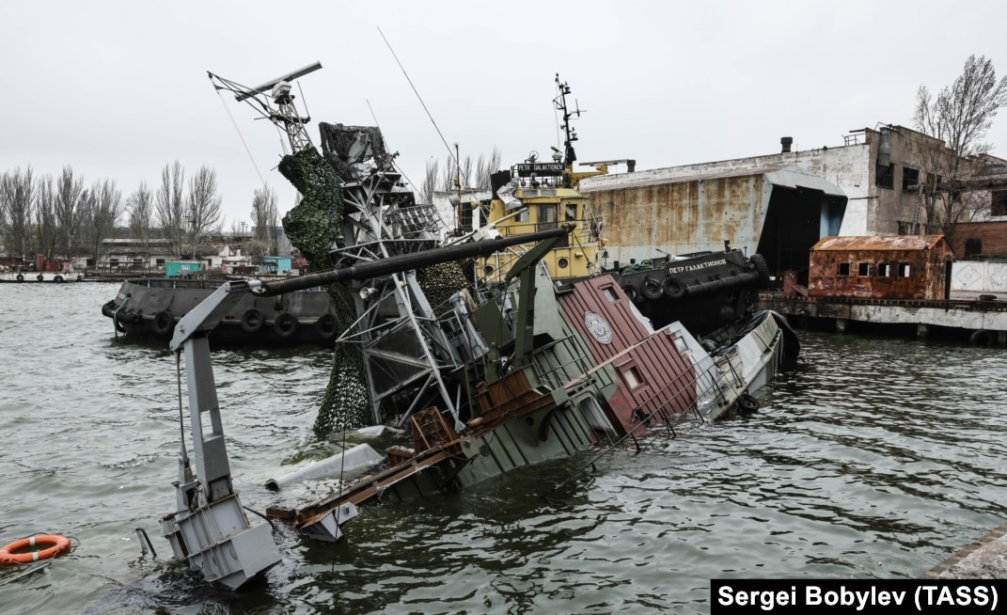
Ukraine War: Impacts to Maritime Supply Chains
War: the Ultimate complex disruption.
We are preparing a report on the impacts of the Ukraine War on the MTS.
  Attacks on seafarers, ships, ports, and maritime infrastructure
  Food and energy
  Economic sanctions
  Deceptive Shipping Practices
Example: Food:
Russia and Ukraine produce much of the world’s food and fertilizer.
Russia targeted port facilities in Ukraine.
Ukraine struggled to export grain via rail.
Russia is allowing only limited Ukrainian exports via the UN brokered grain deal.
“An enduring global food crisis has become one of the farthest-reaching consequences of Russia’s war, contributing to widespread starvation, poverty and premature deaths.”
  New York Times, Jan 2, 2023.

Slide 13
Ukraine War: General Maritime Impacts
When the war broke out, various EU ports experienced short term but significant congestion as they struggled to meet the economic sanctions.
Many western maritime and energy companies pulled out of Russia voluntarily, or as a result of sanctions.
Increased use of “Deceptive Shipping Practices” by Russian affiliated ships as a way to avoid sanctions.
IMO, USCG, other agencies, and various maritime companies and organizations will continue to be involved in the conflict to manage sanctions and the energy and food trade deals.
A conflict in Asia would have a much greater impact on the world economy, U.S. trade, and West Coast ports

Slide 14
The MCAT Economic Consequence Analysis Tool
We are working to transform the analysis into a user-friendly, decision-support tool for use by the Coast Guard and others to improve risk management.
The Tool (Complex Maritime Economic Consequence Analysis Tool – MCAT) is based on an Economic Consequence Analysis Tool (E-CAT) developed by our partner center CREATE to identify direct and indirect economic impacts of disruptive events.
  Uses an internationally linked computable general equilibrium (CGE) model consisting of over 100 countries with 65 sectors each.
  Extends the well-known Global Trade Analysis Project (GTAP) CGE model.
  Will help determine economic impacts of complex disruptions and provide insight into how to minimize them.
Notes:
Add summary of project

Slide 15
MCAT Modeling/Economics Application: Economic Impacts of the Ukraine War
Tested out our preliminary ideas for the MCAT tool to study economic impacts of the Ukraine War on Grain and Metal Markets
Applied GTAP Computable General Equilibrium Modeling System
Results in terms of GDP impacts:
- Ukraine projected to lose $2.6 billion (2%) in first year of the War
- Russia projected to lose only $0.6 billion (0.3%) in first-year
- Losses to Ukraine much larger because of its greater trade dependency
- Other countries/regions to suffer losses: Rest of Asia, China, RFSU, Africa
- Countries/regions expected to gain: India, Latin America, NATO, Oceana, Japan
15

Slide 16
Real GDP Impacts of Export Reduction in Grains and Metal Commodities from the Ukraine-Russia War (in millions of 2014 U.S. dollars)
Scenario | Export Reduction from Russia |  |  | Export Reduction from Ukraine |  |  | Export Reduction from both Russia and Ukraine
Region | quantity change | percent change |  | quantity change | percent change |  | quantity change | percent change
USA | 0 | 0.0000 |  | 18 | 0.0001 |  | 16 | 0.0001
Rest of North America | 12 | 0.0009 |  | 1 | 0.0001 |  | 14 | 0.0010
China | -95 | -0.0009 |  | 32 | 0.0003 |  | -81 | -0.0008
Japan | 29 | 0.0006 |  | 61 | 0.0013 |  | 86 | 0.0019
India | 0 | 0.0000 |  | 213 | 0.0104 |  | 209 | 0.0102
Rest of Asia | -52 | -0.0010 |  | -487 | -0.0096 |  | -567 | -0.0111
Canada | -7 | -0.0004 |  | 17 | 0.0010 |  | 13 | 0.0007
Latin America | 57 | 0.0011 |  | 79 | 0.0015 |  | 140 | 0.0027
Oceania | 56 | 0.0033 |  | 63 | 0.0037 |  | 126 | 0.0074
NATO (except US, Canada) | -76 | -0.0004 |  | 236 | 0.0013 |  | 126 | 0.0007
Rest of Europe | 6 | 0.0002 |  | 54 | 0.0022 |  | 59 | 0.0024
Russia | -300 | -0.0148 |  | -261 | -0.0128 |  | -559 | -0.0275
RFSU | -19 | -0.0034 |  | -69 | -0.0129 |  | -87 | -0.0162
Ukraine | 16 | 0.0124 |  | -2602 | -1.9745 |  | -2596 | -1.9697
Mid-East | -16 | -0.0006 |  | -12 | -0.0004 |  | -31 | -0.0011
Africa | -7 | -0.0003 |  | -55 | -0.0022 |  | -67 | -0.0027
Rest of World | 0 | 0.0000 |  | 0 | 0.0000 |  | 0 | 0.0060
Total | -397 | -0.0005 |  | -2712 | -0.0035 |  | -3200 | -0.0041

Slide 17
Stakeholder Engagement
Distinguished Advisory Board including USCG, port security, private sector
Interviews with over 30 SMEs from government, industry, and nonprofits
Presentations made or invited to be made in the future:
  USCG Sector New York including tabletop
  USCG Sector Los Angeles-Long Beach including tabletop
  Port Authority of NY/NJ
  US Committee on the Marine Transportation System (CMTS)
  CISA Committee on the Continuity of the Economy
  CISA Resilience Services Branch
  US Maritime Administration (MARAD)
  Interagency Supply Chain Working Group run by DOT
  Emergency Support Function – Transportation run by FEMA
  Interagency Port of Baltimore Multiple Disruptions Tabletop
Notes:
Add summary of project

Slide 18
A Selection of Observations from Interviews and Other Stakeholder Engagement
Better coordination between shippers, vessels, and port facility operators could improve port efficiency; technology provides promising information-sharing solutions.
  However, business confidentiality concerns are limiting progress in this area.
Port capacity is a challenge, and a single, low-capacity link in a supply chain can make improvements in other areas irrelevant.
  Case in point: No way to get ports to operate 24/7 because we don’t have enough warehouse space.
There has been tremendous innovation on specialized low- and no-carbon marine fuels, but less attention on how to respond to a salvage or firefighting incident, or a lack of their availability at critical times.
Notes:
Add summary of project

Slide 19

A Selection of Observations from Interviews and Other Stakeholder Engagement
The combination of cyber and physical disruptions, particularly in critical areas (such as chokepoints), is a significant risk.
Sustained power outages are also a concern, particularly where automation and air quality requirements may limit the ability to return to manual operations at the desired throughput.
credit Commons.wikimedia commons Camerafiend at English Wikipedia no changes
Notes:
Add summary of project

Slide 20

A Selection of Observations from Interviews and Other Stakeholder Engagement
Security complacency may be an issue. For several years, the focus has been on COVID and its impacts, and on issues such as automation and electrification.
The ability of some ports and maritime stakeholders to conduct efficient MTS activity during a sustained security threat is uncertain. A security threat could therefore lead to greater than expected disruptions.
Image credit: Wikimedia Commons
Notes:
Add summary of project

Slide 21
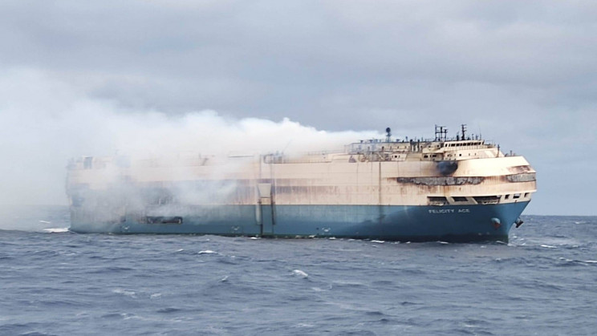
A Selection of Observations from Interviews and Other Stakeholder Engagement
Cyberattacks that compromise data integrity can have a significant impact on operations, even in systems where no direct, kinetic impact is possible. There is increasing concern that simply creating the perception of a data integrity problem could be sufficient to shut down operations or cause major disruptions.
Undeclared or improperly packaged hazardous
materials, including lithium-ion batteries, are
a growing concern and could lead to a fire or
other incident.
Image credit: Wikimedia Commons
Notes:
Add summary of project

Slide 22
For More Information: Other Team Members
Fred Roberts
  froberts@dimacs.rutgers.edu
  908-803-7851
Adam Rose
  adamzros@usc.edu
  814-777-6789‬
Andrew Tucci (USCG, ret.)
Dennis Egan (Rutgers)
Peter March (Rutgers)
Christie Nelson (Rutgers)
Ryan Whytlaw (consultant)
Dan Wei (USC)
Zenhua Chen (Ohio State)
Konstantinos Papaefthymiou (USC) student
Tanmay Sati (Rutgers) student
Anna Singer (USC) student
Latha Vijayagopal (Rutgers) student
Notes:
Add summary of project

