Slide 1

Game Theory, Mechanism Design, Differential Privacy (and you).
Aaron Roth
DIMACS Workshop on Differential Privacy
October 24

Slide 2

Algorithms vs. Games
If we control the whole system, we can just design an algorithm.

Slide 3
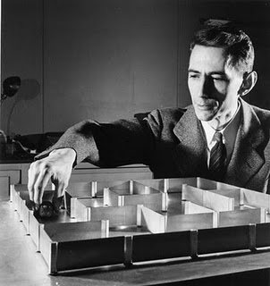
Algorithms vs. Games
Otherwise, we have to design the constraints and incentives so that agents in the system work to achieve our goals.

Slide 4

Game Theory
Model the incentives of rational, self interested agents in some fixed interaction, and predict their behavior.

Slide 5
Mechanism Design
Model the incentives of rational, self interested agents, and design the rules of the game to shape their behavior.
Can be thought of as “reverse game theory”

Slide 6
Relationship to Privacy
“Morally” similar to private algorithm design.
 | Mechanism Design | Private Algorithm Design
Input data ‘belongs’ to | Participants | Individuals
Individuals experience | Utility as a function of the outcome | Cost as a function of (consequences of) the outcome
Must incentivize individuals to participate? | Yes | Yes?

Slide 7
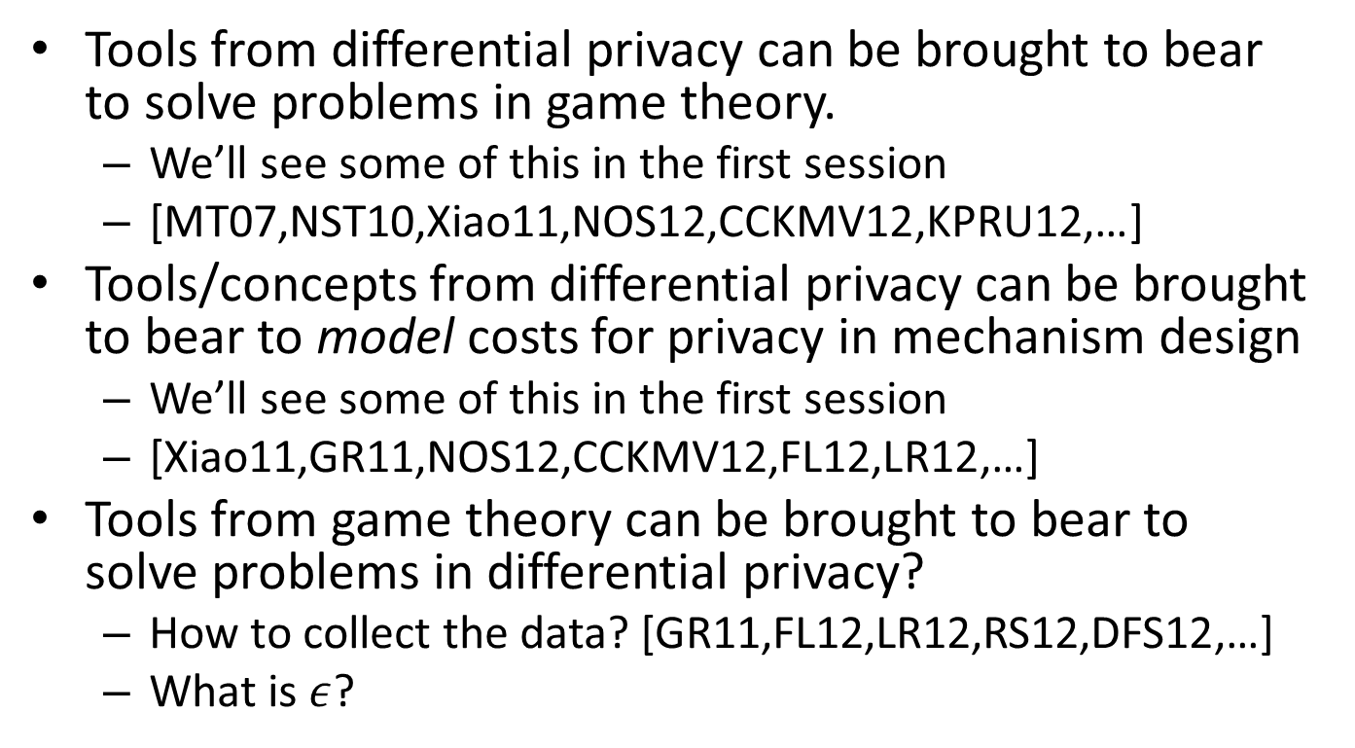
Relationship to Privacy
Tools from differential privacy can be brought to bear to solve problems in game theory.
  We’ll see some of this in the first session
  [MT07,NST10,Xiao11,NOS12,CCKMV12,KPRU12,…]
Tools/concepts from differential privacy can be brought to bear to model costs for privacy in mechanism design
  We’ll see some of this in the first session
  [Xiao11,GR11,NOS12,CCKMV12,FL12,LR12,…]
Tools from game theory can be brought to bear to solve problems in differential privacy?
  How to collect the data? [GR11,FL12,LR12,RS12,DFS12,…]
  What is $ε$?

Slide 8
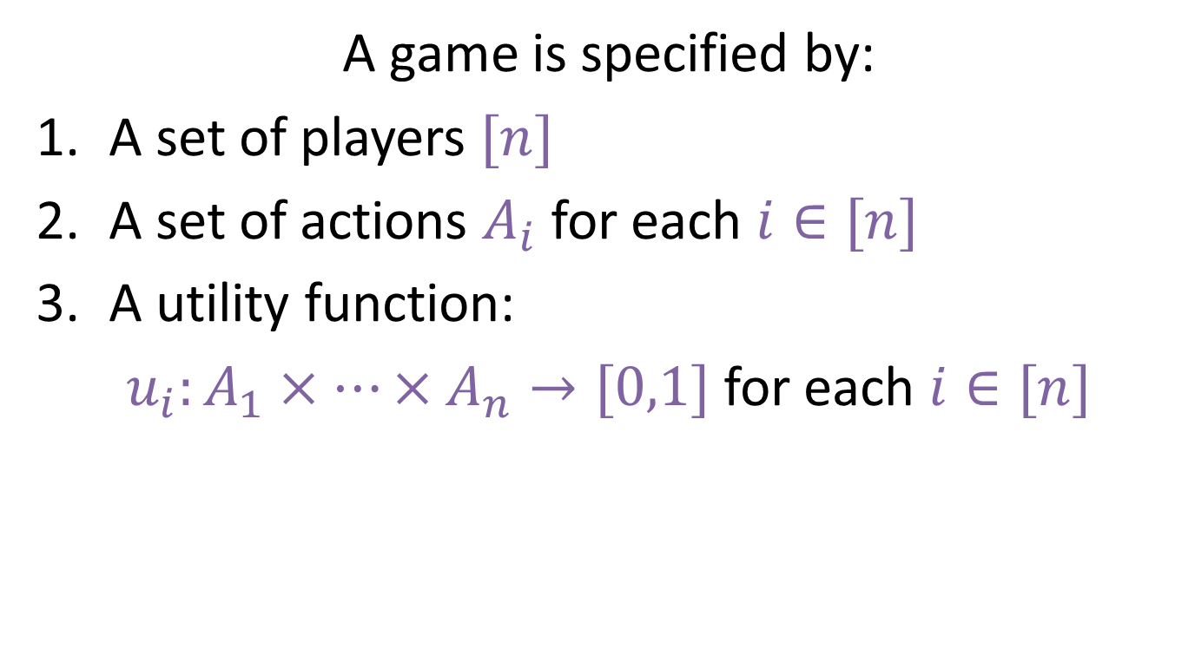
Specification of a Game
A game is specified by:
A set of players $[n]$
A set of actions $A_{i}$ for each $i∈[n]$
A utility function:
$u_{i}:A_{1}×…×A_{n}→[0,1]$ for each $i∈[n]$

Slide 9



Specification of a Game
0,0 | -1,1 | 1,-1
1,-1 | 0,0 | -1 , 1
-1,1 | 1 , -1 | 0,0

Slide 10
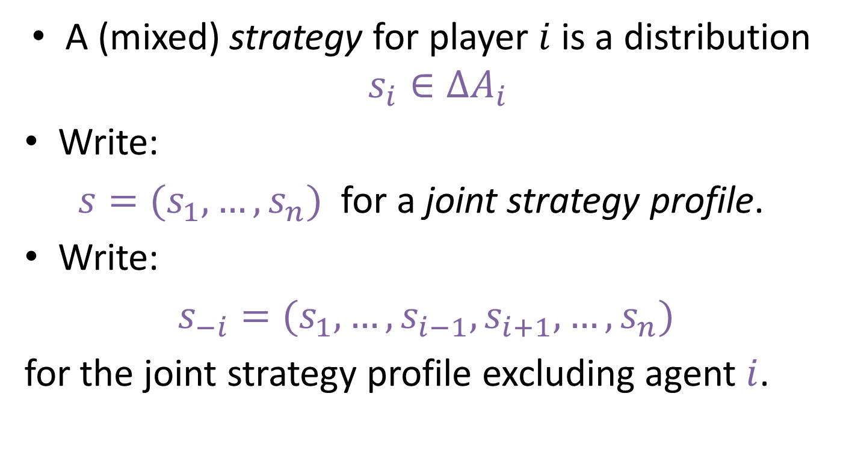
Playout of a game
A (mixed) strategy for player $i$ is a distribution $s_{i}∈ΔA_{i}$
Write:
$s=(s_{1},…, s_{n})$ for a joint strategy profile.
Write:
$s_{−i}=(s_{1},…,s_{i−1},s_{i+1},…,s_{n})$
for the joint strategy profile excluding agent $i$.

Slide 11


Playout of a game
Simultaniously, each agent $i$ picks $s_{i}∈ΔA_{i}$
Each agent derives (expected) utility $\text{E}[u_{i}\left(s\right)]$
Agents “Behave so as to Maximize Their Utility”

Slide 12
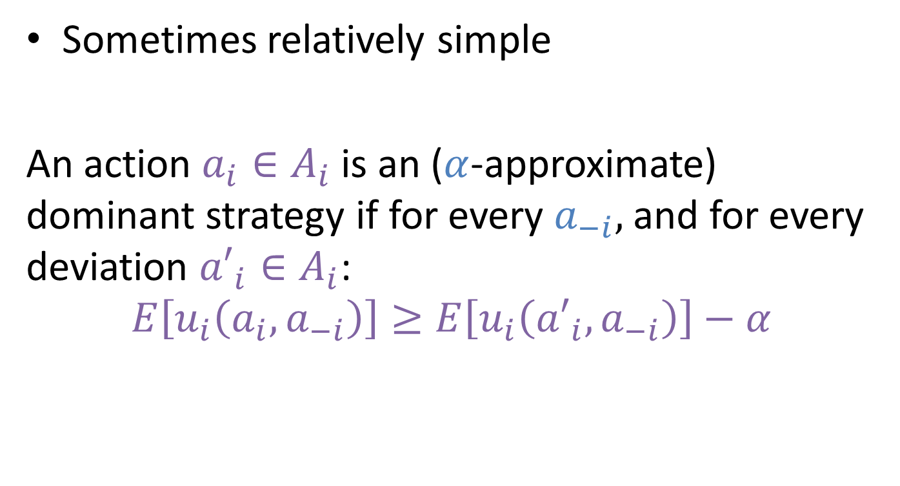
Behavioral Predictions?
Sometimes relatively simple
An action $a_{i}∈A_{i}$ is an ($α$-approximate) dominant strategy if for every $a_{−i},$ and for every deviation ${a′}_{i}∈A_{i}$:
$$E\left[u_{i}\left(a_{i},a_{−i}\right)\right]≥E\left[u_{i}\left({a′}_{i},a_{−i}\right)\right]−α$$

Slide 13
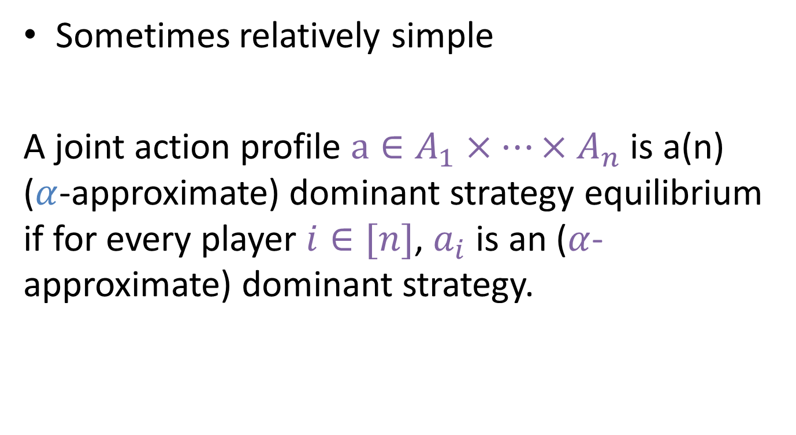
Behavioral Predictions?
Sometimes relatively simple
A joint action profile $a∈A_{1}×…×A_{n}$ is a(n) ($α$-approximate) dominant strategy equilibrium if for every player $i∈[n]$, $a_{i}$ is an ($α$-approximate) dominant strategy.

Slide 14

Behavioral Predictions?
Dominant strategies don’t always exist…
Good ol’ rock. Nuthin beats that!

Slide 15
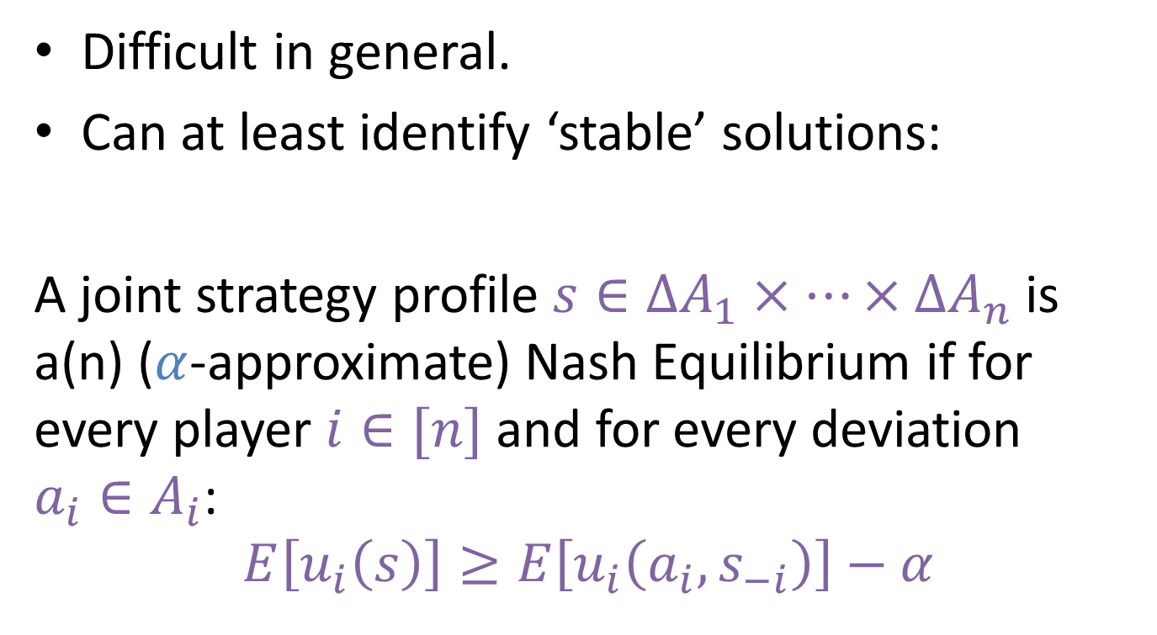
Behavioral Predictions?
Difficult in general.
Can at least identify ‘stable’ solutions:
A joint strategy profile $s∈{ΔA}_{1}×…×ΔA_{n}$ is a(n) ($α$-approximate) Nash Equilibrium if for every player $i∈[n]$ and for every deviation $a_{i}∈A_{i}$:
$$E\left[u_{i}\left(s\right)\right]≥E\left[u_{i}\left(a_{i},s_{−i}\right)\right]−α$$

Slide 16
Behavioral Predictions
Nash Equilibrium always exists (may require randomization)
33% 33% 33%

Slide 17
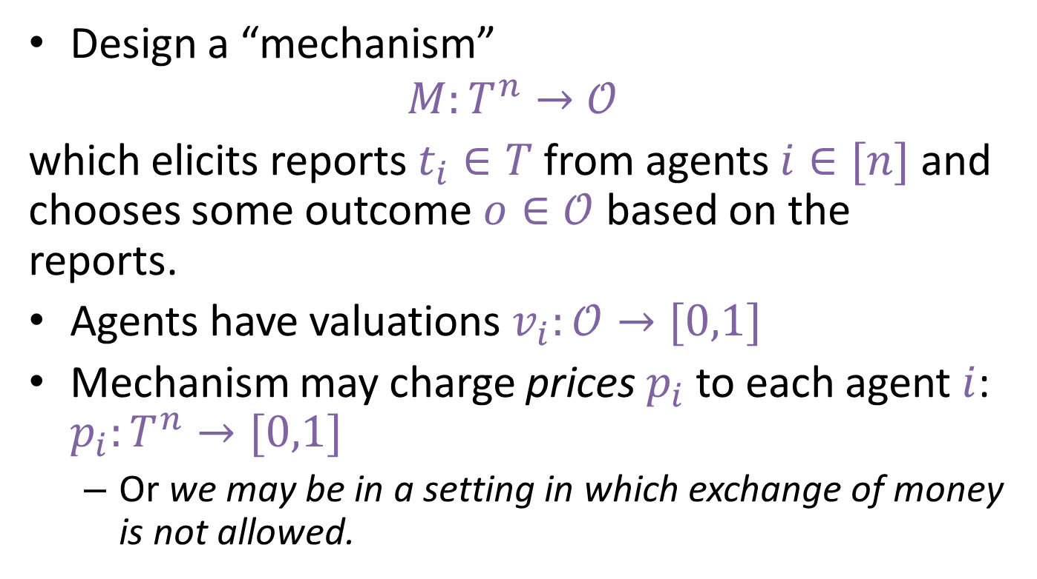
Mechanism Design
Design a “mechanism”
$$M:T^{n}→𝒪$$
which elicits reports $t_{i}∈T$ from agents $i∈[n]$ and chooses some outcome $o∈𝒪$ based on the reports.
Agents have valuations $v_{i}:𝒪→[0,1]$
Mechanism may charge prices $p_{i}$ to each agent $i$: $p_{i}:T^{n}→[0,1]$
  Or we may be in a setting in which exchange of money is not allowed.

Slide 18
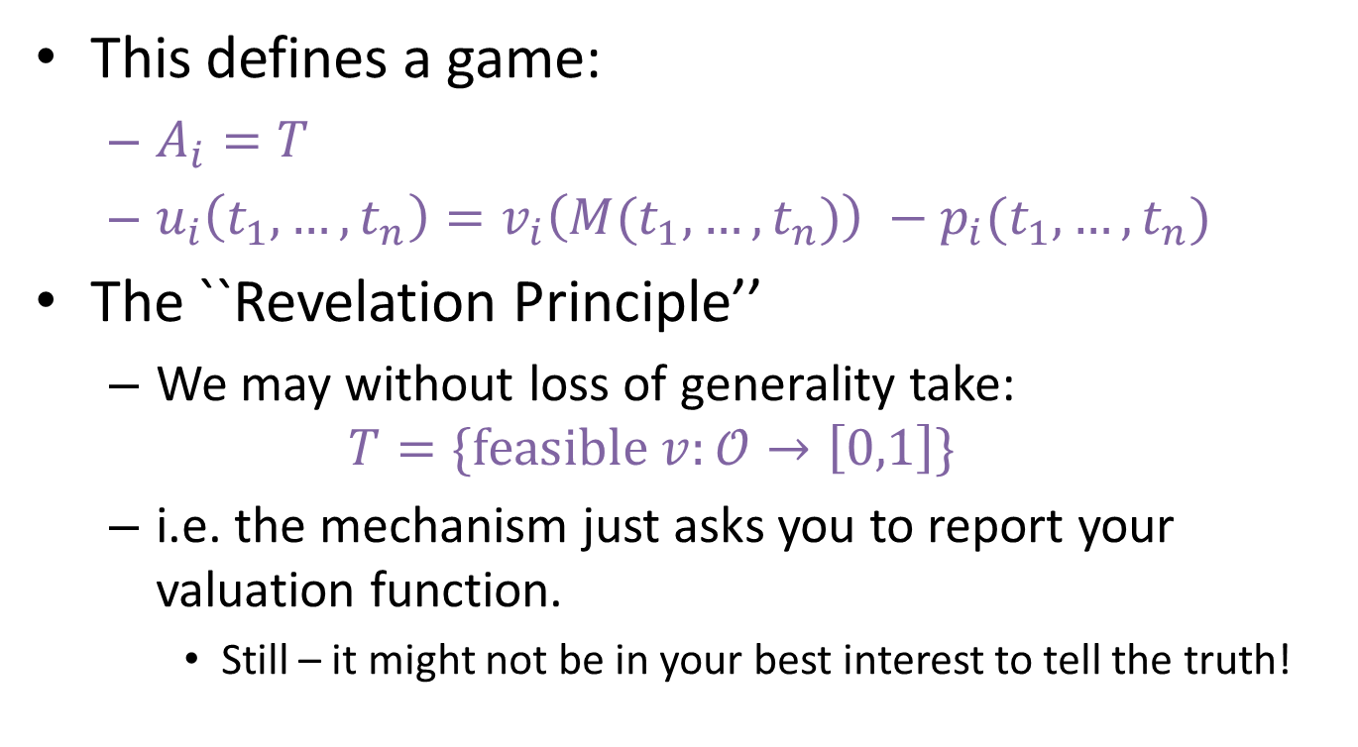
Mechanism Design
This defines a game:
  $A_{i}=T$
  $u_{i}\left(t_{1},…,t_{n}\right)=v_{i}\left({M(t}_{1},…,t_{n})\right) −p_{i}(t_{1},…,t_{n})$
The ``Revelation Principle’’
  We may without loss of generality take:
  $$T=\{\text{feasible} v:𝒪→\left[0,1\right]\}$$
  i.e. the mechanism just asks you to report your valuation function.
    Still – it might not be in your best interest to tell the truth!

Slide 19
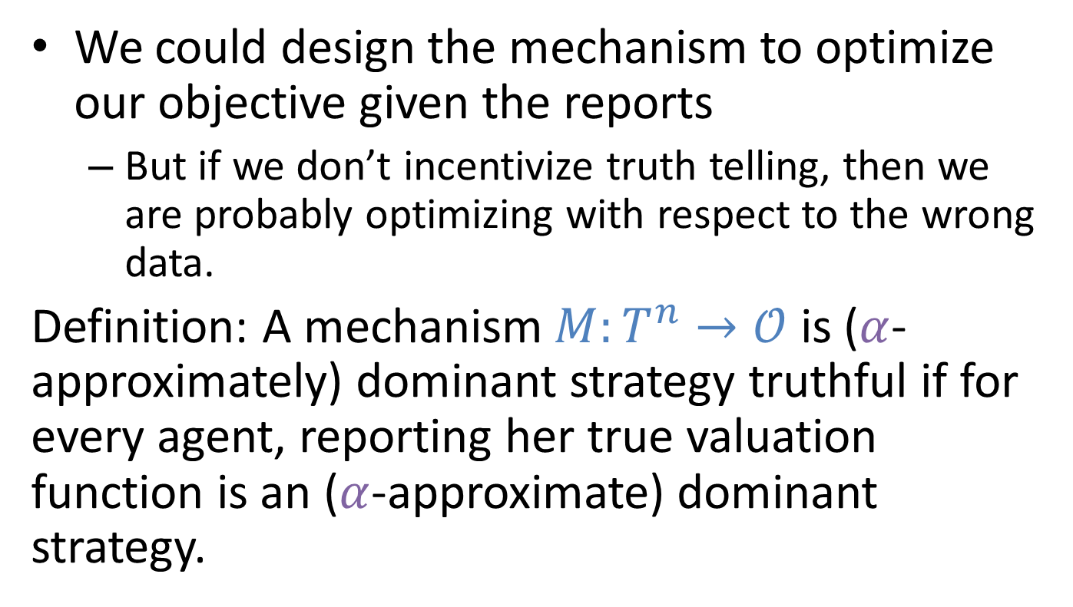
Mechanism Design
We could design the mechanism to optimize our objective given the reports
  But if we don’t incentivize truth telling, then we are probably optimizing with respect to the wrong data.
Definition: A mechanism $M:T^{n}→𝒪$ is ($α$-approximately) dominant strategy truthful if for every agent, reporting her true valuation function is an ($α$-approximate) dominant strategy.

Slide 20
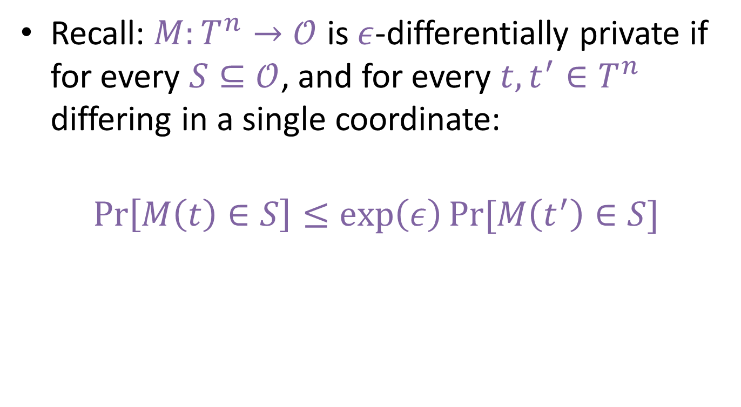
So how can privacy help?
Recall: $M:T^{n}→𝒪$ is $ε$-differentially private if for every $S⊆𝒪$, and for every $t,t^{′}∈T^{n}$ differing in a single coordinate:
$$\operatorname{Pr}\left[M\left(t\right)∈S\right]≤\exp\left(ε\right)Pr⁡[M\left(t^{′}\right)∈S]$$

Slide 21
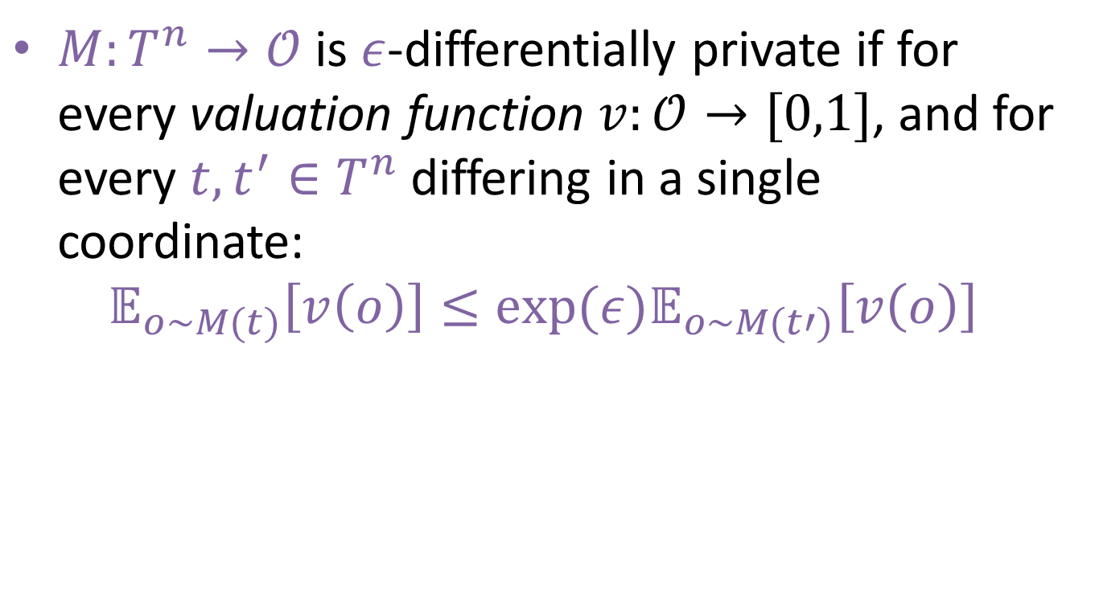
Equivalently
$M:T^{n}→𝒪$ is $ε$-differentially private if for every valuation function $v:𝒪→[0,1]$, and for every $t,t^{′}∈T^{n}$ differing in a single coordinate:
$$𝔼_{o∼M(t)}\left[v\left(o\right)\right]≤exp⁡(ε)𝔼_{o∼M(t′)}\left[v\left(o\right)\right]$$

Slide 22
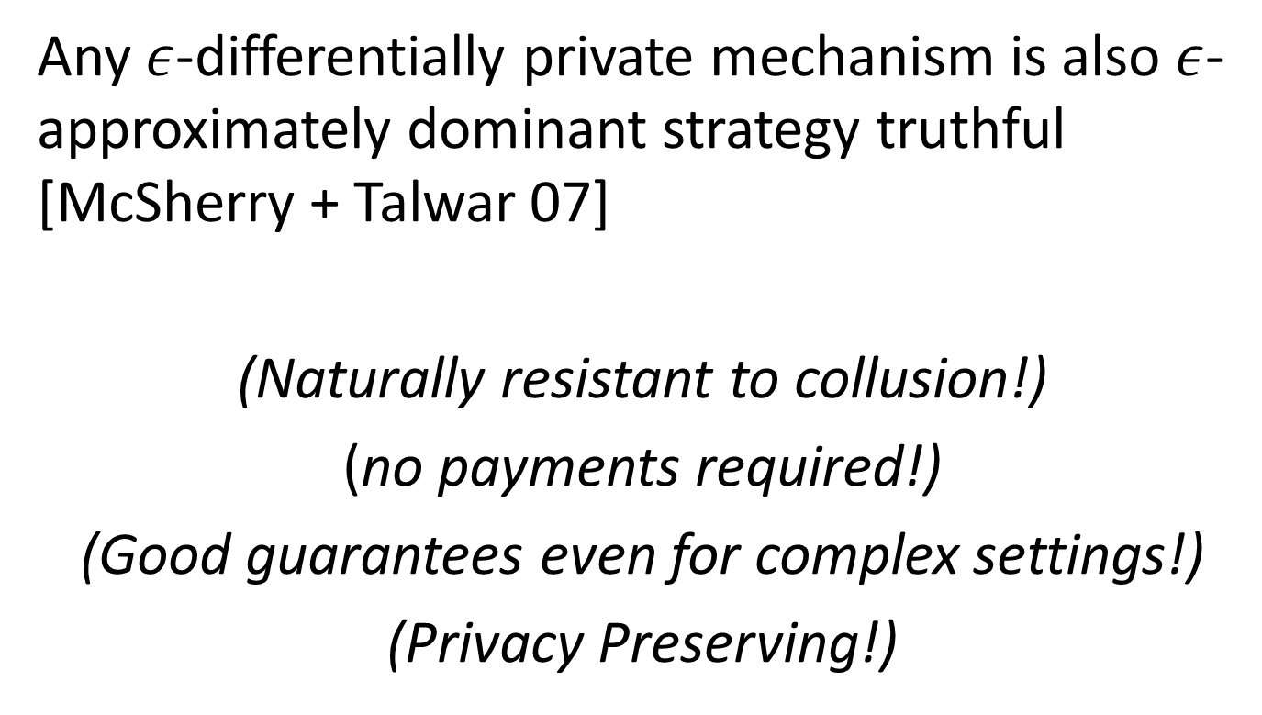
Therefore
Any $ε$-differentially private mechanism is also $ε$-approximately dominant strategy truthful [McSherry + Talwar 07]
(Naturally resistant to collusion!)
(no payments required!)
(Good guarantees even for complex settings!)
(Privacy Preserving!)

Slide 23
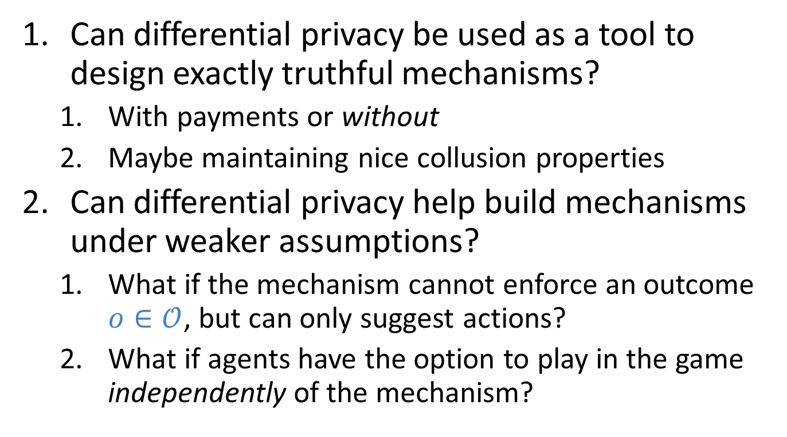
So what are the research questions?
Can differential privacy be used as a tool to design exactly truthful mechanisms?
  With payments or without
  Maybe maintaining nice collusion properties
Can differential privacy help build mechanisms under weaker assumptions?
  What if the mechanism cannot enforce an outcome $o∈𝒪$, but can only suggest actions?
  What if agents have the option to play in the game independently of the mechanism?

Slide 24
Why are we designing mechanisms which preserve privacy
Presumably because agents care about the privacy of their type.
  Because it is based on medical, financial, or sensitive personal information?
  Because there is some future interaction in which other players could exploit type information.

Slide 25
But so far this is unmodeled
Could explicitly encode a cost for privacy in agent utility functions.
  How should we model this?
    Differential privacy provides a way to quantify a worst-case upper bound on such costs
    But may be too strong in general.
    Many good ideas! [Xiao11, GR11, NOS12, CCKMV12, FL12, LR12, …]
    Still an open area that needs clever modeling.

Slide 26
How might mechanism design change?
Old standards of mechanism design may no longer hold
  i.e. the revelation principle: asking for your type is maximally disclosive.
Example: The (usually unmodeled) first step in any data analysis task: collecting the data.

Slide 27




A Basic Problem

Slide 28


A Better Solution

Slide 29
A Market for Private Data
Who wants $1 for their STD Status?
The wrong price leads to response bias
Me! Me!

Slide 30
Standard Question in Game Theory
What is the right price?
Standard answer:
Design a truthful direct revelation mechanism.

Slide 31
An Auction for Private Data
How much for your STD Status?
Hmmmm…
$9999999.99
$1.25
$1.50
$0.62

Slide 32
Problem: Values for privacy are themselves correlated with private data!
Upshot: No truthful direct revelation mechanism can guarantee non-trivial accuracy and finite payments. [GR11]
There are ways around this by changing the cost model and abandoning direct revelation mechanisms [FL12,LR12]

Slide 33



What is $ε$?
If the analysis of private data has value for data analysts, and costs for participants, can we choose $ε$ using market forces?
  Recall we still need to ensure unbiased samples.

Slide 34
Summary
Privacy and game theory both deal with the same problem
  How to compute while managing agent utilities
Tools from privacy are useful in mechanism design by providing tools for managing sensitivity and noise.
  We’ll see some of this in the next session.
Tools from privacy may be useful for modeling privacy costs in mechanism design
  We’ll see some of this in the next session
  May involve rethinking major parts of mechanism design.
Can ideas from game theory be used in privacy?
  “Rational Privacy”?

Slide 35
Summary
Privacy and game theory both deal with the same problem
  How to compute while managing agent utilities
Tools from privacy are useful in mechanism design by providing tools for managing sensitivity and noise.
  We’ll see some of this in the next session.
Tools from privacy may be useful for modeling privacy costs in mechanism design
  We’ll see some of this in the next session
  May involve rethinking major parts of mechanism design.
Can ideas from game theory be used in privacy?
  “Rational Privacy”?
Thank You!

