Slide 1
Coding for Distributed Storage
Alex Dimakis (UT Austin)
Joint work with
Mahesh Sathiamoorthy (USC)
Megasthenis Asteris, Dimitris Papailipoulos (UT Austin)
Ramkumar Vadali, Scott Chen, Dhruba Borthakur (Facebook)

Slide 2
current hadoop architecture
file 1
1
2
3
4
file 2
1
2
3
4
5
6
file 3
1
2
3
4
5
…
NameNode
DataNode 1
DataNode 2
DataNode 3
DataNode 4

Slide 3
current hadoop architecture
file 1
1
2
3
4
1
2
3
4
1
2
3
4
file 2
1
2
3
4
5
6
1
2
3
4
5
6
1
2
3
4
5
6
file 3
1
2
3
4
5
1
2
3
4
5
1
2
3
4
5
…
NameNode
DataNode 1
DataNode 2
DataNode 3
DataNode 4

Slide 4
current hadoop architecture
file 1
1
2
3
4
1
2
3
4
1
2
3
4
file 2
1
2
3
4
5
6
1
2
3
4
5
6
1
2
3
4
5
6
file 3
1
2
3
4
5
1
2
3
4
5
1
2
3
4
5
1
1
4
3
…
4
2
6
3
1
1
3
4
NameNode
DataNode 1
DataNode 2
DataNode 3
DataNode 4

Slide 5

current hadoop architecture
file 1
1
2
3
4
1
2
3
4
1
2
3
4
file 2
1
2
3
4
5
6
1
2
3
4
5
6
1
2
3
4
5
6
file 3
1
2
3
4
5
1
2
3
4
5
1
2
3
4
5
1
1
4
3
…
4
2
6
3
1
1
3
4
NameNode
DataNode 1
DataNode 2
DataNode 3
DataNode 4

Slide 6
current hadoop architecture
file 1
1
2
3
4
1
2
3
4
1
2
3
4
file 2
1
2
3
4
5
6
1
2
3
4
5
6
1
2
3
4
5
6
file 3
1
2
3
4
5
1
2
3
4
5
1
2
3
4
5
1
4
1
4
1
3
…
4
2
6
3
1
1
3
4
NameNode
DataNode 1
DataNode 2
DataNode 3
DataNode 4

Slide 7
Real systems that use distributed storage codes
Windows Azure, (Cheng et al. USENIX 2012) (LRC Code)
Used in production in Microsoft
CORE (Li et al. MSST 2013) (Regenerating EMSR Code)
NCCloud (Hu et al. USENIX FAST 2012) (Regenerating Functional MSR)
ClusterDFS (Pamies Juarez et al. ) (SelfRepairing Codes)
StorageCore (Esmaili et al. ) (over Hadoop HDFS)
HDFS Xorbas (Sathiamoorthy et al. VLDB 2013 ) (over Hadoop HDFS) (LRC code)
Testing in Facebook clusters

Slide 8
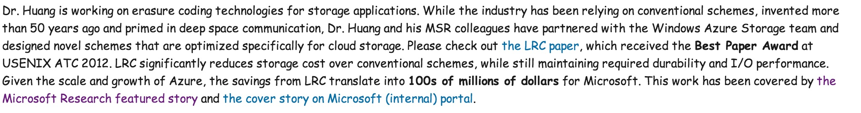
Coding theory for Distributed Storage
Storage efficiency is the main driver for cost in distributed storage systems.
‘Disks are cheap’
Today all big storage systems use some form of erasure coding
Classical RS codes or modern codes with Local repair (LRC)
Still theory is not fully understood

Slide 9
How to store using erasure codes
file 1
1
2
3
4
1
2
3
4
1
2
3
4
file 1
1
2
3
4
P1
P2

Slide 10
how to store using erasure codes
n=3
k=2
A
File or data object
A
A
B
B
B
A+B
(3,2) MDS code, (single parity) used in RAID 5
Notes:
This is another example a code with n=4, k=2. In the right we have a good erasure code (any 2 suffice). Notice that
2 is the minimum number of packets required to have any hope of recovering so in that sense good-erasure codes introduce redundancy in an optimal way. Here, we compare it to replication. Now assume we store each packet on a storage node. If we lose each node with probability ½ , we can calculate the probability that we cannot recover the data. It is clear the erasure codes outperform repetition.
Reed-Solomon, LT codes and Raptor codes are all good erasure codes that have numerous applications.

Slide 11
how to store using erasure codes
n=3
k=2
A
File or data object
A
A
B
B
B
A+B
A= 0 1 0 1 1 1 0 1 …
(3,2) MDS code, (single parity) used in RAID 5
B= 1 1 0 0 0 1 1 1 …
A+B = 1 0 0 1 1 0 1 0 ……
Notes:
This is another example a code with n=4, k=2. In the right we have a good erasure code (any 2 suffice). Notice that
2 is the minimum number of packets required to have any hope of recovering so in that sense good-erasure codes introduce redundancy in an optimal way. Here, we compare it to replication. Now assume we store each packet on a storage node. If we lose each node with probability ½ , we can calculate the probability that we cannot recover the data. It is clear the erasure codes outperform repetition.
Reed-Solomon, LT codes and Raptor codes are all good erasure codes that have numerous applications.

Slide 12
how to store using erasure codes
n=3
n=4
k=2
A
A
File or data object
A
A
B
B
B
B
A+B
A+B
(3,2) MDS code, (single parity) used in RAID 5
A+2B
(4,2) MDS code. Tolerates any 2 failures
Used in RAID 6
Notes:
This is another example a code with n=4, k=2. In the right we have a good erasure code (any 2 suffice). Notice that
2 is the minimum number of packets required to have any hope of recovering so in that sense good-erasure codes introduce redundancy in an optimal way. Here, we compare it to replication. Now assume we store each packet on a storage node. If we lose each node with probability ½ , we can calculate the probability that we cannot recover the data. It is clear the erasure codes outperform repetition.
Reed-Solomon, LT codes and Raptor codes are all good erasure codes that have numerous applications.

Slide 13
how to store using erasure codes
n=3
n=4
k=2
A
A
File or data object
A
A
B
B
B
B
A+B
A+B
A= 0 1 0 1 1 1 0 1 …
(3,2) MDS code, (single parity) used in RAID 5
A+2B
B= 1 1 0 0 0 1 1 1 …
(4,2) MDS code. Tolerates any 2 failures
Used in RAID 6
A+2B = 0 0 0 1 1 0 1 0 ……
Notes:
This is another example a code with n=4, k=2. In the right we have a good erasure code (any 2 suffice). Notice that
2 is the minimum number of packets required to have any hope of recovering so in that sense good-erasure codes introduce redundancy in an optimal way. Here, we compare it to replication. Now assume we store each packet on a storage node. If we lose each node with probability ½ , we can calculate the probability that we cannot recover the data. It is clear the erasure codes outperform repetition.
Reed-Solomon, LT codes and Raptor codes are all good erasure codes that have numerous applications.

Slide 14
erasure codes are reliable
(4,2) MDS erasure code (any 2 suffice to recover)
Replication
File or data object
A
A
A
A
B
B
vs
B
A+B
B
A+2B
Notes:
This is another example a code with n=4, k=2. In the right we have a good erasure code (any 2 suffice). Notice that
2 is the minimum number of packets required to have any hope of recovering so in that sense good-erasure codes introduce redundancy in an optimal way. Here, we compare it to replication. Now assume we store each packet on a storage node. If we lose each node with probability ½ , we can calculate the probability that we cannot recover the data. It is clear the erasure codes outperform repetition.
Reed-Solomon, LT codes and Raptor codes are all good erasure codes that have numerous applications.

Slide 15
storing with an (n,k) code
An (n,k) erasure code provides a way to:
Take k packets and generate n packets of the same size such that
Any k out of n suffice to reconstruct the original k
Optimal reliability for that given redundancy. Well-known and used frequently, e.g. Reed-Solomon codes, Array codes, LDPC and Turbo codes.
Each packet is stored at a different node, distributed in a network.

Slide 16
current default hadoop architecture
640 MB file => 10 blocks
1
2
3
4
5
6
7
8
9
10
1
2
3
4
5
6
7
8
9
10
1
2
3
4
5
6
7
8
9
10
3x replication is HDFS current default.
Very large storage overhead.
Very costly for BIG data

Slide 17
facebook introduced Reed-Solomon (HDFS RAID)
640 MB file => 10 blocks
1
2
3
4
5
6
7
8
9
10
P1
P2
P3
P4
Older files are switched from 3-replication to (14,10) Reed Solomon.

Slide 18
Tolerates 2 missing blocks, Storage cost 3x
1
2
3
4
5
6
7
8
9
10
1
2
3
4
5
6
7
8
9
10
1
2
3
4
5
6
7
8
9
10
Tolerates 4 missing blocks, Storage cost 1.4x
1
2
3
4
5
6
7
8
9
10
P1
P2
P3
P4
HDFS RAID. Uses Reed-Solomon Erasure Codes
Diskreduce (B. Fan, W. Tantisiriroj, L. Xiao, G. Gibson)

Slide 19
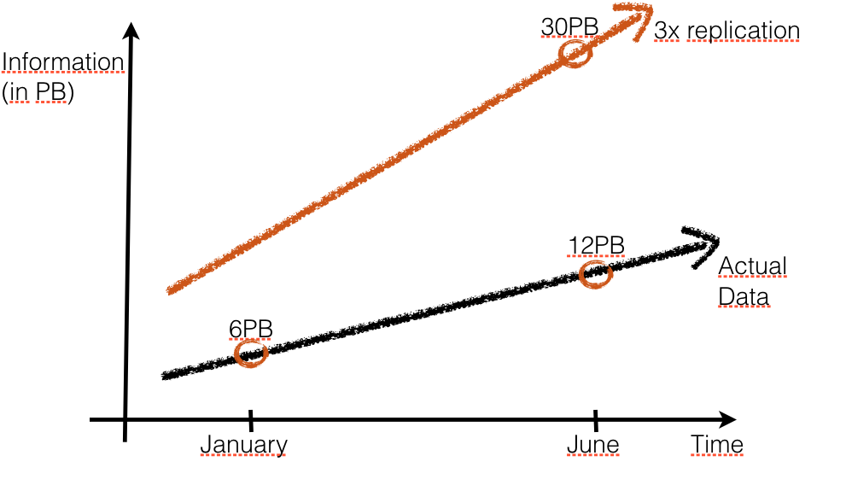
erasure codes save space

Slide 20
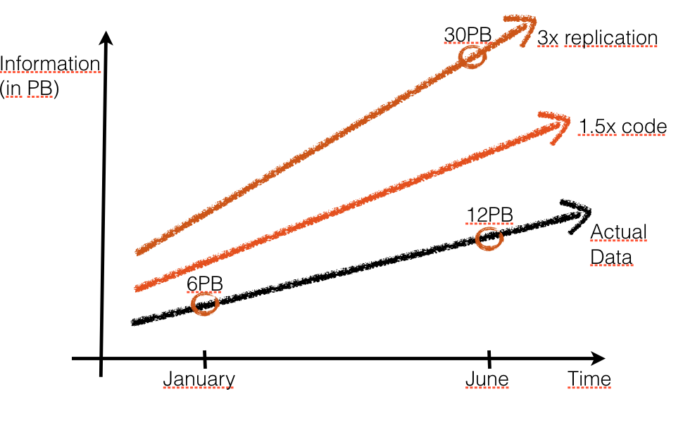
erasure codes save space

Slide 21
Limitations of classical codes
Currently only 8% of facebook’s data is Reed-Solomon encoded.
Goal: Move to 50-60% encoded data
(Save petabytes)
Bottleneck: Repair problem

Slide 22
The repair problem
1
8
Great, we can tolerate n-k=4 node failures.
9
2
10
3
P1
4
P2
5
P3
6
P4
7

Slide 23
The repair problem
1
8
Great, we can tolerate 4 node failures.
Most of the time we start with a single failure.
9
2
10
3
P1
4
P2
5
P3
6
P4
7

Slide 24
The repair problem
1
8
Great, we can tolerate 4 node failures.
Most of the time we start with a single failure.
9
2
10
3
P1
4
P2
5
P3
6
???
P4
7
3’

Slide 25
The repair problem
1
8
Great, we can tolerate 4 node failures.
Most of the time we start with a single failure.
Read from any 10 nodes, send all data to 3’ who can repair the lost block.
9
2
10
3
P1
4
P2
5
P3
6
P4
7
3’

Slide 26
The repair problem
1
8
Great, we can tolerate 4 node failures.
Most of the time we start with a single failure.
Read from any 10 nodes, send all data to 3’ who can repair the lost block.
High network traffic
High disk read
10x more than the lost information
9
2
10
3
P1
4
P2
5
P3
6
P4
7
3’

Slide 27
The repair problem
1
8
If we have 1 failure, how do we rebuild the redundancy in a new disk?
Naïve repair: send k blocks.
Filesize B, B/k per block.
9
2
10
3
P1
4
P2
5
P3
6
P4
7
Do I need to reconstruct the
Whole data object to repair
one failure?
3’

Slide 28
Three repair metrics of interest
Number of bits communicated in the network during single node failures (Repair Bandwidth)
The number of bits read from disks during single node repairs
(Disk IO)
3. The number of nodes accessed to repair a single node failure
(Locality)

Slide 29
Three repair metrics of interest
Number of bits communicated in the network during single node failures (Repair Bandwidth)
Capacity known for two points only. My 3-year old conjecture for intermediate points was just disproved. [ISIT13]
2. The number of bits read from disks during single node repairs
(Disk IO)
3. The number of nodes accessed to repair a single node failure
(Locality)

Slide 30
Three repair metrics of interest
Number of bits communicated in the network during single node failures (Repair Bandwidth)
Capacity known for two points only. My 3-year old conjecture for intermediate points was just disproved. [ISIT13]
2. The number of bits read from disks during single node repairs
(Disk IO)
Capacity unknown.
Only known technique is bounding by Repair Bandwidth
3. The number of nodes accessed to repair a single node failure
(Locality)

Slide 31
Three repair metrics of interest
Number of bits communicated in the network during single node failures (Repair Bandwidth)
Capacity known for two points only. My 3-year old conjecture for intermediate points was just disproved. [ISIT13]
2. The number of bits read from disks during single node repairs
(Disk IO)
Capacity unknown.
Only known technique is bounding by Repair Bandwidth
3. The number of nodes accessed to repair a single node failure
(Locality)
Capacity known for some cases.
Practical LRC codes known for some cases. [ISIT12, Usenix12, VLDB13]
General constructions open

Slide 32
Three repair metrics of interest
Number of bits communicated in the network during single node failures (Repair Bandwidth)
Capacity known for two points only. My 3-year old conjecture for intermediate points was just disproved. [ISIT13]
2. The number of bits read from disks during single node repairs
(Disk IO)
Capacity unknown.
Only known technique is bounding by Repair Bandwidth
3. The number of nodes accessed to repair a single node failure
(Locality)
Capacity known for some cases.
Practical LRC codes known for some cases. [ISIT12, Usenix12, VLDB13]
General constructions open

Slide 33
The repair problem
1
8
Great, we can tolerate 4 node failures.
Most of the time we start with a single failure.
Read from any 10 nodes, send all data to 3’ who can repair the lost block.
High network traffic
High disk read
10x more than the lost information
9
2
10
3
P1
4
P2
5
P3
6
P4
7
3’

Slide 34
The repair problem
1
8
Ok, great, we can tolerate n-k disk failures without losing data.
If we have 1 failure however, how do we rebuild the redundancy in a new disk?
Naïve repair: send k blocks.
Filesize B, B/k per block.
9
2
10
3
P1
4
P2
5
P3
6
P4
Functional repair: 3’ can be different from 3. Maintains the any k out of n reliability property.
Exact repair: 3’ is exactly equal to 3.
7
Do I need to reconstruct the
Whole data object to repair
one failure?
3’

Slide 35
The repair problem
1
8
Ok, great, we can tolerate n-k disk failures without losing data.
If we have 1 failure however, how do we rebuild the redundancy in a new disk?
Naïve repair: send k blocks.
Filesize B, B/k per block.
Theorem: It is possible to functionally repair a code by communicating only
As opposed to naïve repair cost of B bits.
(Regenerating Codes, IT Transactions 2010)
9
2
10
3
P1
4
P2
5
P3
6
P4
Functional repair: 3’ can be different from 3. Maintains the any k out of n reliability property.
Exact repair: 3’ is exactly equal to 3.
7
Do I need to reconstruct the
Whole data object to repair
one failure?
3’

Slide 36
The repair problem
1
8
Ok, great, we can tolerate n-k disk failures without losing data.
If we have 1 failure however, how do we rebuild the redundancy in a new disk?
Naïve repair: send k blocks.
Filesize B, B/k per block.
Theorem: It is possible to functionally repair a code by communicating only
As opposed to naïve repair cost of B bits.
(Regenerating Codes, IT Transactions 2010)
For n=14, k=10, B=640MB,
Naïve repair: 640 MB repair bandwidth
Optimal Repair bw (βd for MSR point): 208 MB
9
2
10
3
P1
4
P2
5
P3
6
P4
Functional repair: 3’ can be different from 3. Maintains the any k out of n reliability property.
Exact repair: 3’ is exactly equal to 3.
7
Do I need to reconstruct the
Whole data object to repair
one failure?
3’

Slide 37
The repair problem
1
8
Ok, great, we can tolerate n-k disk failures without losing data.
If we have 1 failure however, how do we rebuild the redundancy in a new disk?
Naïve repair: send k blocks.
Filesize B, B/k per block.
Theorem: It is possible to functionally repair a code by communicating only
As opposed to naïve repair cost of B bits.
(Regenerating Codes, IT Transactions 2010)
For n=14, k=10, B=640MB,
Naïve repair: 640 MB repair bandwidth
Optimal Repair bw (βd for MSR point): 208 MB
Can we match this with Exact repair?
Theoretically yes. No practical codes known!
9
2
10
3
P1
4
P2
5
P3
6
P4
Functional repair: 3’ can be different from 3. Maintains the any k out of n reliability property.
Exact repair: 3’ is exactly equal to 3.
7
Do I need to reconstruct the
Whole data object to repair
one failure?
3’

Slide 38
Storage-Bandwidth tradeoff
For any (n,k) code we can find the minimum functional repair bandwidth
There is a tradeoff between storage α and repair bandwidth β.
This defines a tradeoff region for functional repair.

Slide 39
Repair Bandwidth Tradeoff Region
Min Bandwidth point (MBR)
Min Storage point (MSR)

Slide 40
Exact repair region?
Min Bandwidth point (MBR)
Min Storage point (MSR)

Slide 41
Status in 2011

Slide 42
Status in 2012
Code constructions by:
Rashmi,Shah,Kumar
Suh,Ramchandran
El Rouayheb,
Oggier,Datta
Silberstein, Viswanath et al.
Cadambe,Maleki, Jafar
Papailiopoulos, Wu, Dimakis
Wang, Tamo, Bruck
?

Slide 43
Status in 2013
Provable gap from CutSet Region.
(Chao Tian, ISIT 2013)
Exact Repair Region remains open.

Slide 44
Taking a step back
Finding exact regenerating codes is still an open problem in coding theory
What can we do to make practical progress ?
Change the problem.

Slide 45
Locally Repairable Codes

Slide 46
Three repair metrics of interest
Number of bits communicated in the network during single node failures (Repair Bandwidth)
Capacity known for two points only. My 3-year old conjecture for intermediate points was just disproved. [ISIT13]
2. The number of bits read from disks during single node repairs
(Disk IO)
Capacity unknown.
Only known technique is bounding by Repair Bandwidth
3. The number of nodes accessed to repair a single node failure
(Locality)
Capacity known for some cases.
Practical LRC codes known for some cases. [ISIT12, Usenix12, VLDB13]
General constructions open

Slide 47
Minimum Distance
The distance of a code d is the minimum number of erasures after which data is lost.
Reed-Solomon (10,14) (n=14, k=10). d= 5
R. Singleton (1964) showed a bound on the best distance possible:
Reed-Solomon codes achieve the Singleton bound (hence called MDS)

Slide 48
Locality of a code
A code symbol has locality r if it is a function of r other codeword symbols.
A systematic code has message locality r if all its systematic symbols have locality r
A code has all-symbol locality r if all its symbols have locality r.
In an MDS code, all symbols have locality at most r <= k
Easy lemma: Any MDS code must have trivial locality r=k for every symbol.

Slide 49
Example: code with message locality 5
RS
1
2
3
4
5
6
7
8
9
10
p1
p2
p3
p4
+
+
x1
x2
All k=10 message blocks can be recovered by reading r=5 other blocks.
A single parity block failure requires still 10 reads.
Best distance possible for a code with locality r?

Slide 50
Locality-distance tradeoff
Codes with all-symbol locality r can have distance at most:
Shown by Gopalan et al. for scalar linear codes (Allerton 2012)
Papailiopoulos et al. information theoretically (ISIT 2012)
r=k (trivial locality) gives Singleton Bound.
Any non-trivial locality will hurt the fault tolerance of the storage system
Pyramid codes (Huang et al) achieve this bound for message-locality
Few explicit code constructions known for all-symbol locality.

Slide 51
All-symbol locality
RS
1
2
3
4
5
6
7
8
9
10
p1
p2
p3
p4
+
+
+
x1
x2
x3
The coefficients need to make the local forks in general position compared to the global parities.
Random works whp in exponentially large field. Checking requires exponential time.
General Explicit LRCs for this case are an open problem.

Slide 52
Recap: locality and distance
If each symbol has optimal size α=M/k, best distance possible:
(bound by R. Singleton 1964)
Achievable by Reed-Solomon codes (1960). No locality possible.
If we need locality r, best distance possible:
(Gopalan et al., Papailiopoulos et al.)
If each symbol has slightly larger size α=(1+ε) M/k, best distance possible:

Slide 53
Recent work on LRCs
Silberstein, Kumar et al., Pamies-Juarez et al.:
Work on local repair even if multiple failures happen within each group.
Tamo et al. Explicit LRC constructions (for some values of n,k,r)
Mazumdar et al. Locality bounds for given field size

Slide 54
LRC code design
RS
1
2
3
4
5
6
7
8
9
10
p1
p2
p3
p4
+
+
+
x1
x2
x3
Local XORs allow single block recovery by transferring only 5 blocks (320MB) instead of 10 blocks (640 MB in HDFS RAID).
17 total blocks stored
Storage overhead increased to 1.7x from 1.4x

Slide 55
LRC code design
RS
1
2
3
4
5
6
7
8
9
10
p1
p2
p3
p4
+
+
+
x1
x2
x3
Local XORs can be any local linear combinations (just invert in repair)
Choose coefficients so that x1+x2=x3 (interference alignment)
Do not store x3!

Slide 56
LRC code design
RS
1
2
3
4
5
6
7
8
9
10
p1
p2
p3
p4
+
+
+
x1
x2
x3
+
x3
+
p2

Slide 57
code we implemented in HDFS
RS
1
2
3
4
5
6
7
8
9
10
p1
p2
p3
p4
+
+
+
x1
x2
x3
Single block failures can be repaired by accessing 5 blocks. (vs 10)
Stores 16 blocks
1.6x Storage overhead vs 1.4x in HDFS RAID.
Implemented this in Hadoop (system available on github/madiator)

Slide 58

Practical Storage Systems and Open Problems

Slide 59
Real systems that use distributed storage codes
Windows Azure, (Cheng et al. USENIX 2012) (LRC Code)
Used in production in Microsoft
CORE (Li et al. MSST 2013) (Regenerating EMSR Code)
NCCloud (Hu et al. USENIX FAST 2012) (Regenerating Functional MSR)
ClusterDFS (Pamies Juarez et al. ) (SelfRepairing Codes)
StorageCore (Esmaili et al. ) (over Hadoop HDFS)
HDFS Xorbas (Sathiamoorthy et al. VLDB 2013 ) (over Hadoop HDFS) (LRC code)
Testing in Facebook clusters

Slide 60
HDFS Xorbas (HDFS with LRC codes)
Practical open-source Hadoop file system with built in locally repairable code.
Tested in Facebook analytics cluster and Amazon cluster
Uses a (16,10) LRC with all-symbol locality 5
Microsoft LRC has only message-symbol locality
Saves storage, good degraded read, bad repair.

Slide 61


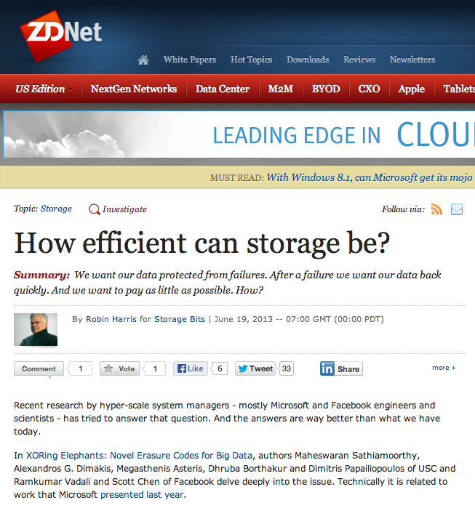

HDFS Xorbas

Slide 62
code we implemented in HDFS
RS
1
2
3
4
5
6
7
8
9
10
p1
p2
p3
p4
+
+
+
x1
x2
x3
Single block failures can be repaired by accessing 5 blocks. (vs 10)
Stores 16 blocks
1.6x Storage overhead vs 1.4x in HDFS RAID.
Implemented this in Hadoop (system available on github/madiator)

Slide 63
Java implementation

Slide 64
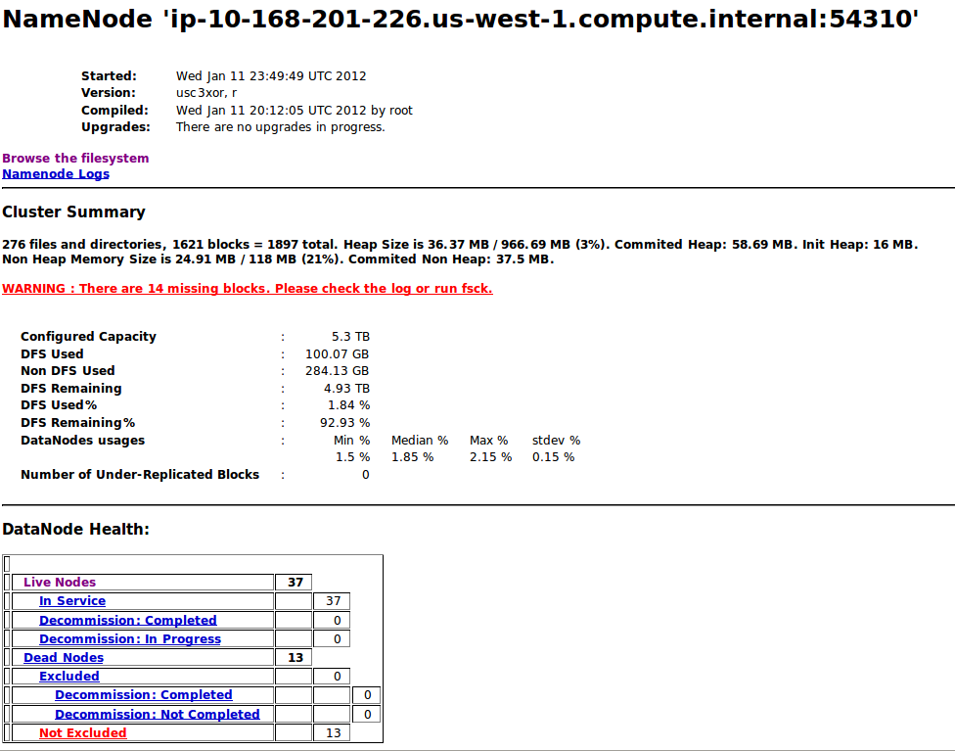
Some experiments

Slide 65
Some experiments
100 machines on Amazon ec2
50 machines running HDFS RAID (facebook version, (14,10) Reed Solomon code )
50 running our LRC code
50 files uploaded on system, 640MB per file
Killing nodes and measuring network traffic, disk IO, CPU, etc during node repairs.

Slide 66
Repair Network traffic
Facebook HDFS RAID (RS code)
Xorbas HDFS (LRC code)

Slide 67
CPU
Facebook HDFS RAID (RS code)
Xorbas HDFS (LRC code)

Slide 68
Disk IO
Facebook HDFS RAID (RS code)
Xorbas HDFS (LRC code)

Slide 69
what we observe
New storage code reduces bytes read by roughly 2.6x
Network bandwidth reduced by approximately 2x
We use 14% more storage. Similar CPU.
In several cases 30-40% faster repairs.
Provides four more zeros of data availability compared to replication
Gains can be much more significant if larger codes are used (i.e. for archival storage systems).
In some cases might be better to save storage, reduce repair bandwidth but lose in locality
(PiggyBack codes: Rashmi et al. USENIX HotStorage 2013)

Slide 70
Conclusions and Open Problems

Slide 71




Which repair metric to optimize?
Repair BW, All-Symbol Locality, Message-Locality, Disk I/O, Fault tolerance, A combination of all?
Depends on type of storage cluster
(Cloud, Analytics, Photo Storage, Archival, Hot vs Cold data)

Slide 72
Open problems
Repair Bandwidth:
Exact repair bandwidth region ?
Practical E-MSR codes for high rates ?
Repairing codes with a small finite field limit ?
Better Repair for existing codes (EvenOdd, RDP, Reed-Solomon) ?
Disk IO:
Bounds for disk IO during repair?
Locality:
Explicit LRCs for all values of n,k,r ?
Simple and practical constructions ?
Further:
Network topology awareness (same rack/data center) ?
Solid state drives, hot data (photo clusters)
Practical system designs for different applications
71

Slide 73
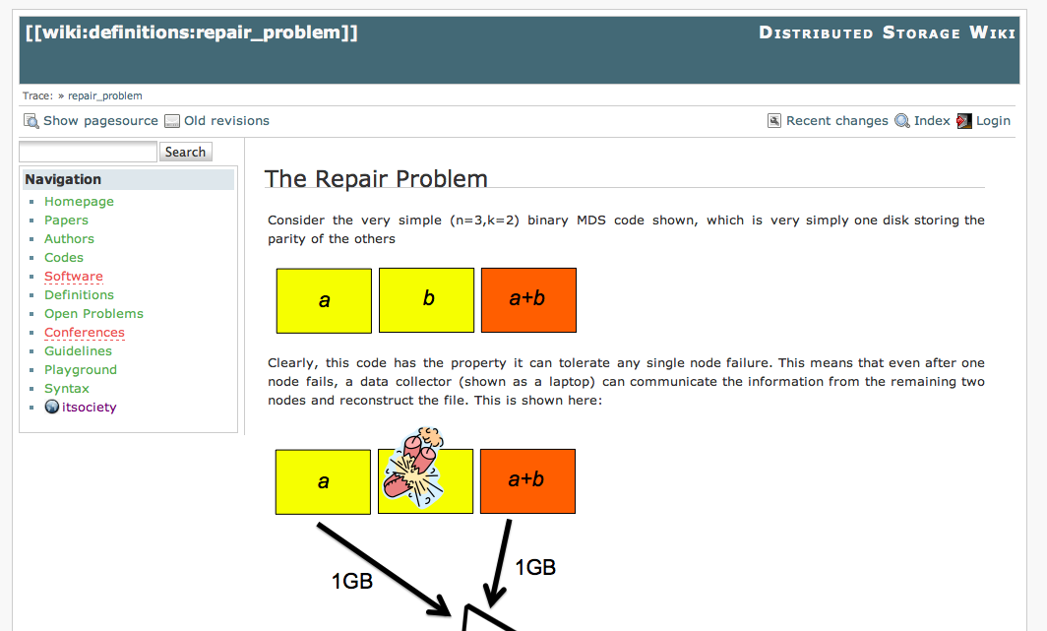
Coding for Storage wiki

