Slide 1
Half-Sibling Reconstruction A Theoretical Analysis
Brothers!
?
?
Saad Sheikh
Department of Computer Science
University of Illinois at Chicago

Slide 2
Introduction
Many Problems exist where
No way to ascertain the ground-truth
Correlate naturally with theoretical problems
E.g. Finding Communities, Sequence Alignment and:
Sibling Reconstruction
Given genetic information on a cohort of individuals determine the sibling relationships in the population.
Theoretically linked to classical problems including graph coloring, triangle packing and Raz’s Parallel Repetition Theorem

Slide 3
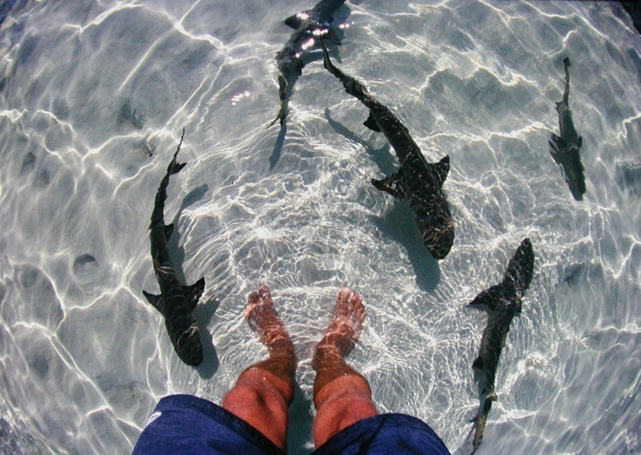
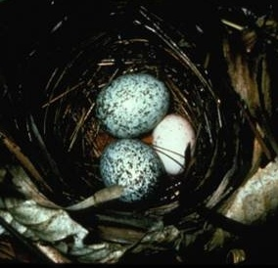
Biological Motivation
Used in: conservation biology, animal management, molecular ecology, genetic epidemiology
Necessary for: estimating heritability of quantitative characters, characterizing mating systems and fitness.
Lemon sharks, Negaprion brevirostris
But: hard to sample parent/offspring pairs. Sampling cohorts of juveniles is easier
2 Brown-headed cowbird (Molothrus ater) eggs in a Blue-winged Warbler's nest
Notes:
3

Slide 4
Basic Genetics
Gene
Unit of inheritance
Allele
Actual genetic sequence
Locus
Location of allele in entire genetic sequence
Diploid
2 alleles at each locus
Individual | Locus 1 | Locus 2
I1 | 5/10 | 20/30
I2 | 1/4 | 50/60

Slide 5
Microsatellites (STR)
Advantages:
Codominant (easy inference of genotypes and allele frequencies)
Many heterozygous alleles per locus
Possible to estimate other population parameters
Cheaper than SNPs
But:
Few loci
And:
Large families
Self-mating
…
CACACACA
5’
Alleles
#1
CACACACA
#2
CACACACACACA
#3
CACACACACACACA
Genotypes
1/1
2/2
3/3
1/2
1/3
2/3

Slide 6
Sibling Reconstruction Problem
Animal
Locus1
Locus2
allele1/allele2
Sibling Groups:
2, 4, 5, 6
1, 3
7, 8
1
1/2
11/22
2
1/3
33/44
3
1/4
33/55
4
1/3
77/66
5
1/3
33/44
6
1/3
33/77
7
1/5
88/22
8
1/6
22/22
S={P1={2,4,5,6},P2={1,3},P3={7,8}}

Slide 7
Existing Methods
Method | Approach | Assumptions
Almudevar & Field (1999,2003) | Minimal Sibling groups under likelihood | Minimal sibgroups, representative allele frequencies
KinGroup (2004) | Markov Chain Monte Carlo/ML | Allele Frequencies etc. are representative
Family Finder(2003) | Partition population using likelihood graphs | Allele Frequencies etc. are representative
Pedigree (2001) | Markov Chain Monte Carlo/ML | Allele Frequencies etc are representative
COLONY (2004) | Simulated Annealing | Monogamy for one sex
Fernandez & Toro (2006) | Simulated Annealing | Co-ancestry matrix is a good measure, parents can be reconstructed or are available

Slide 8
Full Sibling Reconstruction
Objective
Find the minimum Full Sibgroups necessary to explain the cohort
Algorithm [Berger-Wolf et al. ISMB 2007]
Enumerate all maximal feasible full sibgroups
Determine the minimum number of full sibgroups necessary to explain the cohort
Complexity [Ashley et al. JCSS 2009]
NP-Hard (Graph Coloring)
Inapproximable
ILP [Chaovalitwongse et al. 09 INFORMS JoC]

Slide 9
Mendelian Constraints
4-allele rule: siblings have at most 4 different alleles in a locus
Yes: 3/3, 1/3, 1/5, 1/6
No: 3/3, 1/3, 1/5, 1/6, 3/2
2-allele rule:
In a locus in a sibling group:
a + R ≤ 4
Yes: 3/3, 1/3, 1/5
No: 3/3, 1/3, 1/5, 1/6
Num distinct alleles
Num alleles that appear with 3 others or are homozygote
Notes:
9

Slide 10
Minimum Set Cover
Given: universe U = {1, 2, …, n} collection of sets S = {S₁, S₂,…,S_{m}}
where S_{i} subset of U
Find: the smallest number of sets in S whose union is the universe U
Minimum Set Cover is NP-hard
(1+ln n)-approximable (sharp)
Notes:
10

Slide 11
Parsimony: Alternate Objectives
Min number of sibgroups is just ONE (effective) way to interpret parsimony
Alternate Objectives
Sibship that minimizes number of parents
Sibship that minimizes number of matings
Sibship that maximizes family size
Sibship that tries to satisfy uniform allele distributions

Slide 12
2-Allele Algorithm Overview
Generate candidate sets by all pairs of individuals
Compare every set to every individual x
if x can be added to the set without any affecting “accomodability” or violating 2-allele:
add it
If the “accomodability” is affected , but the 2-allele property is still satisfied:
create a new copy of the set, and add to it
Otherwise ignore the individual, compare the next
Notes:
12

Slide 13
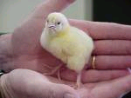
Examples
Add
New Group Add (won’t accommodate (2,2))
Can’t add (a+R =4)
1, 2
3, 4
1,4
3, 2
1,2
3,2
3,2
1,4
1,2
1,1
1,5
1,4
Notes:
13

Slide 14
Parsimony: Minimize Parents
Problem Statement:
Given a population U of individuals, partition the individuals into groups G such that the parents (mothers+fathers) necessary for G are minimized
Observations and Challenges:
MinParents: intractable, inapproximable
Reduction from Min-Rep Problem (Raz’s Parallel Repetition Theorem)
There may be O(2^{|loci|}) potential parents for a sibgroup
Self-mating (plants) may or may not be allowed

Slide 15
Full Sibling Reconstruction MP
Objective
Minimize the number of parents necessary to generate the sibling reconstruction
Algorithm
Enumerate all (closed) maximal feasible full sibgroups
Generate all possible parents for full sibgroups
Use a special vertex cover to determine the minimum number of parents
Complexity [Ashley et al. AAIM 2009]
NP-Hard (Raz’s Parallel Repetition Theorem)
Inapproximable

Slide 16
Raz’s Parallel Repetition Theorem
restriction
Unique games
conjecture
restriction
2-prover 1-round
proof system
label cover problem
for bipartite graphs
small inapproximability
boosting
(Raz’s parallel repetition theorem)
label cover problem
for some kind of
“graph product” for
bipartite graphs
parallel repetition of
2-prover 1-round
proof system
larger inapproximability
a parallel repetition of any two-prover one-round proof system (MIP(2,1)) decreases the probability of error at an exponential rate.

Slide 17
Inapproximability for MINREP
(Raz’s parallel repetition theorem)
Let L∈NP and x be an input instance of L
O(n^{polylog(n)})
time
L
MINREP
x∈L
OPT ≤ α+β
x∉L
OPT ≥ (α+β) 2^{logε |A| +|B|}
0 < ε < 1 is any constant

Slide 18
MINREP (minimum representative) problem
α partitions
all of equal size
α partitions
all of equal size
A “super”-nodes
A₁
A₁
A₂
A_{α}
A₁
A_{α}
…
A_{α}
A₂
…
A₂
…
A
A
…
…
B
B
B_{β}
B₁
B₂
B₃
B_{β}
B₁
B_{β}
B₁
B₃
B₂
B₃
B₂
β partitions
all of equal size
B “super”-nodes
input graph G
associated “super”-graph H
(A₁,B₂)∈H if ∃ u∈A₁ and v∈B₂ such that (u,v)∈G
In this case, edge (u,v)∈G a witness of the super-edge (A₁,B₂)∈H

Slide 19
MINREP goal
Valid solution:
A’ ⊆ A and B’ ⊆ B such that
A’∪B’ contains a witness for every super-edge
Objective: minimize the size of the solution |A’∪B’|

Slide 20
Informally,
given a set of children
given a candidate set of parents
assuming we believe in Mendelian inheritance law
assuming that the parents tried to be as much monogamous as possible
can we
partition the children into a set of full siblings
(full sibling group has the same pair of parents)
Can reduce MINREP to show that this problem is hard

Slide 21
Min Parents Sib Reconstruction
M={{1,2},{3,6,7},{3,5},
{2,4},{1,6},{2,5},{6,7}}
Generate M a set of covering groups
Select S, a subset of M
For each group x in S
Generate Parent Pairs for x
Insert parent vertices into graph G (if needed)
Connect the parents in each parent pair
Cover the minimum vertices necessary to (doubly) cover all the individuals
S={{1,2,4},{3,5},{6,7}}
X={3,5}
{F=5/10, M=2/20},{F=12/44.M=1/49}
5/
10
X={3,5}
2/
20
X={3,5}
12/44
1/
49

Slide 22
Min Half-Sibs Reconstruction
Objective
Minimum number of half-sibgroups necessary to explain the cohort
Algorithm
Enumerate all maximal feasible half-sibgroups
Use min set cover to determine the minimum number of groups
Complexity
NP-Hard
Inapproximable (Exact Cover By 3-Sets)

Slide 23
Mendelian Constraints
Half-sibs rule: siblings have 2 alleles at each locus from which one allele must be present in each individual
Yes: 3/3, 1/3, 1/5, 1/6,8/3,10/3,29/3 (3/1)
No: 31/3, 1/6, 29/10

Slide 24
Half-Sibs Enumeration
Animal
Locus1
Locus2
Alleles at Locus 1={1,2,3,4,5,6}
All Pairs:
(1,2) =>{1,2,3,4,5,6,7,8}
(1,3),(1,4), (1,5) ,(1,6)
(2,3)=>{1,2,4,5,6}
…
Alleles at Locus 2 ={11,22,33,44,55,66,77,88}
All Pairs:
(11,33)=>{1,2,3,5,6}
(11,22)=>{1,7,8}
(33,66)=>{2,3,4,5,6}
….
Common:
{1,2,3,5,6}
{1,7,8}
….
allele1/allele2
1
1/2
11/22
2
1/3
33/44
3
1/4
33/55
4
1/3
77/66
5
1/3
33/44
6
1/3
33/77
7
1/5
88/22
8
1/6
22/22

Slide 25
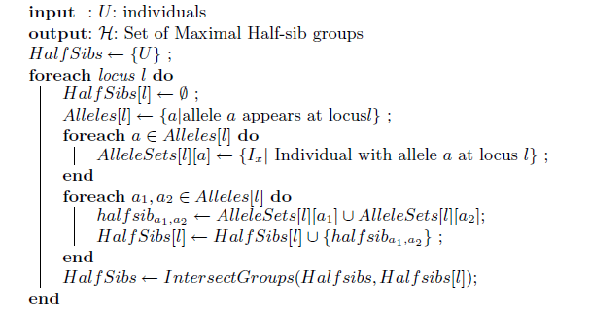
Enumeration Algorithm

Slide 26
Results

Slide 27
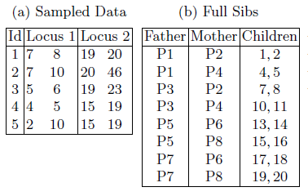
Inherent Problem in Half-Sibs Reconstruction
Biologically Correct Reconstructions
{ {1,2,4,5},{7,8,10,11},{13,14,15,16} ,{ 17,18,19,20} }
{ {1,2,7,8},{4,5,10,11 } {13,14,17,18} { 15,16,19,20} }
{ {1,2,7,8},{4,5,10,11 } {13,14,15,16} { 17,18,19,20} }
{ {1,2,4,5},{7,8,10,11 } {13,14,17,18} { 15,16,19,20} }

Slide 28
Solution
Reconstruct both paternal and maternal half-sibgroups!
What does a half-sibgroup represent? A parent
Intersection of Half-Sibgroups give us full-sibgroups
Sibling Reconstruction by Minimizing Parents
Raz’s Parallel Repetition theorem, Inapproximability, again!

Slide 29
Conclusion
Sibling Reconstruction problem is NP-Hard and Inapproximable for following objectives
Minimum Full Sibs Reconstruction
Minimum Half-Sibs Reconstruction
Minimum Parents Full-Sibs Reconstruction
Minimum Half-Sibs Reconstruction with double cover
We need to think more about Half-Sibs Problem

Slide 30
References
T. Y. Berger-Wolf, S. I. Sheikh, B. DasGupta, M. Ashley, W. Chaovalitwongse and S. P. Lahari, Reconstructing Sibling Relationships in Wild Populations In Proceedings of 15th Annual International Conference on Intelligent Systems for Molecular Biology (ISMB) 2007 and Bioinformatics, 23(13).
S. I. Sheikh, T. Y. Berger-Wolf, Mary V. Ashley, Isabel C. Caballero, Wanpracha Chaovalitwongse and B. DasGupta " Error-Tolerant Sibship Reconstruction for Wild Populations In Proceedings of 7th Annual International Conference on Computational Systems Biology (CSB 2008).
Mary. Ashley, Tanya Y. Berger-Wolf, Isabel Caballero, Wanpracha Chaovalitwongse, Chun-An Chou, Bhaskar DasGupta and Saad Sheikh, Full Sibling Reconstructions in Wild Populations From Microsatellite Genetic Markers, to appear in Computational Biology: New Research, Nova Science Publishers.
M. V. Ashley, I. C. Caballero, W. Chaovalitwongse, B. DasGupta, P. Govindan, S. Sheikh and T. Y. Berger-Wolf. KINALYZER, A Computer Program for Reconstructing Sibling Groups, Molecular Ecology Resources

Slide 31
References
M. Ashley, T. Berger-Wolf, W. Chaovalitwongse, B. DasGupta, A Khokhar S. Sheikh On Approximating An Implicit Cover Problem in Biology , Proceedings of 5th International Conference on Algorithmic Aspects of Information and Management 2009 (to appear)
W. Chaovalitwongse, C-A Chou, T. Y. Berger-Wolf, B. DasGupta, S. Sheikh, M. V. Ashley, I. C. Caballero. New Optimization Model and Algorithm for Sibling Reconstruction from Genetic Markers INFORMS Journal of Computing (to appear)
M. Ashley, T. Berger-Wolf, P. Berman, W. Chaovalitwongse, B. DasGupta, and M.-Y. Kao. On Approximating Four Covering and Packing Problems Journal of Computer and System Science (to appear)
S. I. Sheikh, T. Y. Berger-Wolf, Mary V. Ashley, Isabel C. Caballero, Wanpracha Chaovalitwongse and B. DasGupta " Combinatorial Reconstruction of Half-Sibling Groups

Slide 32
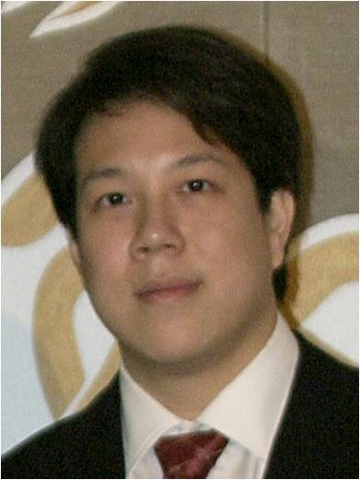
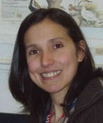
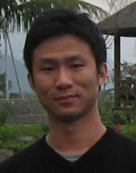
Sibship Reconstruction Project
Thank You!! Questions?
Tanya Berger-Wolf UIC
Ashfaq Khokhar UIC
Bhaskar DasGupta UIC
Mary Ashley UIC
W. Art Chaovalitwongse Rutgers
Priya Govindan UIC
Isabel Caballero UIC
Chun-An (Joe)
Chou
Rutgers

