Slide 1
[Contemporary Video Game Design.] Challenges in Visualization Interaction and Simulation
[Andrew Nealen.]
Department of Computer Science
Rutgers University

Slide 2
[Talk. Origins.]
2 years (= 3 classes) of teaching game design
40 graduates: teams of four students make a game from prototype to final product in 14 weeks
Collaboration on the Design and Programming of the award winning video game Osmos (demo to follow)
Talks, panels, roundtables and blogs
Many, many years of “game analysis”
Yes, I play many (video) games ☺

Slide 3
[Talk. Motivations in 2D.]
[Fibermesh. http://www.nealen.net/prof.html]

Slide 4
[Talk. Rules.]
Please interrupt me if you like
Even better: interrupt me if you can educate me on a topic
This talk is a first
I am a structural engineer/architect/computer scientist (= computer graphics researcher) by education
Ideally I will learn from you
While making this as entertaining as I can

Slide 5
[Definition. Games.]
Games are about meaningful interaction with and within a dynamic formal system
Games have rules
Games have goals
and these goals can be explicit or implicit
or even consist entirely of playful sense-pleasure
Games (can) contain resources
Games are abstractions

Slide 6
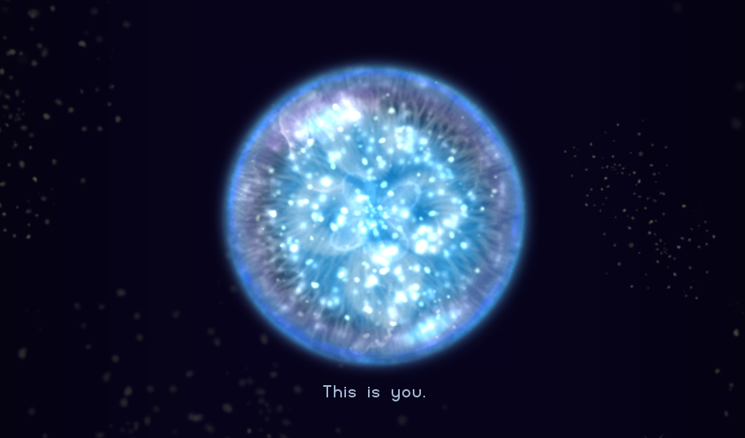
[Example. Osmos.]
[Osmos. Hemisphere Games. http://www.hemispheregames.com/osmos]

Slide 7
[Osmos. Deconstructed.]
Interaction: mouse clicks + mote collisions
Dynamic formal system: “Newtonian” physics
Rules: absorb smaller motes, etc.
Goals: become the biggest + sense pleasure
Resources: mote size. coupled to propulsion mechanic. arguably the key contribution.
Abstractions: gravitational motion, energy conservation, linear momentum, actio = reactio… etc.

Slide 8
[Meaningful. Play.]
Player interaction should (ideally) be
Discernable
Perceive the immediate outcome of player action
Sound or visual effect, game state change
Integrated
Outcome of action is woven into the game system
Long term consequences
Actions in earlier stages have far reaching influence
[Rules of Play. Salen and Zimmerman.]

Slide 9
[Digital. Analog.]

Slide 10
[Digital interaction. Forms.]
Two forms of interaction in video games
Direct interaction
Tactile. Grasping. Pulling. Pushing. Shooting.
Indirect interaction
State change. An earlier decision/action has far reaching influence on the dynamic simulation
Contemporary games have problems simulating direct interaction
Instead. state manipulation through abstracted direct interaction

Slide 11
[Digital interaction. Abstraction.]
Discernable actions = abstracted direct interaction
Collision. Gathering. Motion. Buttons. Swinging (Wii).
Integrated actions = state changes and long term consequences as a result of discernable actions
Behaviors. Strategies. Etc.
These are generally also simplified/abstracted to make the game tractable and learnable

Slide 12
[Abstraction. Why?.]
Ongoing discussion among game designers
Controller mappings and tactile feedback
Example. Motion sensing on Nintendo Wii
Where this works well.
Bowling. Throwing. Minor pulling.
Where 1:1 mapping breaks
Collision. Absence of feedback. Solution. Abstraction (break 1:1 motion of device)
Games are always abstractions on some levels

Slide 13
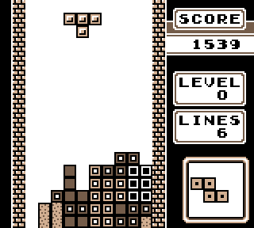
[Input. Reaction. Sensitivity.]
[Tetris. Alexey Pajitnov]

Slide 14
[Game. Feel.]
Tetris input and feedback is discrete.
Many casual players tend to enjoy this kind of play style tremendously.
Learning the game controls is near trivial.
This is not snowboarding. Playing the piano. Etc.
Mastering the game is hard and rewarding.
Balancing the game is difficult.
Iteration and rapid prototyping are valuable tools.
[Principles of Virtual Sensation. Steve Swink]

Slide 15
[Visual. Abstraction.]

Slide 16
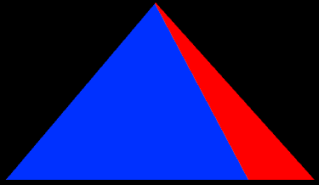
[Visual. Iconography.]
A map of visual iconography
[Understanding Comics. Scott McCloud]

Slide 17
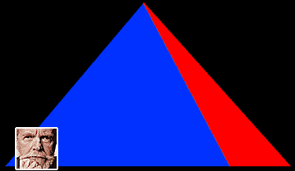
[Visual. Iconography.]
A map of visual iconography
Lower left: visual resemblance (e.g. photography)
[Understanding Comics. Scott McCloud]

Slide 18
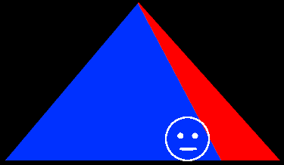
[Visual. Iconography.]
A map of visual iconography
Lower right: iconic abstraction (e.g. cartooning)
[Understanding Comics. Scott McCloud]

Slide 19
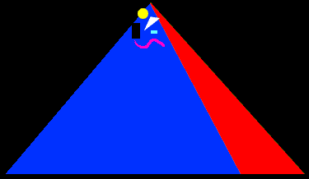
[Visual. Iconography.]
A map of visual iconography
Top: picture plane („pure“ abstraction)
[Understanding Comics. Scott McCloud]

Slide 20
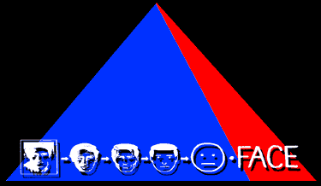
[Visual. Iconography.]
A map of visual iconography
Far right: from realism to cartoons… words as the next logical step
[Understanding Comics. Scott McCloud]

Slide 21
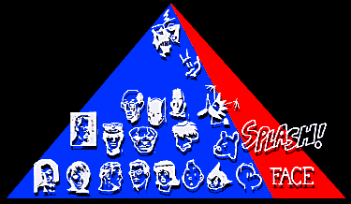
[Visual. Iconography.]
A map of visual iconography
Interesting tool for thinking about comics and games as art
[Understanding Comics. Scott McCloud]

Slide 22
[Game. Context.]
Areas of game design iconography
Potential Uncanny Valley
Final Game
Prototype

Slide 23
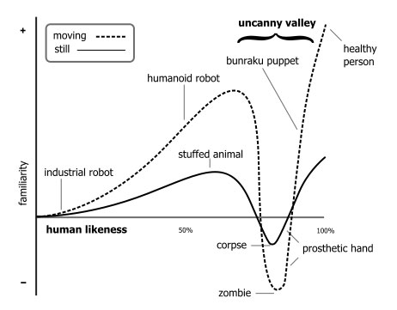
[Uncanny Valley.]
[Bukimi no tani The uncanny valley. Masahiro Mori 1970]

Slide 24
[Uncanny valley. Solved?.]

Slide 25
[Uncanny valley. Solved?.]

Slide 26
[Uncanny valley. State.]
Still images are continuously improving
Just a matter of time. Potentially solvable.
Problem is exacerbated in human animation
Motion capture works for film. Infeasible for physical interaction in games.
Much research effort. Potentially solvable.
But what about digital interaction?

Slide 27
[Digital. Development.]
[Rendering.]
[Animation.]
[Interaction.]

Slide 28
[Uncanny valley. Interaction.]
Currently, meaningful interaction in photorealistic environments is quasi non-existent.
Limited to. Destruction. Shooting. Etc.
Notable example. Exploration.
Sense-pleasure as a goal is possible. Explicit interaction goals other than the most primitive kind are generally absent.
Other Direct interactions ? Indirect interactions/simulations ?

Slide 29
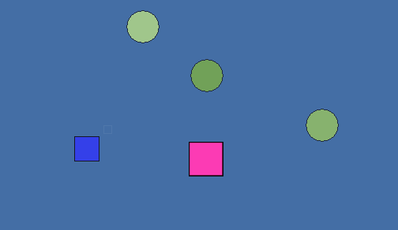
[Visual. Interaction. Abstraction.]
[The Marriage. Rod Humble]

Slide 30
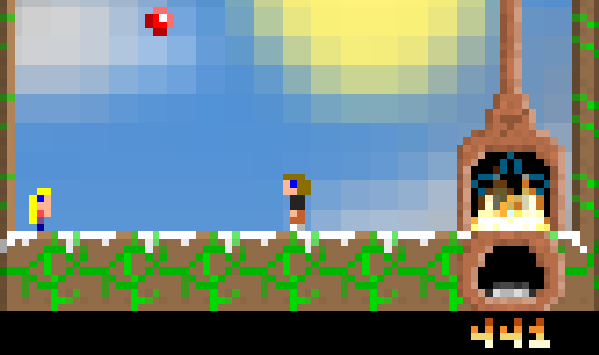
[Simulation. Reality. Abstraction.]
[Gravitation. Jason Rohrer]

Slide 31
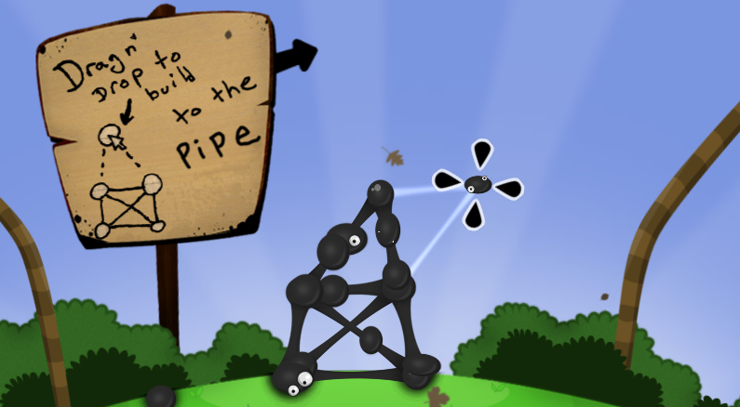
[Engineering. Abstraction.]
[World of Goo. Ron Carmel and Kyle Gabler]

Slide 32
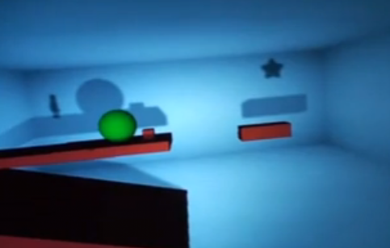
[2D to 3D. Abstraction.]
[Shadow Physics. Steve Swink and Scott Anderson]

Slide 33
[2D Game. Play.]
Success of 2D low DOF games often and mostly attributed to nostalgia.
Surely this helps. But…
Reduced DOFs, Abstraction and simplicity of control equally important
If the game does not feel right it will not succeed
Control. Feedback. State changes. Simulation.

Slide 34
[Games. Strengths.]
Platforms.
Convey meaning. Messages. Ideas. Ideals.
Individuals. Authors. Renaissance people.
Abstraction of and interaction with and within
Concepts. Systems. Worlds.
Low degrees of freedom input. Large possibility space.
Design is hard. Be challenged. Persevere.

Slide 35
[Games. Ideas.]
Data mining
Use games as vehicles to explore human behavior. To improve game systems and interfaces.
As tools to help guide research. ESP Game.
Research into game controls + response
How many and which degrees of freedom.
How many redundant feedback systems.
How to meld sense pleasure and explicit goals.

Slide 36
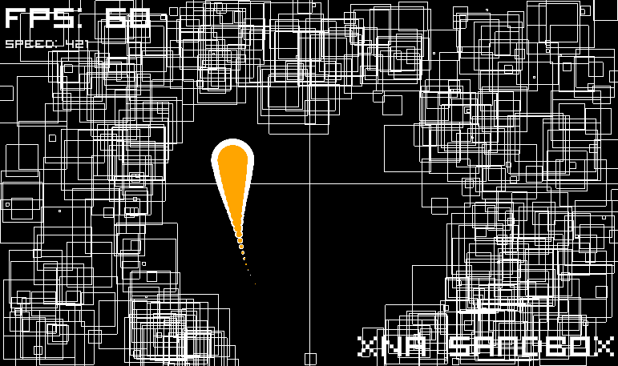
[Visual feedback. Eye candy?.]

Slide 37
[Interdisciplinary. Science. Art.]
Computer science
Art
Cognitive science
Intelligence and adaption of game systems.
Perceptual science
Quantify audiovisual feedback mechanisms.
English / Composition / Drama
Digital composition. Digital narrative. Semiotics.

Slide 38
[Games. Outlook.]
More interesting visualizations. Non photorealistic renderings. Icons. Semiotics.
More rich interactions. Interfaces. Mappings.
Use time as an additional degree of freedom.
Not only binary/analog input devices
Use of games as educational tools.
New exploratory and participatory art forms.
Adaptive games. Adaptive rule sets.

Slide 39
[Thank. You!.]

