Slide 1
Context-Sensitive Supports for Collaborative Information Access
Daqing He

Slide 2
Complex Search Activities in Collaboration Information Access
Information-gathering
Decision-making
Comparison of Transition Probabilities of Hidden states in COL for the two tasks (red arrows indicate significant difference: *p<0.05, **p<0.01)

Slide 3
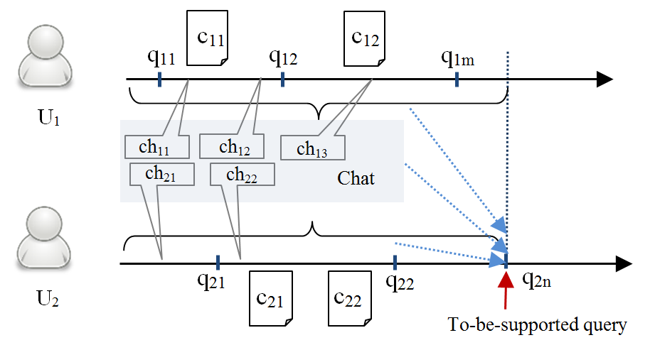
Context Information in Collaborative Information Access

