Slide 1
Discrepancy Minimization by Walking on the Edges
Raghu Meka (IAS/DIMACS)
Shachar Lovett (IAS)

Slide 2
Discrepancy
Subsets $S_{1},S_{2},…, S_{m}⊆[n]$
Color with $1$or -$1$ to minimize imbalance
1 2 3 4 5
1 2 3 4 5
1 | * | 1 | 1 | *
* | 1 | 1 | * | 1
1 | 1 | 1 | 1 | 1
* | * | * | 1 | 1
1 | * | 1 | * | 1
1 | * | 1 | 1 | *
* | 1 | 1 | * | 1
1 | 1 | 1 | 1 | 1
* | * | * | 1 | 1
1 | * | 1 | * | 1
3
1
1
0
1

Slide 3
Discrepancy Examples
Fundamental combinatorial concept
Arithmetic Progressions
Roth 64: $Ω{(n}^{1/4})$
Matousek, Spencer 96: $Θ{(n}^{1/4})$
$$\left\{1,3,5,⋯\right\}, \left\{1,4,7,⋯\right\}, ⋯$$

Slide 4
Discrepancy Examples
Fundamental combinatorial concept
Halfspaces
Alexander 90:
Matousek 95:

Slide 5
Discrepancy Examples
Fundamental combinatorial concept
Axis-aligned boxes
Beck 81:
Srinivasan 97:

Slide 6
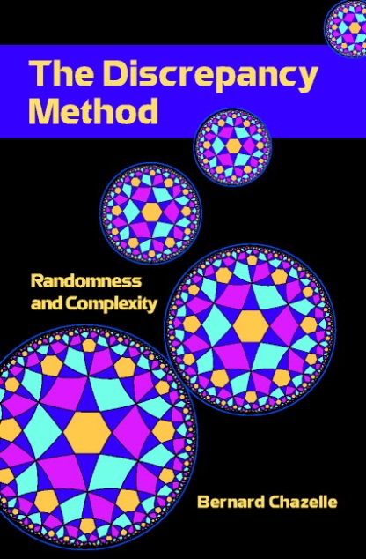
Why Discrepancy?
Complexity theory
Communication Complexity
Computational Geometry
Pseudorandomness
Many more!

Slide 7
Spencer’s Six Sigma Theorem
“Six standard deviations suffice”
Spencer 85: System with n sets has discrepancy at most .
Central result in discrepancy theory.
Beats random:
Tight: Hadamard.

Slide 8
A Conjecture and a Disproof
Spencer 85: System with n sets has discrepancy at most .
Non-constructive pigeon-hole proof
Conjecture (Alon, Spencer): No efficient algorithm can find one.
Bansal 10: Can efficiently get discrepancy .

Slide 9
This Work
New elemantary constructive proof of Spencer’s result
Main: Can efficiently find a coloring with discrepancy $O\left(\sqrt{n}\right).$
Truly constructive
Algorithmic partial coloring lemma
Extends to other settings
EDGE-WALK: New algorithmic tool

Slide 10
Outline
Partial coloring Method
EDGE-WALK: Geometric picture

Slide 11
Partial Coloring Method
Input:
Output:
Lemma: Can do this in randomized
time.
Focus on m = n case.

Slide 12
Outline
Partial coloring Method
EDGE-WALK: Geometric picture

Slide 13
Discrepancy: Geometric View
Subsets $S_{1},S_{2},…, S_{m}⊆[n]$
Color with $1$or -$1$ to minimize imbalance
1 2 3 4 5
1 | * | 1 | 1 | *
* | 1 | 1 | * | 1
1 | 1 | 1 | 1 | 1
* | * | * | 1 | 1
1 | * | 1 | * | 1
3
1
-1
1
1
-1
3
1
1
0
1
1
1
0
1

Slide 14
Discrepancy: Geometric View
Vectors $v_{1}, v_{2},…, v_{m}∈{\left\{0,1\right\}}^{n}.$
Want
1 2 3 4 5
1 | * | 1 | 1 | *
* | 1 | 1 | * | 1
1 | 1 | 1 | 1 | 1
* | * | * | 1 | 1
1 | * | 1 | * | 1
1
-1
1
1
-1
3
1
1
0
1

Slide 15
Discrepancy: Geometric View
Vectors $v_{1}, v_{2},…, v_{m}∈{\left\{0,1\right\}}^{n}.$
Want
Polytope view used earlier by Gluskin’ 88.
Goal: Find non-zero lattice points in

Slide 16
Edge-Walk
Goal: Find non-zero lattice point in
Claim: Will find good partial coloring.
Start at origin
Gaussian walk until you hit a face
Gaussian walk within the face

Slide 17
Edge-Walk: Algorithm
Gaussian random walk in subspaces
Subspace V, rate $γ$
Gaussian walk in V
Standard normal in V:
Orthonormal basis change

Slide 18
Edge-Walk Algorithm
Discretization issues: hitting faces
Might not hit face
Slack: face hit if close to it.

Slide 19
Edge-Walk: Algorithm
Input: Vectors $v_{1},v_{2},…, v_{m}.$
Parameters: $δ, Δ, γ\left(≪δ\right), T=1/γ^{2}$
$X_{0}=0.$For $t=1,…, T.$
$Var_{t}=$Cube faces nearly hit by $X_{t}$.
$Disc_{t}=$Disc. faces nearly hit by $X_{t}$.
$V_{t}=$Subspace orthongal to ${Var}_{t}, Disc_{t}$

Slide 20
Edge-Walk: Intuition
Discrepancy faces much farther than cube’s
$$\operatorname{Pr}\left[Walk hits a disc. face\right] ≪Pr⁡[ Walk hits a cube^{′}s]$$
$$\operatorname{Pr}\left[Walk hits a disc. face\right]$$
$$∝\exp\left(−{100}^{2}\right).$$
$$\operatorname{Pr}\left[Walk hits a cube face\right]$$
$$∝\exp\left(−1\right).$$
100
Hit cube more often!
1

Slide 21
Summary
Edge-Walk: Algorithmic partial coloring lemma
Recurse on unfixed variables
Spencer’s Theorem

Slide 22
Open Problems
Q:
Beck-Fiala Conjecture 81: Discrepancy $O(\sqrt{t})$ for degree t.
Some promise: our PCL “stronger” than Beck’s
Q: Other applications?
General IP’s, Minkowski’s theorem?

Slide 23
Thank you

Slide 24
Main Partial Coloring Lemma
Algorithmic partial coloring lemma
Th: Given $v_{1},…, v_{m},$thresholds $λ_{1},λ_{2},…λ_{m},$
Can find $X∈{\left[−1,1\right]}^{n}$with
1.
2.

