Slide 1
Harnessing Wind in China: Controlling Variability
through Location and Regulation
DIMACS Workshop:
U.S.-China Collaborations in Computer Science and Sustainability
September 19 2011
Warren B. Powell
Hui Fang ‘11
Rui Zhang ‘11
PENSA Laboratory
Princeton University
© 2011 Warren B. Powell, Princeton University
Slide 1
Notes:
1

Slide 2
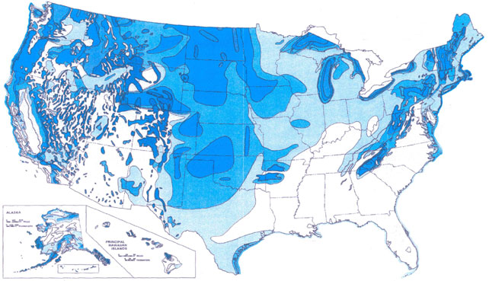
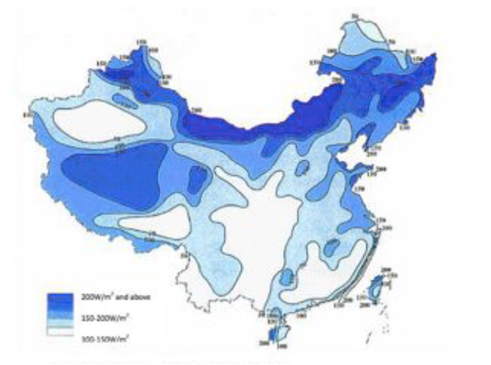
Wind and a tale of two countries
The United States
  More than enough potential energy from wind to satisfy the needs of the entire country.
  Problem 1: Wind is windy
  Problem 2: It doesn’t blow where people live.
China
  More than enough potential energy from wind to satisfy the needs of the entire country.
  Problem 1: Wind is windy
  Problem 2: It doesn’t blow where people live.

Slide 3
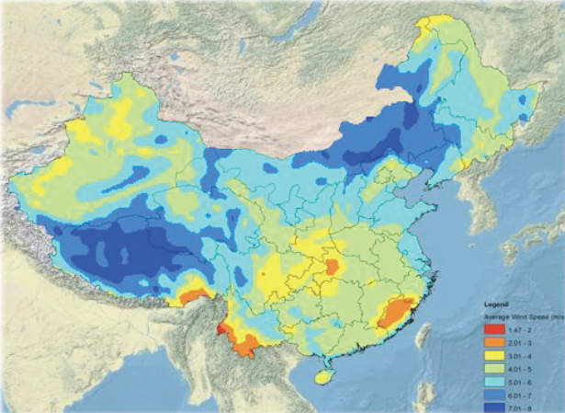
Wind in China
Mean wind speeds

Slide 4
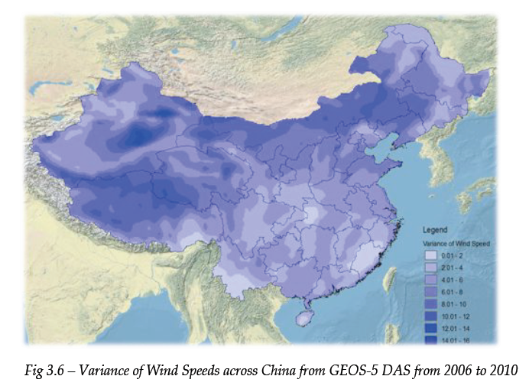
Wind in China
Variance of wind speeds

Slide 5
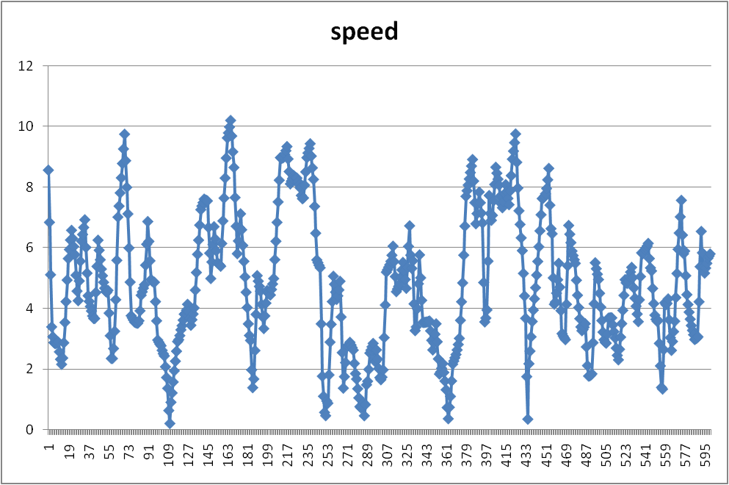
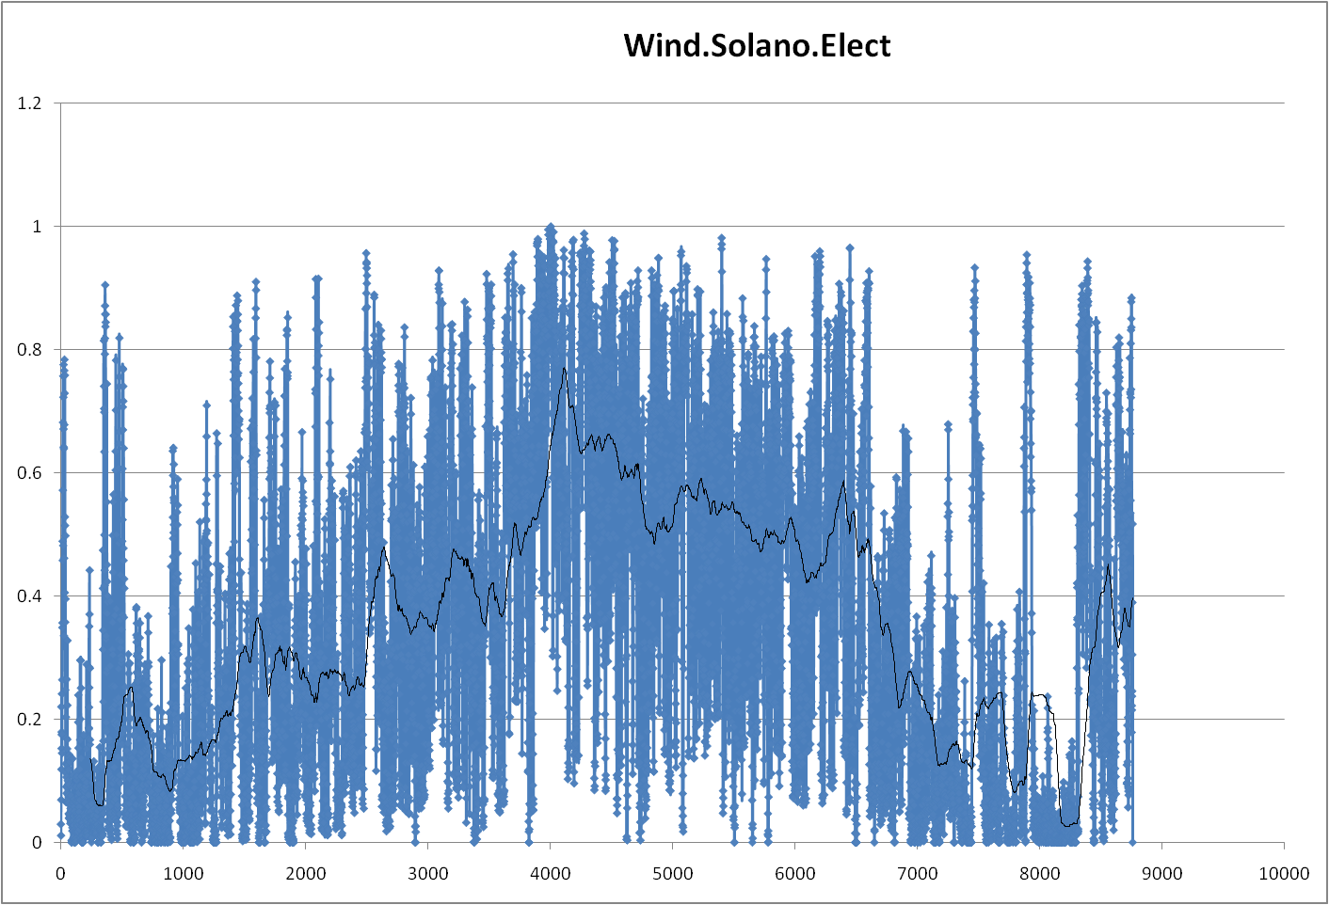
The variability of wind
30 days
1 year
Notes:
Discuss fine-grained and coarser-grained (yearly) patterns.

Slide 6
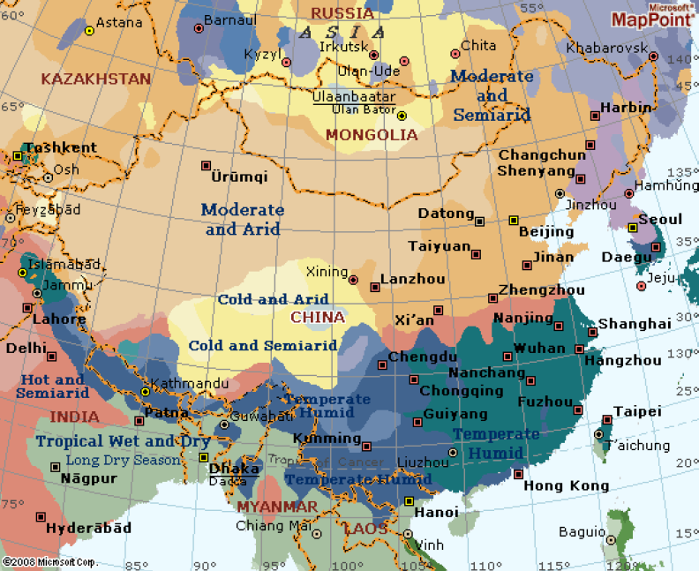
The climates of China

Slide 7
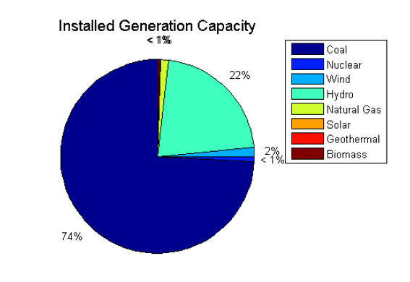
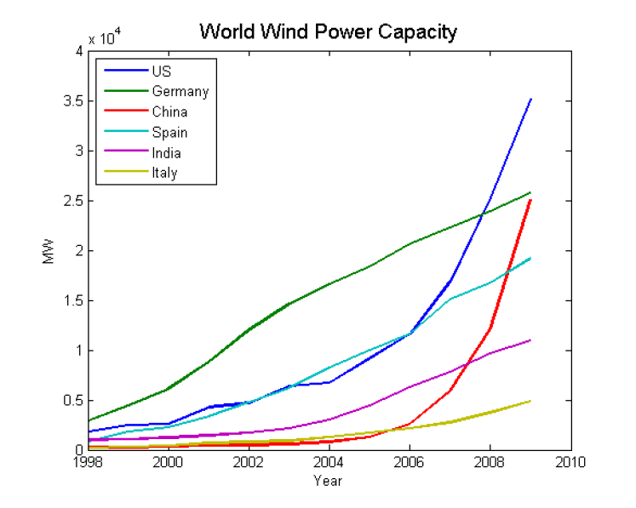
From coal to wind
As a result of rapid growth, energy generation in China is dominated by coal.
But it also enjoys significant amounts of hydroelectric power.
Installed wind generation capacity in China is growing rapidly, matching the growth in the U.S.
But how to deal with the variability?

Slide 8
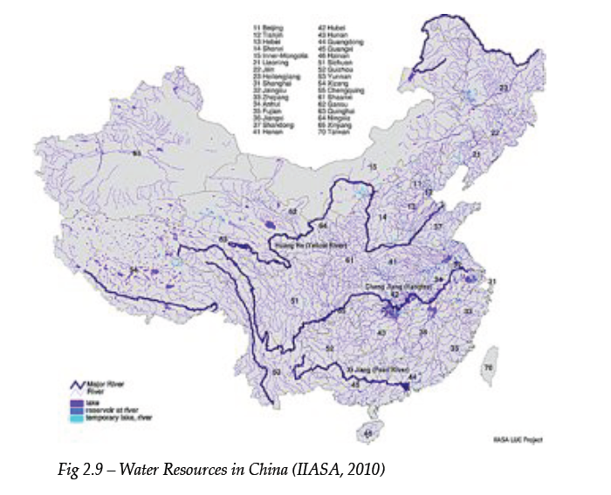
The China advantage - water
Water resources in China

Slide 9
The wind energy challenge
We want to take advantage of clean, cost-effective energy from wind, but we struggle with the variability.
Proposals:
  Smooth the variability by designing efficient portfolios of wind farms.
    Senior thesis research by CC Fang ‘11
  Use the large amount of hydroelectric power as a source of regulation.
    Senior thesis research by Rui Zhang ‘11

Slide 10
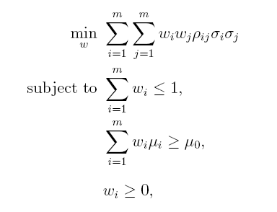
Optimal wind farm portfolios
We can design a portfolio of wind farms to reduce variability using Markowitz portfolio theory.
Correlation coefficient
Target average wind speed

Slide 11
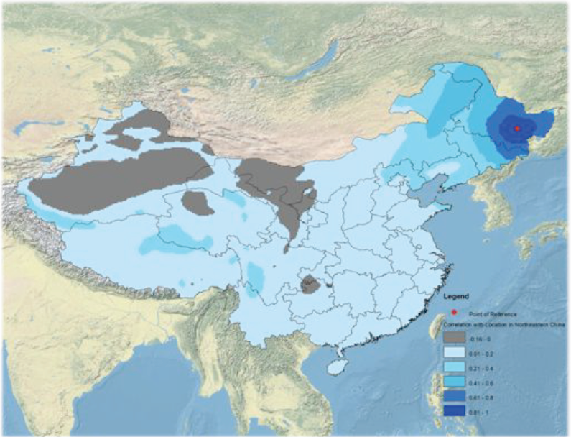
Correlations with northeast

Slide 12
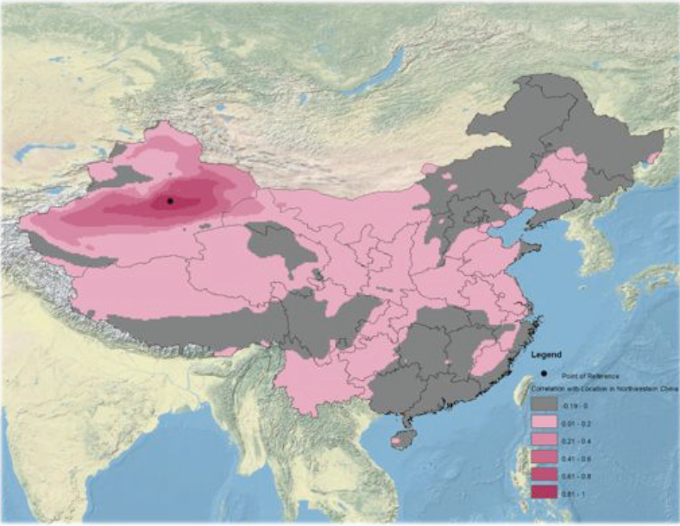
Correlations with northwest

Slide 13
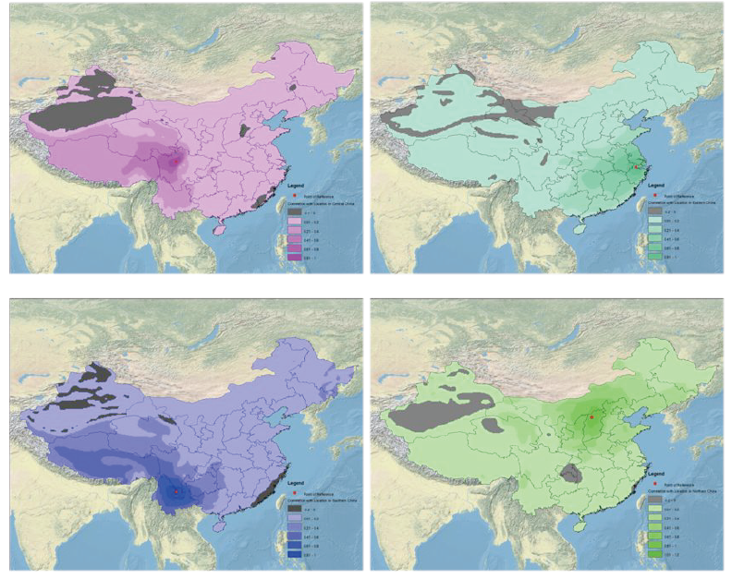
Other correlations

Slide 14
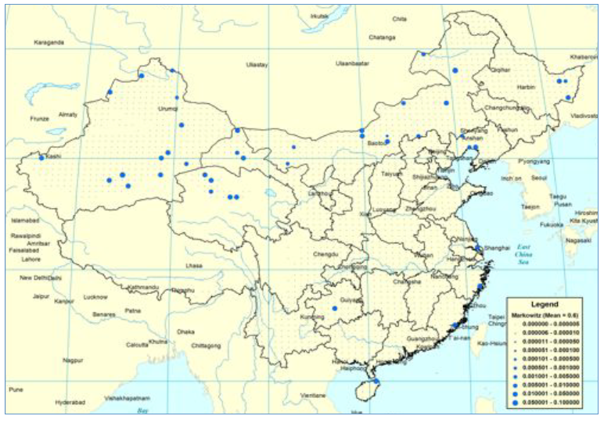
Optimal wind farm placement

Slide 15
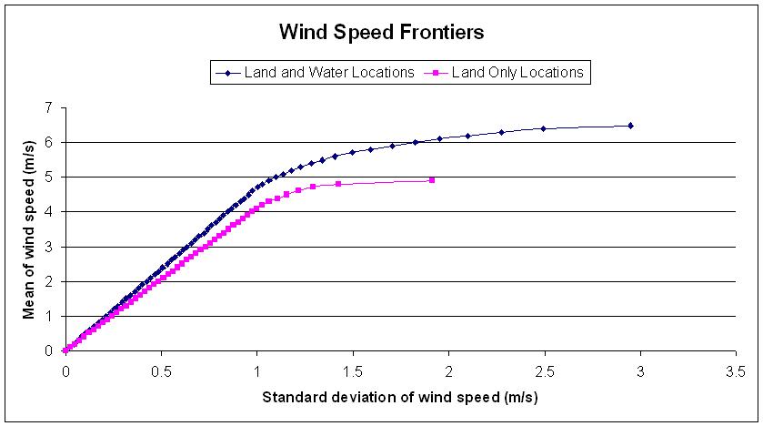
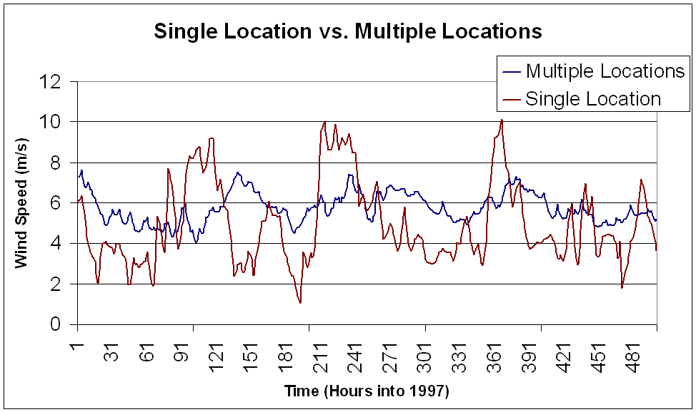
Markowitz model results
Efficient frontiers
  Using a Markowitz model, we can allocate wind farms to find the best balance between average wind speed and variability
Reducing volatility
  Using sensible allocation of wind farms, we can get the same level of energy with a lot less variability.

Slide 16
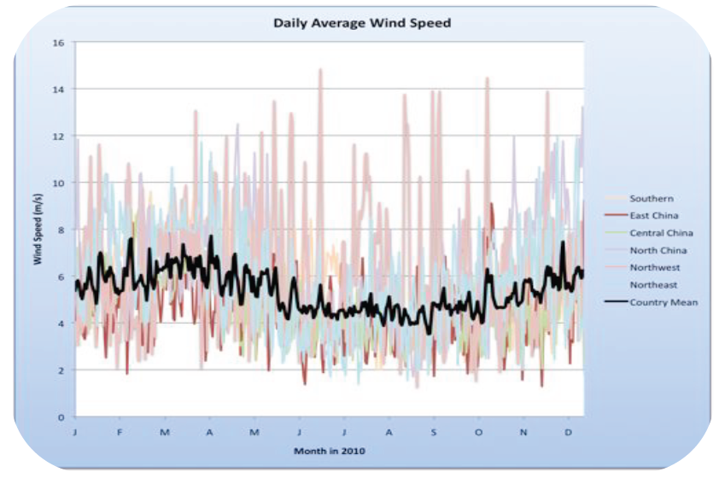
Seasonality of wind in China

Slide 17
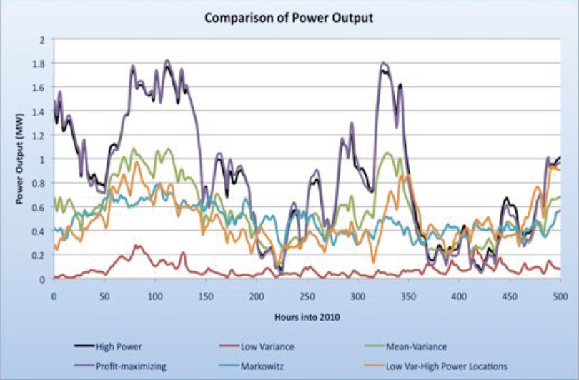
Power output from different models

Slide 18
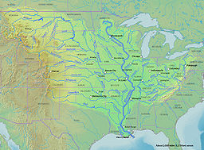
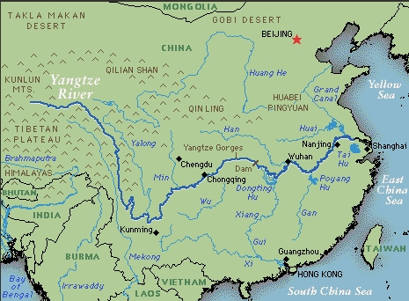
Hydroelectric power
The Mississippi river
  No power generation
The Yangtze river
  Completed in 2008
  Will have 22,500 Mw of electricity generation from 32 main turbines and 2 smaller ones.

Slide 19
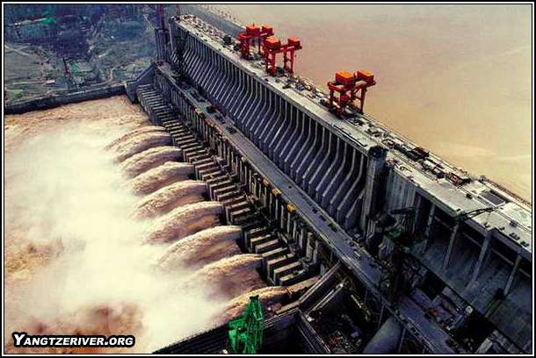
Hydroelectric power
Regulating wind energy using hydroelectric power
  China has tremendous hydroelectric resources.
  Hydroelectric power can be changed fairly quickly

Slide 20
Wind energy regulation using hydro
Concept
  Use the Three Gorges dam (and other hydroelectric facilities) to regulate energy from wind.
  We are limited by how much we can vary the output because of downstream uses of water.
  Proposal: penalize deviations from current outflow. By varying the penalty for deviations, we can strike a balance between smoothing energy from wind and deviating from the natural outflow of the river.
  Deviations are limited to 5 percent of outflow at any point of time.

Slide 21
A stochastic optimization model
The objective function
  Given a system model (transition function)
Expectation over all
random outcomes
Contribution function
State variable
Decision function (policy)
Finding the best policy

Slide 22
The model
Some notation:
The cost function

Slide 23
The stochastic unit commitment problem
Algorithmic strategy
  Hybrid lookahead with adaptive hour-ahead policy
    is determined at time t, to be implemented at time t’
    is determined at time t’, to be implemented at time t’+1
  Important to recognize information content
    At time t, is deterministic.
    At time t, is stochastic.

Slide 24
The stochastic unit commitment problem
Algorithmic strategy
  Hybrid lookahead with adaptive hour-ahead policy
    is determined at time t, to be implemented at time t’
    is determined at time t’ by the policy
  The policy is constrained by the solution which is influenced by two parameters:
    p is the fraction of power allocated for spinning reserve
    q is the fraction of the wind that we plan on using.

Slide 25
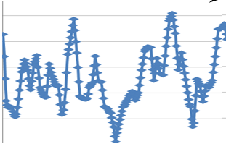
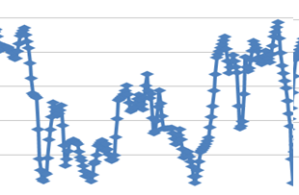
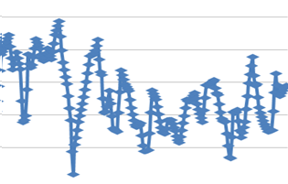
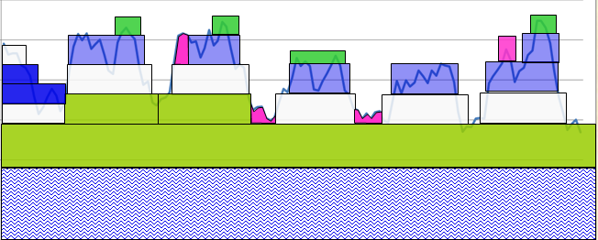
The stochastic unit commitment problem
The unit commitment problem
  Rolling forward with perfect forecast of actual wind, demand, …
hour 0-24
hour 25-48
hour 49-72

Slide 26
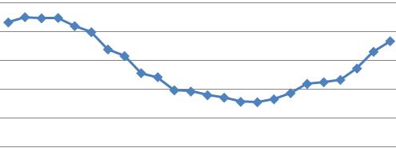
The stochastic unit commitment problem
When planning, we have to use a forecast of energy from wind, then live with what actually happens.
hour 0-24
Notes:
With this sequence of slides I am going to illustrate

Slide 27
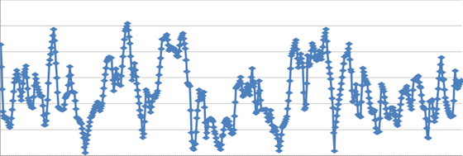
The stochastic unit commitment problem
The unit commitment problem
  Stepping forward observing actual wind, making small adjustments
hour 0-24
Notes:
With this sequence of slides I am going to illustrate

Slide 28
The stochastic unit commitment problem
The unit commitment problem
  Stepping forward observing actual wind, making small adjustments
hour 0-24
Notes:
With this sequence of slides I am going to illustrate

Slide 29
The stochastic unit commitment problem
The unit commitment problem
  Stepping forward observing actual wind, making small adjustments
hour 0-24
Notes:
With this sequence of slides I am going to illustrate

Slide 30
The stochastic unit commitment problem
The unit commitment problem
  Stepping forward observing actual wind, making small adjustments
hour 0-24
Notes:
With this sequence of slides I am going to illustrate

Slide 31
The stochastic unit commitment problem
The unit commitment problem
  Stepping forward observing actual wind, making small adjustments
hour 0-24
Notes:
With this sequence of slides I am going to illustrate

Slide 32
The stochastic unit commitment problem
The unit commitment problem
  Stepping forward observing actual wind, making small adjustments
hour 0-24
Notes:
With this sequence of slides I am going to illustrate

Slide 33
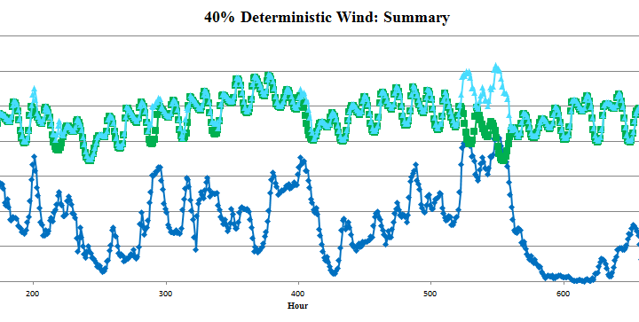
Analysis of wind
40 percent wind scenario

Slide 34
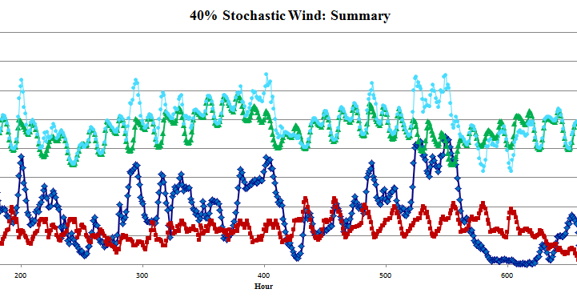
Variability vs. uncertainty
40 percent wind scenario

Slide 35
The stochastic unit commitment problem
The effect of modeling uncertainty in wind

Slide 36
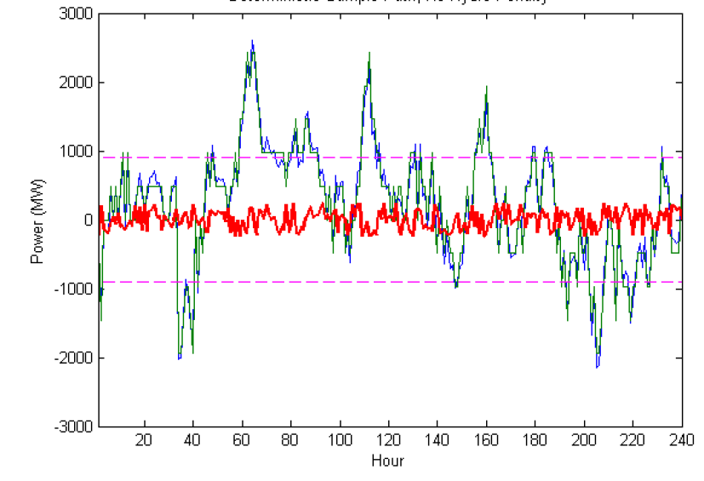
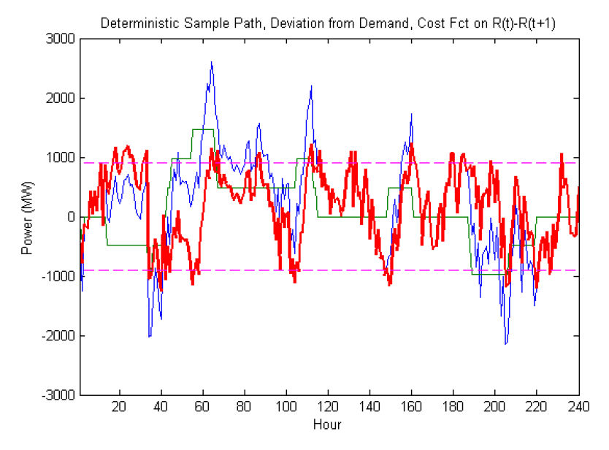
Regulation using hydroelectric power
Deterministic wind:
No hydro penalty
Red line gives difference between desired and actual output, showing almost perfect regulation.
Hydro penalty limits our ability to regulate the dam.
Deviations from desired output stay within 5 percent band.

Slide 37
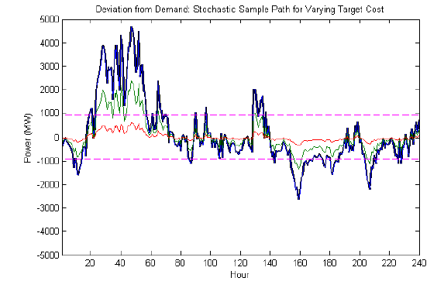
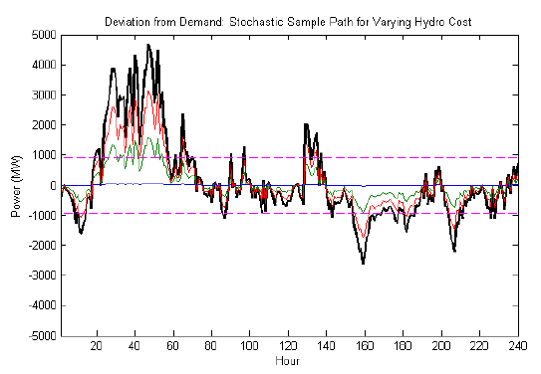
Regulation using hydroelectric power
Stochastic wind:
Effect of varying penalty for deviating from target energy production
Effect of varying penalty for controlling dam output.

Slide 38
Challenges
We still need to get the electricity from where it is generated (primarily in the north) to where it is used.
We also have to combine wind and hydro in the same grid.
Can China do this?

Slide 39
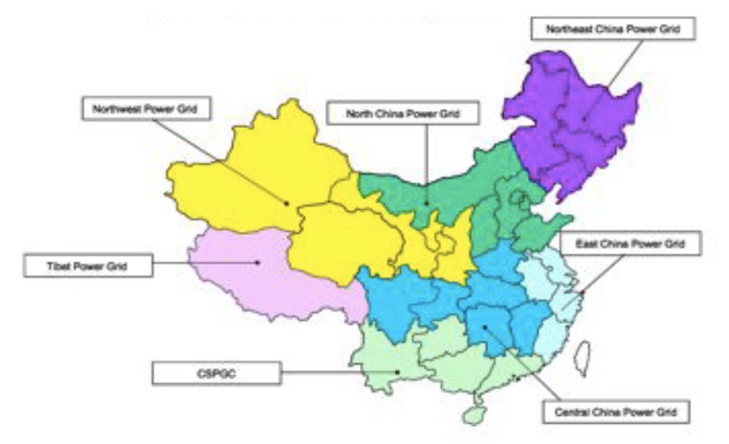
The Chinese power system

Slide 40
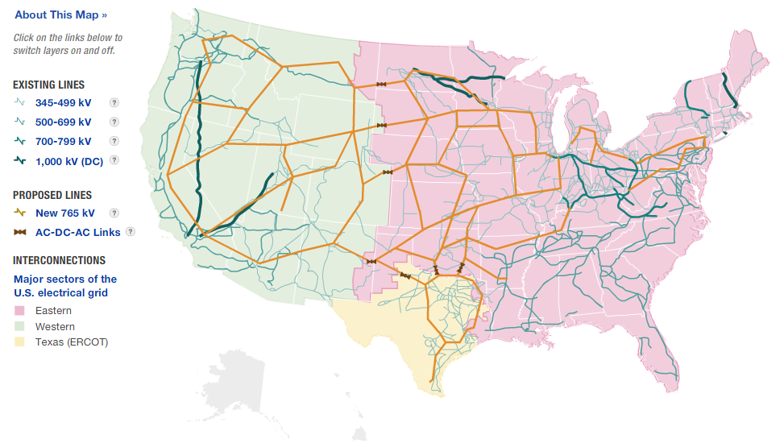
The U.S. power system

Slide 41
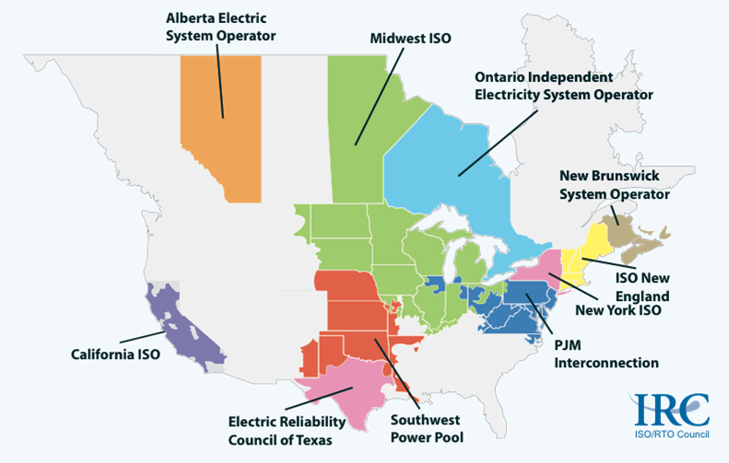
The U.S. grid
RTO’s and ISO’s in the U.S.

Slide 42
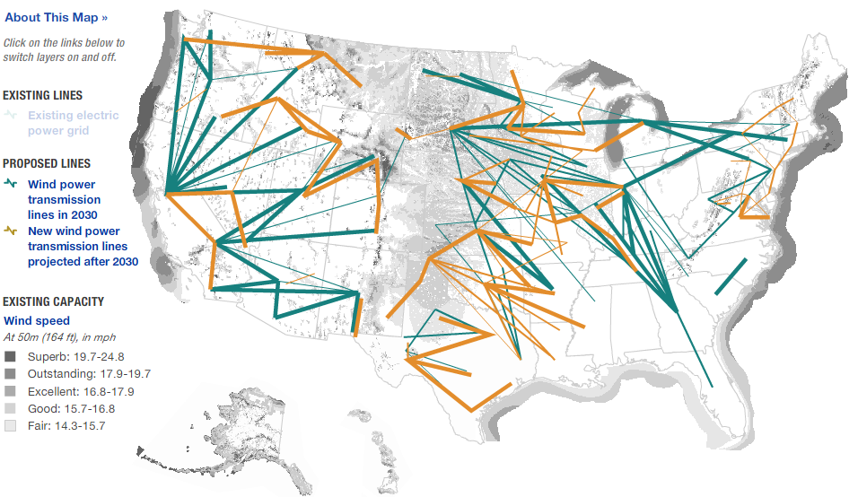
Wind in the U.S.

Slide 43
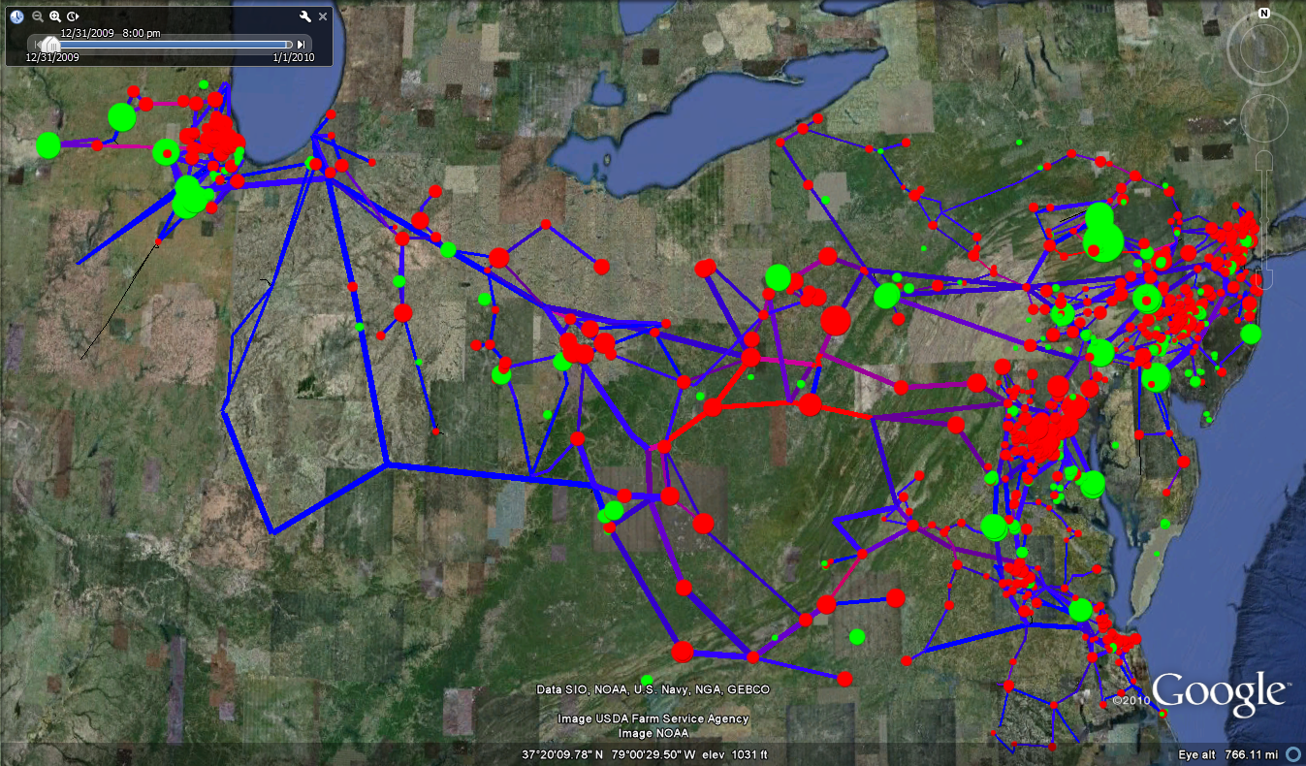
The PJM high voltage grid

Slide 44
Conclusions
Hydroelectric power can help regulate variations from wind in China.
Reduces, but does not eliminate, variation from wind.
Seasonality is a major challenge. It is unlikely that the Three Gorges dam can play a significant role in storing energy across seasons.
But this requires a national power grid and sophisticated algorithms for forecasting generation and loads.

