Slide 1
Scalable Transactional Memory Scheduling
Gokarna Sharma
(A joint work with Costas Busch)
Louisiana State University

Slide 2
Agenda
Introduction and Motivation
Scheduling Bounds in Different Software Transactional Memory Implementations
Tightly-Coupled Shared Memory Systems
Execution Window Model
Balanced Workload Model
Large-Scale Distributed Systems
General Network Model
Future Directions
CC-NUMA Systems
Hierarchical Multi-level Cache Systems

Slide 3
Retrospective
1993
A seminal paper by Maurice Herlihy and J. Eliot B. Moss: Transactional Memory: Architectural Support for Lock-Free Data Structures
Today
Several STM/HTM implementation efforts by Intel, Sun, IBM; growing attention
Why TM?
Many drawbacks of traditional approaches using Locks, Monitors: error-prone, difficult, composability, …
lock data
modify/use data
unlock data
Only one thread can execute

Slide 4
TM as a Possible Solution
Simple to program
Composable
Achieves lock-freedom (though some TM systems use locks internally), wait-freedom, …
TM takes care of performance (not the programmer)
Many ideas from database transactions
atomic {
modify/use data
}
Transaction A()
atomic {
B()
…
}
Transaction B()
atomic {
…
}

Slide 5
Transactional Memory
Transactions perform a sequence of read and write operations on shared resources and appear to execute atomically
TM may allow transactions to run concurrently but the results must be equivalent to some sequential execution
Example:
ACI(D) properties to ensure correctness
Initially, x == 1, y == 2
T1
atomic {
x = 2;
y = x+1;
}
atomic {
r1 = x;
r2 = y;
}
T2
T1
x = 2;
y = 3;
r1 == 1
r2 = 3;
T2
T1 then T2 r1==2, r2==3
Incorrect r1 == 1, r2 == 3
T2 then T1 r1==1, r2==2

Slide 6
Software TM Systems
Conflicts:
A contention manager decides
Aborts or delay a transaction
Centralized or Distributed:
Each thread may have its own CM
Example
Initially, x == 1, y == 1
T1
atomic {
…
x = 2;
}
atomic {
y = 2;
…
x = 3;
}
T2
T1
atomic {
…
x = 2;
}
atomic {
y = 2;
…
x = 3;
}
T2
conflict
conflict
Abort undo changes (set x==1) and restart
Abort (set y==1) and restart OR wait and retry

Slide 7
Transaction Scheduling
The most common model:
m transactions (and threads) starting concurrently on m cores
Sequence of operations and a operation takes one time unit
Duration is fixed
Problem Complexity:
NP-Hard (related to
vertex coloring)
Challenge:
How to schedule transactions such that total time is minimized?
3
1
4
2
5
7
8
6

Slide 8
Contention Manager Properties
Contention mgmt is an online problem
Throughput guarantees
Makespan = the time needed until all m transactions finished and committed
Makespan of my CM
Makespan of optimal CM
Progress guarantees
Lock, wait, and obstruction-freedom
Lots of proposals
Polka, Priority, Karma, SizeMatters, …
Competitive Ratio:

Slide 9
Lessons from the literature…
Drawbacks
Some need globally shared data (i.e., global clock)
Workload dependent
Many have no theoretical provable properties
i.e., Polka – but overall good empirical performance
Mostly empirical evaluation
Empirical results suggest:
Choice of a contention manager significantly affects the performance
Do not perform well in the worst-case (i.e., contention, system size, and number of threads increase)

Slide 10
Scalable Transaction Scheduling
Objectives:
Design contention managers that exhibit both good theoretical and empirical performance guarantees
Design contention managers that scale with the system size and complexity

Slide 11
We explore STM implementation bounds in:
1. Tightly-coupled
Shared Memory Systems
2. Large-Scale
Distributed Systems
CC-NUMA and
Hierarchical Multi-level
Cache Systems
…
Processor
Processor
Memory
Processor
Memory
Processor
Memory
…
Comm. network
Processor
Processor
Processor
Processor
Level 1
Level 2
caches
Level 3

Slide 12
1. Tightly-Coupled Systems
The most common scenario:
multiple identical processors connected to a single shared memory
Shared memory access cost is uniform across processors
Processor
Processor
Processor
Processor
Processor
Shared Memory

Slide 13
Related Work
[Model: m concurrent equi-length transactions that share s objects]
Guerraoui et al. [PODC’05]:
First contention management algorithm GREEDY with O(s²) competitive bound
Attiya et al. [PODC’06]:
Bound of GREEDY improved to O(s)
Schneider and Wattenhofer [ISAAC’09]:
RandomizedRounds with O(C . log m) (C is the maximum degree of a transaction in the conflict graph)
Attiya et al. [OPODIS’09]:
Bimodal scheduler with O(s) bound for read-dominated workloads

Slide 14
Two different models on Tightly-Coupled Systems:
Execution Window Model
Balanced Workload Model

Slide 15
Execution Window Model [DISC’10]
[collection of n sets of m concurrent equi-length transactions that share s objects]
Transactions
1
2
3
. . .
n
1
2
Threads
3
. . .
m
m
n
Assuming maximum degree in conflict graph C and execution time duration τ
Serialization upper bound: τ . min(Cn,mn)
One-shot bound: O(sn) [Attiya et al., PODC’06]
Using RandomizedRounds: O(τ . Cn log m)

Slide 16
Contributions
Offline Algorithm: (maximal independent set)
For scheduling with conflicts environments, i.e., traffic intersection control, dining philosophers problem
Makespan: O(τ. (C + n log (mn)), (C is conflict measure)
Competitive ratio: O(s + log (mn)) whp
Online Algorithm: (random priorities)
For online scheduling environments
Makespan: O(τ. (C log (mn) + n log² (mn)))
Competitive ratio: O(s log (mn) + log² (mn))) whp
Adaptive Algorithm
Conflict graph and maximum degree C both not known
Adaptively guesses C starting from 1

Slide 17
Intuition
Introduce random delays at the beginning of the execution window
n’
Transactions
1
2
3
n
1
. . .
n
1
2
3
2
3
m
m
m
n
Random interval
n
Random delays help conflicting transactions shift avoiding many conflicts

Slide 18
Experimental Results [APDCM’11]
Polka – Published best CM but no provable properties
Greedy – First CM with both properties
Priority – Simple priority-based CM

Slide 19
Balanced Workload Model [OPODIS’10]

Slide 20
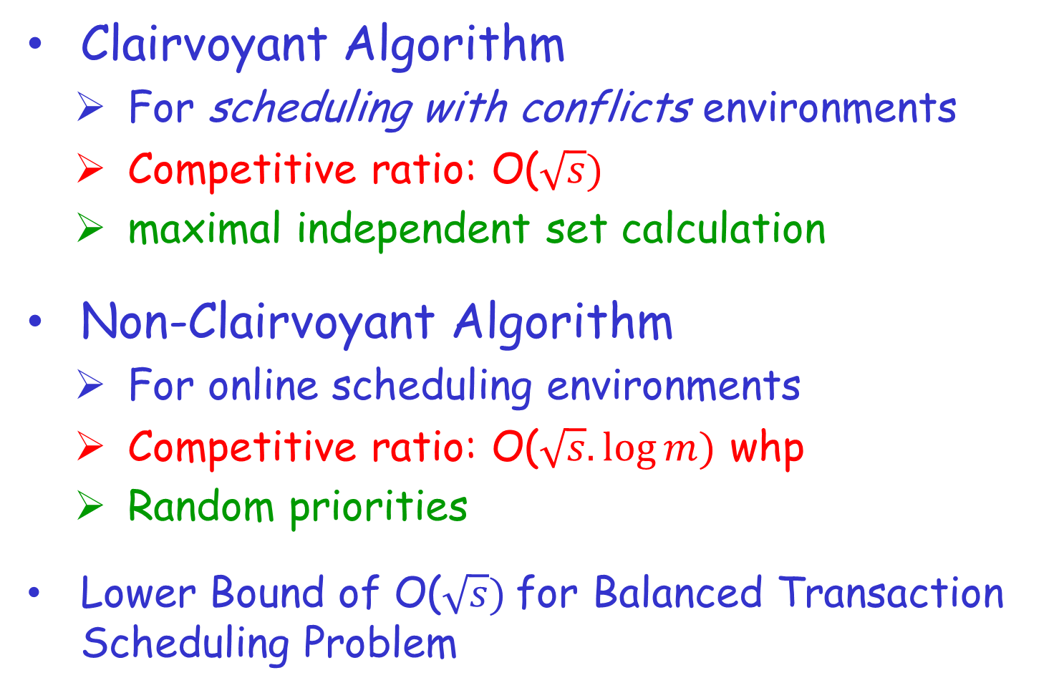
Contributions

Slide 21
An Impossibility Result
No polynomial time balanced transaction scheduling algorithm such that for β = 1 the algorithm achieves competitive ratio smaller than
Idea: Reduce coloring problem to transaction scheduling
|V| = n, |E| = s
Clairvoyant algorithm is tight
T3
T1
3
1
T4
4
R12
T2
2
T5
5
R48
T7
7
T8
T6
8
6
τ = 1, β = 1
Time | Step 1 | Step 2 | Step 3
Run and commit | T1, T4, T6 | T2, T3, T7 | T5, T8

Slide 22
2. Large-Scale Distributed Systems
The most common scenario:
Network of nodes connected by a communication network (communicate via message passing)
Communication cost depends on the distance between nodes
Typically asymmetric (non-uniform) among nodes
Processor
Processor
Processor
Processor
Processor
Memory
Memory
Memory
Memory
Memory
Communication Network

Slide 23
STM Implementation in Large-Scale Distributed Systems
Transactions are immobile (running at a single node) but objects move from node to node
Consistency protocol for STM implementation should support three operations
Publish: publish the created object so that other nodes can find it
Lookup: provide read-only copy to the requested node
Move: provide exclusive copy to the requested node

Slide 24
Related Work
[Model: m transactions ask for a share object resides at some node]
Demmer and Herlihy [DISC’98]:
Arrow protocol : stretch same as the stretch of used spanning tree
Herlihy and Sun [DISC’05]:
First distributed consistency protocol BALLISTIC with O(log Diam) stretch on constant-doubling metrics using hierarchical directories
Zhang and Ravindran [OPODIS’09]:
RELAY protocol: stretch same as Arrow
Attiya et al. [SSS’10]:
Combine protocol: stretch = O(d(p,q)) in overlay tree, where d(p,q) is distance between requesting node p and predecessor node q

Slide 25
Drawbacks
Arrow, RELAY, and Combine
Stretch of spanning tree and overlay tree may be very high as much as diameter
BALLISTIC
Race condition while serving concurrent move or lookup requests due to hierarchical construction enriched with shortcuts
All protocols analyzed only for triangle-inequality or constant-doubling metrics

Slide 26
A Model on Large-Scale Distributed Systems:
General Network Model

Slide 27
General Approach:
Hierarchical clustering

Slide 28
General Approach:
Hierarchical clustering

Slide 29
At the lowest level every node is a cluster
Directories at each level cluster, downward pointer if object locality known

Slide 30
Requesting node
Predecessor node

Slide 31
Send request to leader node of the cluster
upward in hierarchy

Slide 32
Continue up phase until downward pointer found

Slide 33
Continue up phase

Slide 34
Continue up phase

Slide 35
Downward pointer found, start down phase

Slide 36
Continue down phase

Slide 37
Continue down phase

Slide 38
Predecessor reached

Slide 39
Contributions
Spiral Protocol
Stretch: O(log² n. log D) where,
n is the number of nodes and D is the diameter of general network
Intuition: Hierarchical directories based on sparse covers
Clusters at each level are ordered to avoid race conditions

Slide 40
Future Directions
We plan to explore TM contention management in:
CC-NUMA Machines (e.g., Clusters)
Hierarchical Multi-level Cache Systems

Slide 41
CC-NUMA Systems
The most common scenario:
A node is an SMP with several multi-core processors
Nodes are connected with high speed network
Access cost inside a node is fast but remote memory access is much slower (approx. 4 ~ 10 times)
Processor
Processor
Processor
Processor
Memory
Memory
Processor
Processor
Processor
Processor
Interconnection Network

Slide 42
Hierarchical Multi-level Cache Systems
The most common scenario:
Communication cost uniform at same level and varies among different levels
Processor
Processor
Processor
Processor
Processor
Processor
Processor
Processor
Level 1
Level 2
caches
Level k-1
Level k
Hierarchical Cache
w₂
Core Communication Graph
w_{i}: edge weights
P
P
P
P
P
P
P
w₁
P
w₃

Slide 43
Conclusions
TM contention management is an important online scheduling problem
Contention managers should scale with the size and complexity of the system
Theoretical as well as practical performance guarantees are essential for design decisions

