Slide 1
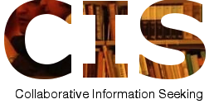
Social and Collaborative Information Seeking (SCIS): Space, Time, and Beyond
Chirag Shah
Rutgers University
Goal: Create synergy through collaboration (1+1>2)
Approaches:
(1) Create appropriate context (user driven)
(2) Provide appropriate assistance (system driven)
collab.infoseeking.org
social.infoseeking.org
infoseeking.org

Slide 2
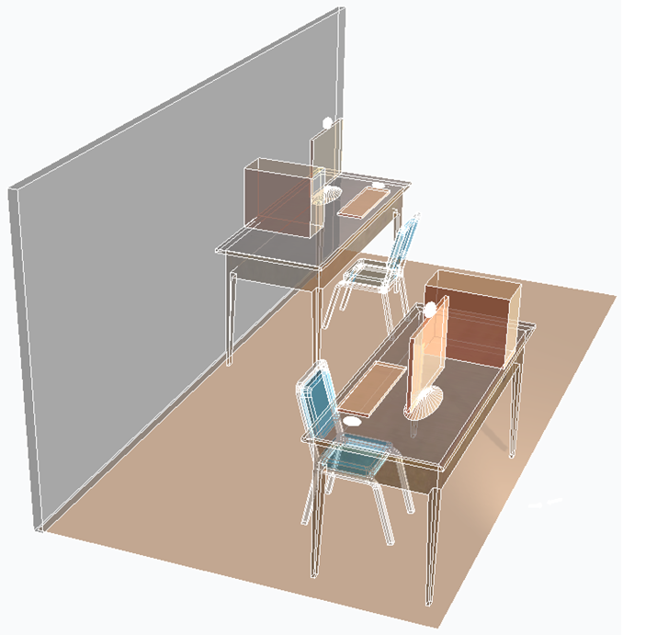
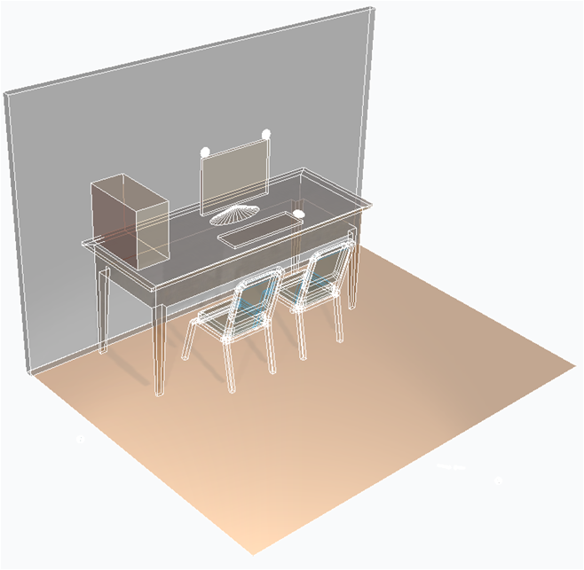
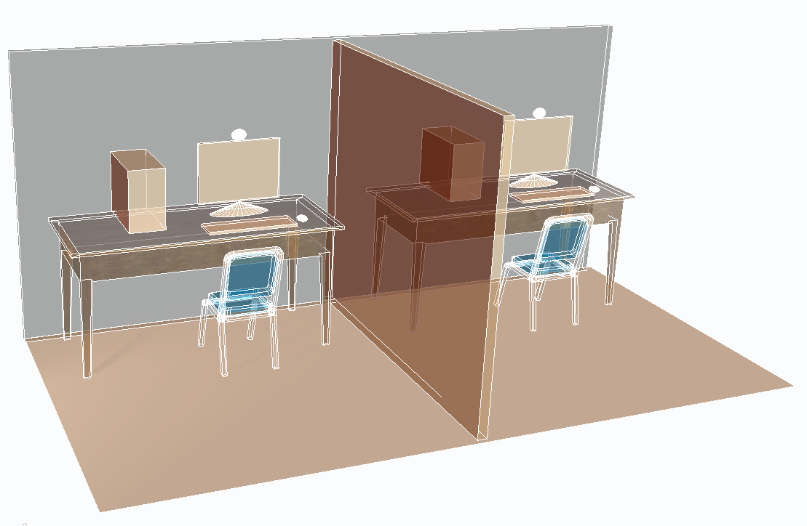
(1) Create appropriate context (user driven)
Spatial context (SIGIR 2011, IP&M 2012)
Temporal context (ASIST 2012)
Remotely located collaborators have more diversity and better discovery of information.
Co-located collaborators have more social interactions.
Co-located collaborators with a shared workstation do less, but have better quality.
Synchronously working collaborators do division-of-labor around the topic.
Asynchronously working collaborators do division-of-labor around the process.
A collaboration generally continues to be productive as long as the number of subtopics and/or subprocesses are fewer than the team members.

Slide 3
(2) Provide appropriate assistance (system driven)
Prospector
Miner
Gatherer
Surveyor
Prospector – Explores promising
areas for mining spots
Miner – Digs deeper looking
for relevant information
Gatherer– Explores highly promising information (higher relevance)
Surveyor – Digs further to explore more diverse information (higher novelty)
SIGIR 2008
IP&M 2010
User-driven mediation
System-based mediation
Annotated document
Bookmarked document
Role Mining
Role Mining
Annotated document
Bookmarked document
***
***
***
***
…
*
**
*
**
*
**
*
**
q1
q3
q5
q6
Shared
information
need
Reader
Expert
***
***
…
**
**
***
q2
*
*
*
**
q4
Querier
q7
Novice
SIGIR 2014
Annotated document
Annotated document

