Slide 1

Exploring the Group within Social and Collaborative Search
Individuals
Small Groups
Pairs
Organizations
Communities
Society
Small Groups Work via Collaboration
Key attributes
  Interaction
  Interdependence
  Awareness
  Shared Understanding
SCIS Workshop, Rutgers University
May 14th, 2015
Dr. Sandra Toze
Notes:
As you can see in the diagram groups are bounded – contain individuals who bring their skills aptitudes and knowledge to the group, but on the other side exist within and organization determines the culture, type of resources, and values.
Size is a component of groups -2 -12 members
Groups Shared goals
Bring a Diversity of Resources
Socially influenced & motivated (group think/power & conflict)
Develop norms and rules over time
In short Groups are Complex adaptive social organisms –where the key properties emerge over time.
Groups work through Collaboration – Highlight what that means?
What do we know about groups?
Information Science – examine seeking in ethnographic studies
CSCW/Information Retrieval – design and test tools for collaborative SEARCH – related to the FIND task
Organizational behaviour – focus incentives & barriers to sharing.
What are the gaps that need to be addressed.
INTERDISCIPLINARITY – bring together perspectives

Slide 2
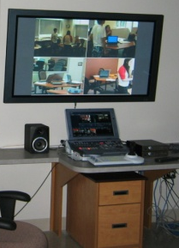
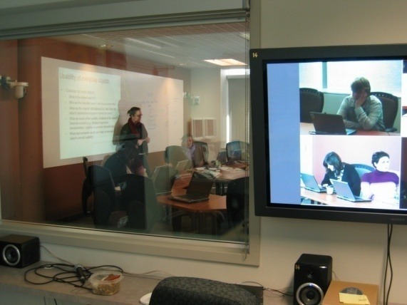
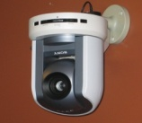

How Can We Study Groups?
Key
Lab Orientation
Study Events
Demographics
Data Collection
Human
Observation
Digital Diaries
Video
Capture
E-Mail
Group Processes
Task Work
Audio
Recording
Screen
Capture
Individual Survey
Individual Session(s)
Group Interview
Notes:
Protocol developed to answer this need.
Participants are real groups
Work on real assignments/tasks – outside of the study
Groups are allowed to set their own schedule
Hold all meetings in the “lab” where there activities can be video and audio taped
Groups agree to use computers with tracking software installed
Allow Researcher to be a silent partner – included in all group communication
Agree to complete diaries between sessions
Agree to complete an individual survey and group interview after their assignment/task is complete
Applied it to 7 groups who required
25 sessions
and 256 stages to complete tasks,
comprising almost 60 hours of video.
Collected data from 2 types of groups
Single Session
Multiple Session

Slide 3
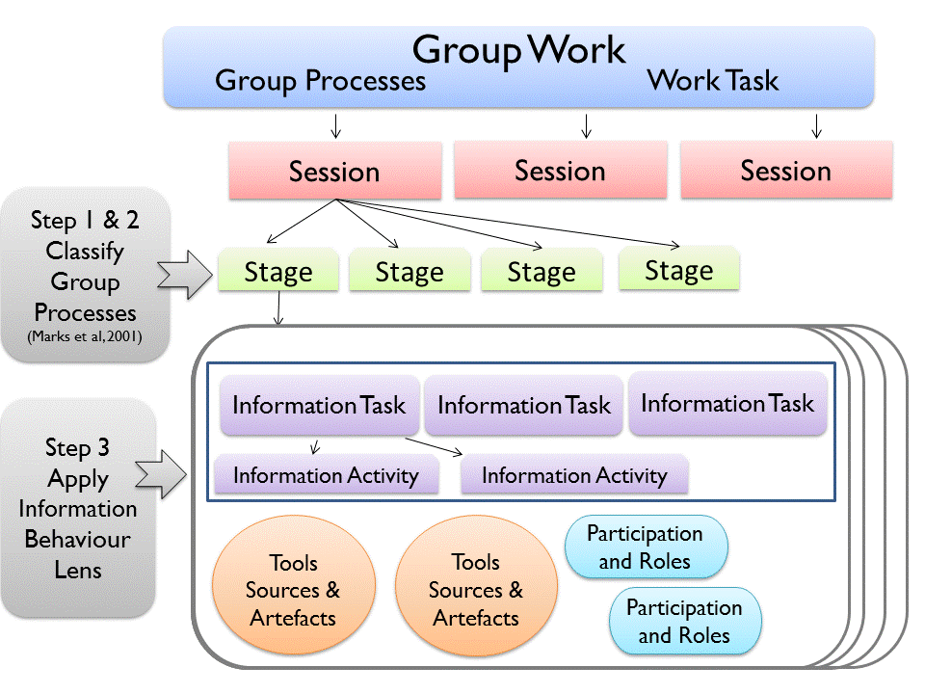
Applying an Information Lens
Notes:
For each of these the coding was done based on the following:
Stages – Marks, Mathieu and Zarraro –
Tasks – By goal (i.e. Taylor/Limberg/Freund)
Activities – (Talja/Blake and Pratt)
Tools – Emerged
Sources – Emerged
Participation & Roles – Emerged
I followed the same process of analysis for each group – walk them through this.
Started with a collection of existing codes from individual work – which I tested to see if they applied to groups
New codes emerged through the process.
Coding was iterative –
I went through each single session group
Needed to go back as new codes emerged
Looked across all the single groups to confirm codes and resolve any issues
Then I proceeded with the multiple session groups
During the coding process I presented my work at PhD colloquium – and received feedback
After all the coding was complete I provided my dictionaries of codes/definitions and examples to a recent PhD graduate – who then applied them to a representative number of sessions. We met to discuss, and final adjustments were made.
The final set of codes included:
3 phases of group activities – Plan, Do, Monitor
3 Information task (Need, Find, Use)
8 information goals
Added Keep Track, Re-Find and Entertainment
19 information activities identified
Added Signal Need, Generate, Question/Clarify and Negotiate
Multiple Sources used including people
Multiple Tools Required
Creation of complex arefacts
Shifts in participation
10 different Roles

Slide 4
Information Tasks within Group Work
Each Task over Time …
Plan
Mission Analysis
Strategy Formulation
Do
Decision Making
Monitor
Monitoring Progress
Goal Specification
Systems Monitoring
Team Monitoring
Generating
Problem Solving
Coordination
Need
Find
Use
Modification of Marks, Mathieu & Zaccaro (2001)
Notes:
WHAT DID I FIND? To answer the 1st Research Question.
While each group had their own trajectory – across all the groups I found the following:
Groups needed to work with information to accomplish 3 key phases of Activities – Planning/Doing and Monitoring
Not all tasks included all 3 phases – and the phases were not necessarily in the same order
Each of these phases had a particular information process
Time spent in each phase depending on a range of factors (which need more examination): Task complexity, Information overload, Time pressure, Attitude towards group work, Diversity
Planning Example
Look at assignment – and particular part of the assignment.
Assess what they really needed to do?
Someone might ask – do we have to?
Another would pull out the assignment
Would share with the group, Group would discuss – make a decision – which may or may not be written down, and continue
Planning most frequently involved the group – but at time
During Monitoring Groups Used Information to
Make Decisions, Decide How to, Keep Track
Information Tasks/Activities: Need, Signal Need, Recognize Need, Understand Need, Share (other members as sources), Use
Questioning & Clarifying
Who, Individual, Group, Sub Group
Roles - Leader, Director
Doing – Most Complex activities
3 group tasks – Problem Solving, Decision Making, Generate
To Generate Groups used information to: Make a decision, Keeping Track, Confirm, Find facts
Information Tasks/Activities - All
Who - Individual, Pair, Sub Group, Group
Roles - Director, Leader, Analyst, Reader, Scribe, Searcher

Slide 5
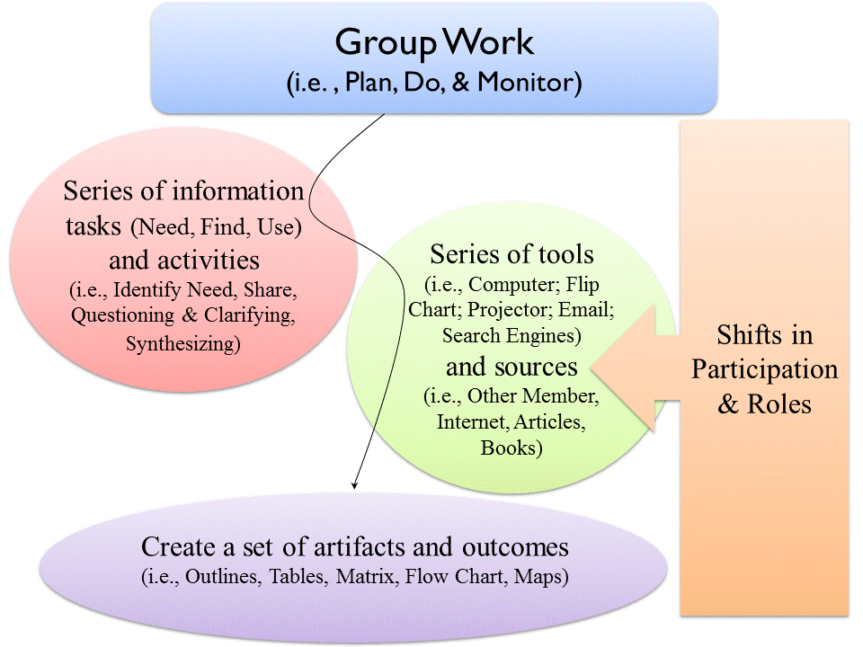
Core Elements of a Group Information Process
Notes:
The first model focussed on the GROUP TASK level – at the procedural level.
This next model looks specifically at the elements of GIP – and how they emerge.
How did these elements fit together?
The mechanics of how groups actually work with information emerged through the detailed analysis of group information interactions
Information tasks (Need, Find, Use) – are triggered in all phases Doing, Monitoring, Finding
To accomplish the tasks the groups needed a range of 19 different information activities to respond to specific information task goals.
These activities involved sources (including humans) and tool. The tools were used to help groups take bits of information and turn them into group artefacts. During all these activities participation varied, and groups at times used roles to help manage this process.

Slide 6
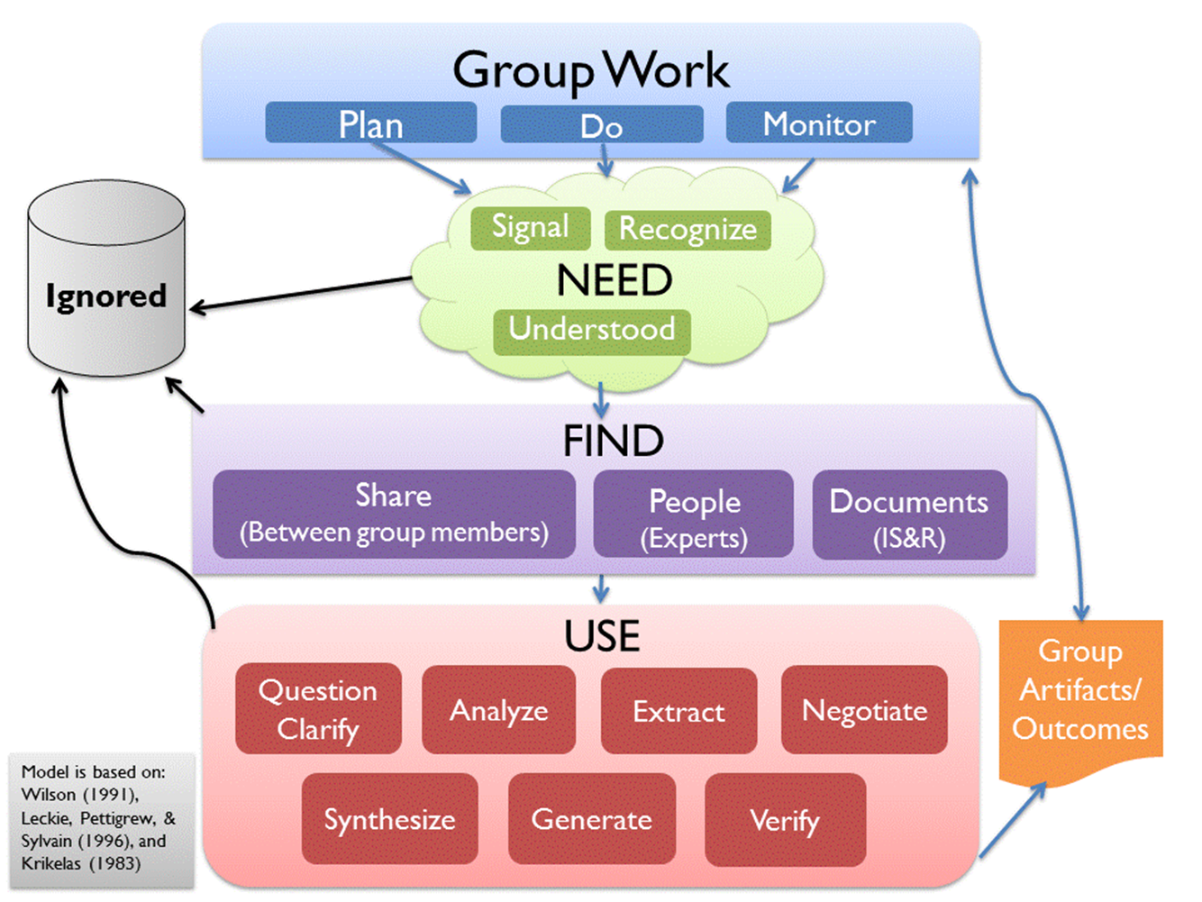
Group Information Process Model
Examine transitions between planning, doing, and monitoring
When, why, & how information is ignored
When are needs accepted and when they are ignored?
How do the social aspects of groups affect information needs?
Examine triggers for shift to external seeking rather than sharing
How information activities translate into changes in artefacts
Relationship between information use and shared understanding
Social aspects of groups and group information use

