Slide 1
Sharing Health Expertise and Information
Mark S. Ackerman
SocialWorlds Research Group
University of Michigan, Ann Arbor
DIMACS Workshop on Social and Collaborative Information Seeking (SCIS)
May 14 - 15, 2015

Slide 2
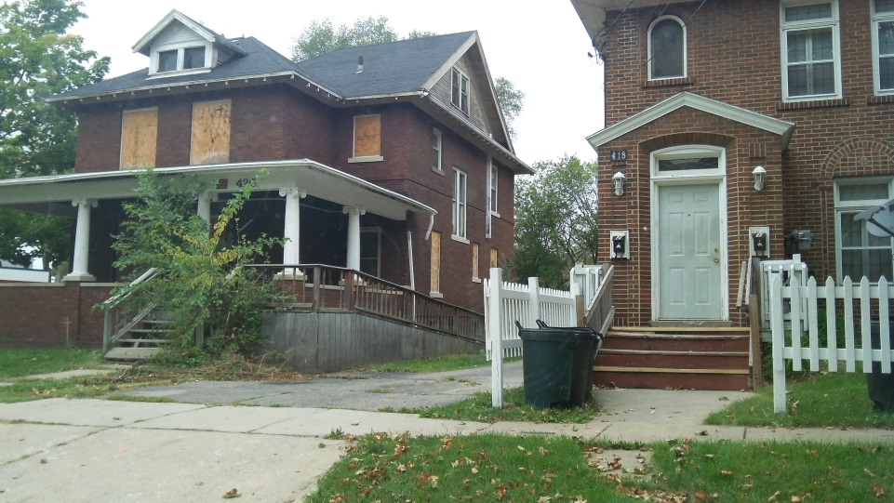
Flint
Flint, Michigan
Poverty rate of 38%
People with diabetes, high blood pressure, and kidney disease
Also diabetes educators
  Liz Kaziunas
  With Tiffany Veinot
photos – Elizabeth Kaziunas

Slide 3
Translations in Information Work
People need translations from medical advice into the local context
  Finding low-cost or free prescription drugs
  Learning how to obtain help in the absence of insurance

Slide 4
Translations in Information Work
These translations occur within social worlds
  Participants tried to find solutions that would work within their social contexts
Information seeking and sharing occurs within social contexts (social worlds)
  Medical viewpoint
    Health educators are mediators
  Friends and family
  People in their churches, etc.
Need to understand async sharing within social contexts among networks of people

Slide 5
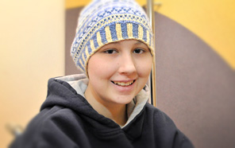
Information in Bone Marrow Transplant
Studies of adult BMT clinic (Ayse Buyuktur) and pediatric BMT ward (Liz Kaziunas)
Focus shift to teams
  Not just clinician teams
  Also requires teamwork among patients, caregivers, family
    And among families
http://my.clevelandclinic.org/

Slide 6
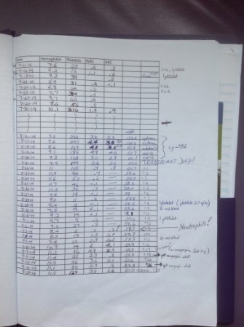
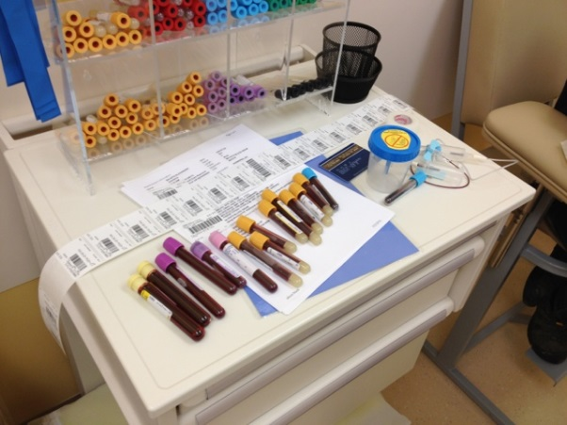
Information in Bone Marrow Transplant
Finding: Parents are no longer part of a clear social world
  Parents are between the medical world and their previous social worlds – neither one nor the other
    Very emotionally draining
Finding: Within BMT, information has emotional meaning
  How is the emotive component understood and shared?
  Example: knowledge about blood work is shared among parents
photos – Elizabeth Kaziunas

Slide 7
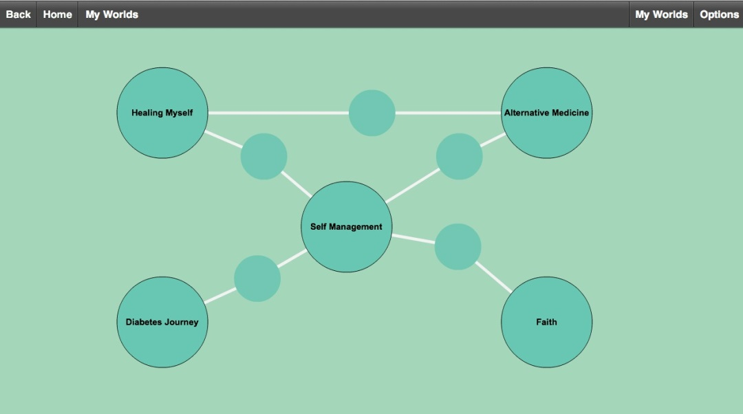
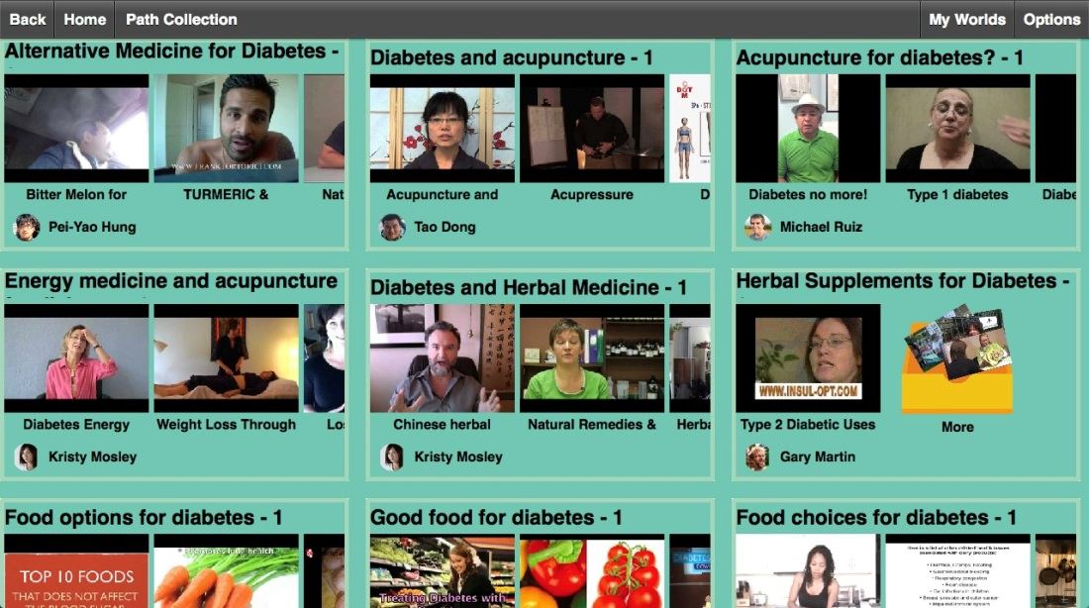
FIT
Prototype for reconciling discrepant health viewpoints
People can annotate and share video clips about a condition
  Within differing social viewpoints
People leave translations for one another
  Pei-yao Hung and Liz Kaziunas

Slide 8
For more information
http://www.socialworldsresearch.org
ackerm@umich.edu

Slide 9
SocialWorlds Research Group
Ongoing
  PET application for pediatric BMT (with Sung Choi, MD and David Hanauer, MD)
  FIT application development (Pei-Yao Hung)
  JIT information for long-term SCI care (Ayse Buyuktur, with Mark Newman)
  Nightscout open source diabetes monitoring (Liz Kaziunas, with Silvia Lindtner and Joyce Lee, MD)
  Jackson community behavior healthcare (Liz Kaziunas, with Michael Klinkman, MD)
Older studies
  Home monitoring of depression patients (Barbara Mirel)
  Diabetes support (Barbara Mirel)
  Depression support in Flint, Michigan (Barbara Mirel, Mike Klinkman)
  Psycho-social information in medical care (Xiaomu Zhu)
  Diabetes support (trajectory matching) (Jina Huh)
  Flint translation work (Liz Kaziunas, with Tiffany Veinot)
  Family health activation in schools (Jasmine Jones)
  Information needs in pediatric bone-marrow transplant (Liz Kaziunas and Jasmine Jones)
  Information scaffolding in bone-marrow transplant (Ayse Buyuktur)

