Slide 1
Wave and Surge Structural Damage to Shorefront Residential Properties from Hurricane Sandy
Andrew Kennedy
University of Notre Dame
Ning Lin
Princeton University
NSF CMMI 1314612
NSF CMMI 1314649

Slide 2
Project Overview
Two major goals:
To collect perishable data on residential building damage levels, failure modes, and building characteristics (elevation, specific connections/members failed, age)
To find damage gradients, and to identify and quantify their causes
Region around Ortley Beach/Seaside Park/Pelican Island, NJ
Five day field data collection, 5-8 field workers at a time
Supplemented by aerial and satellite photos, publicly available records, environmental data, numerical modelling

Slide 3
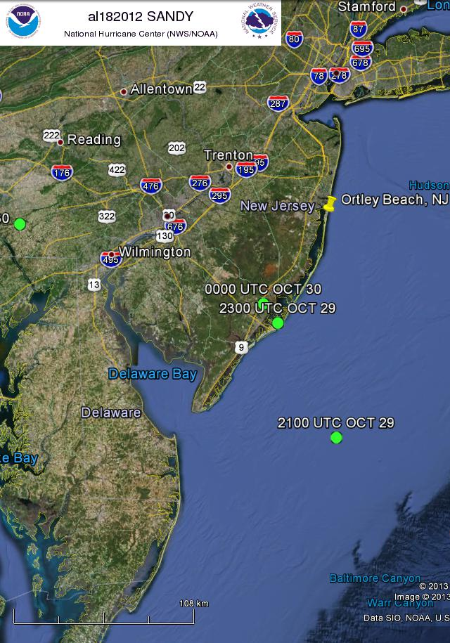
Geographic Overview
Ortley Beach
High waves, surge
Rutgers
Pelican Island
Smaller Waves
South Seaside Park
Largely Protected

Slide 4
Data Collected
House-by-house survey in target areas
Lat/Long
House properties (wood/RC/#stories)
Geotagged photos
Damage descriptions and levels
Many subcategories
House floor elevation
Supplemental info
House age
Assessed value/losses (from tax records)
Aerial/satellite photos
Measured environmental data during storm
Numerical modeling of hydrodynamics
Still in progress
■ 0-33% Damage ■ 33-66% ■ 67-100%

Slide 5
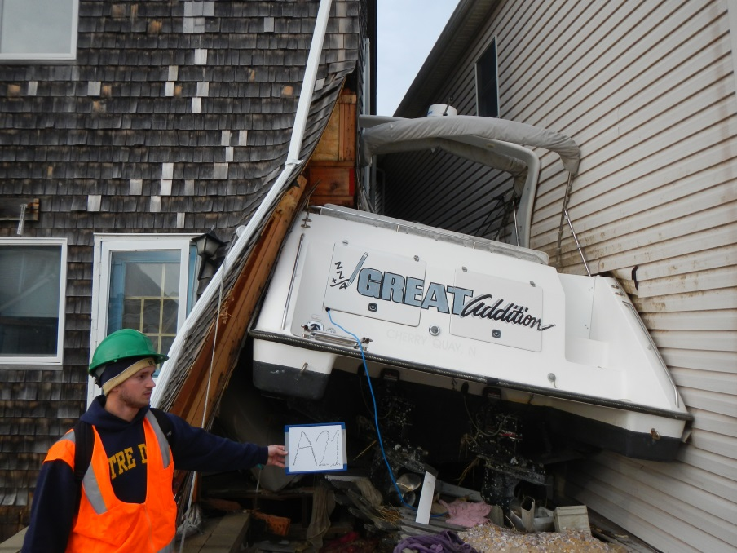
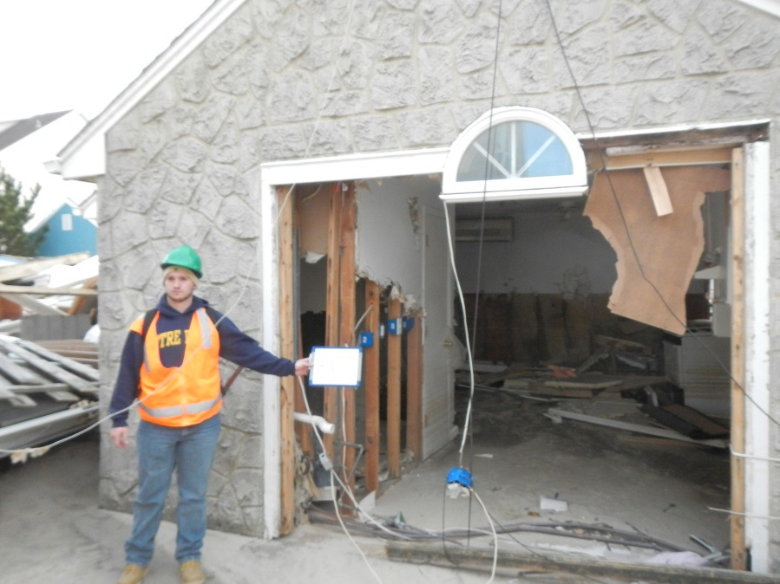
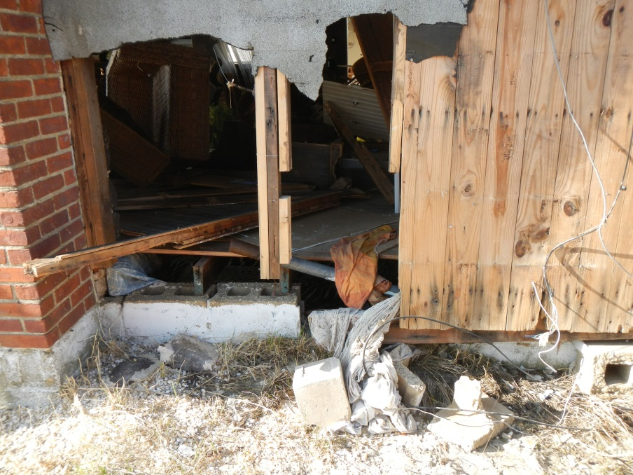
Sample Photos (of ~3900)
Exposed Areas of Ortley Beach
Pelican Island

Slide 6
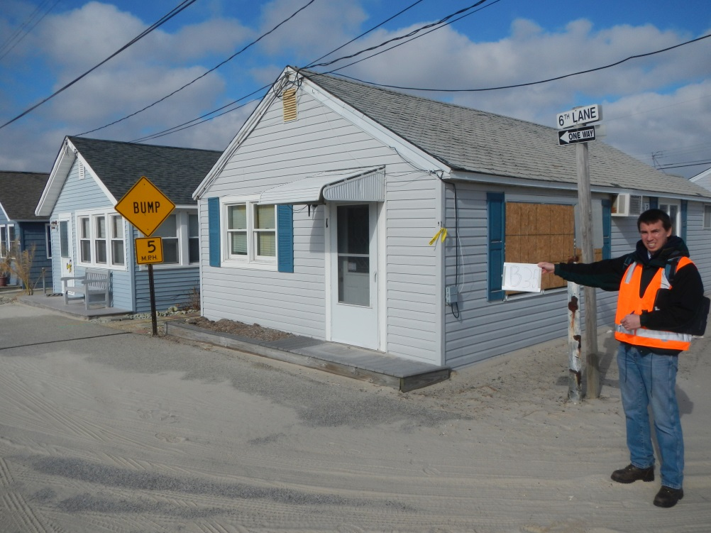
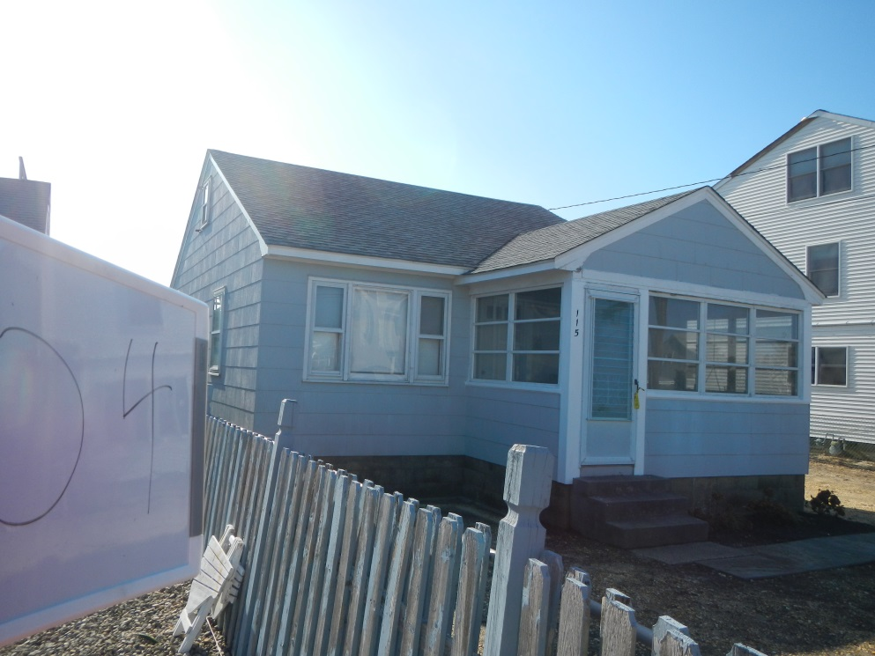
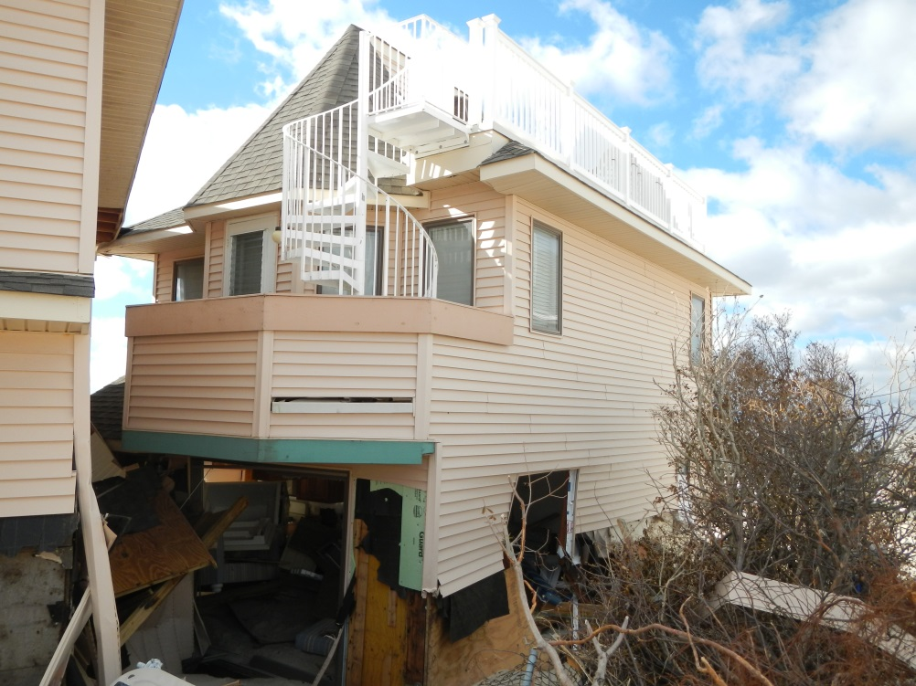
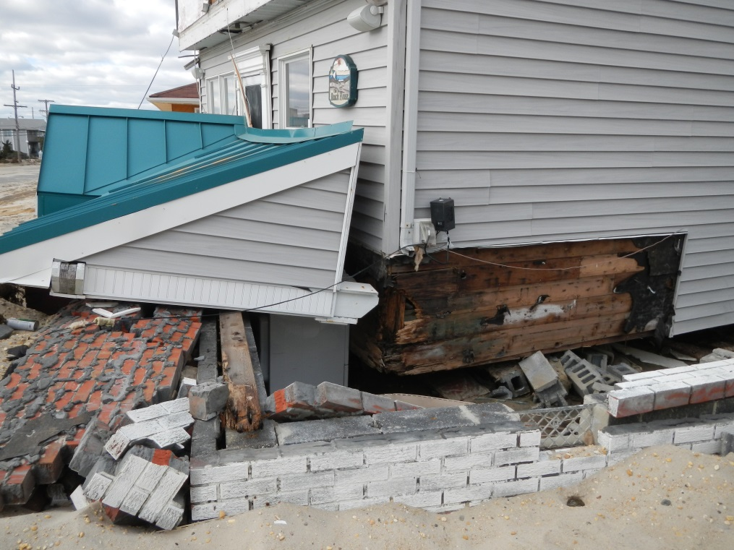
Sheltered Behind Dune South Seaside Park
Exposed to Surge but not Waves
Ortley New Construction
Ortley Sliding Failure

Slide 7
Houses far from Ocean Survived Better
Some trends clear, but distance and age are not only factors
Need hydrodynamic data to distinguish between conditions encountered by structure

Slide 8
Collaborative Geospatial-Enabled Data Management
Web-based system under development to collect all types of Sandy (and other) data sources under one umbrella
Geospatial Format – Grass GIS-based
Searchable Database
Measured data: damage, HWM, etc
Models
Links to external sources
Data sharing and collaboration
Will also be able to run some models
Will be inviting others to join as site development matures

Slide 9
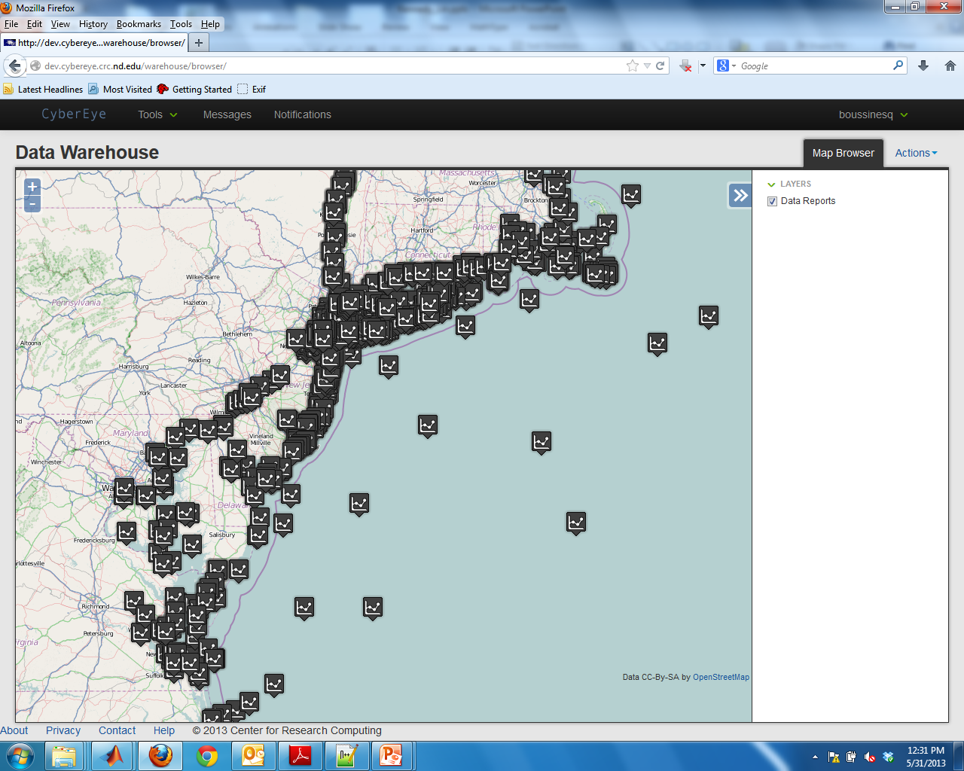
Data Points and Permanent Measuring Stations For Sandy

Slide 10
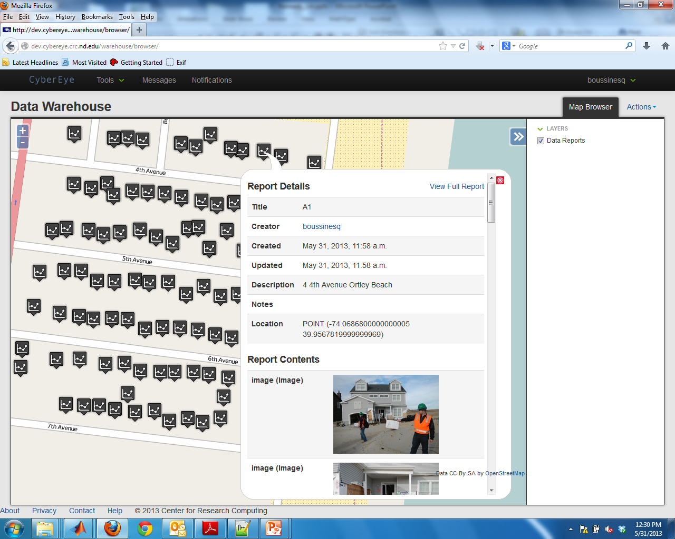
Part of Ortley Beach Dataset and Sample Popup

Slide 11
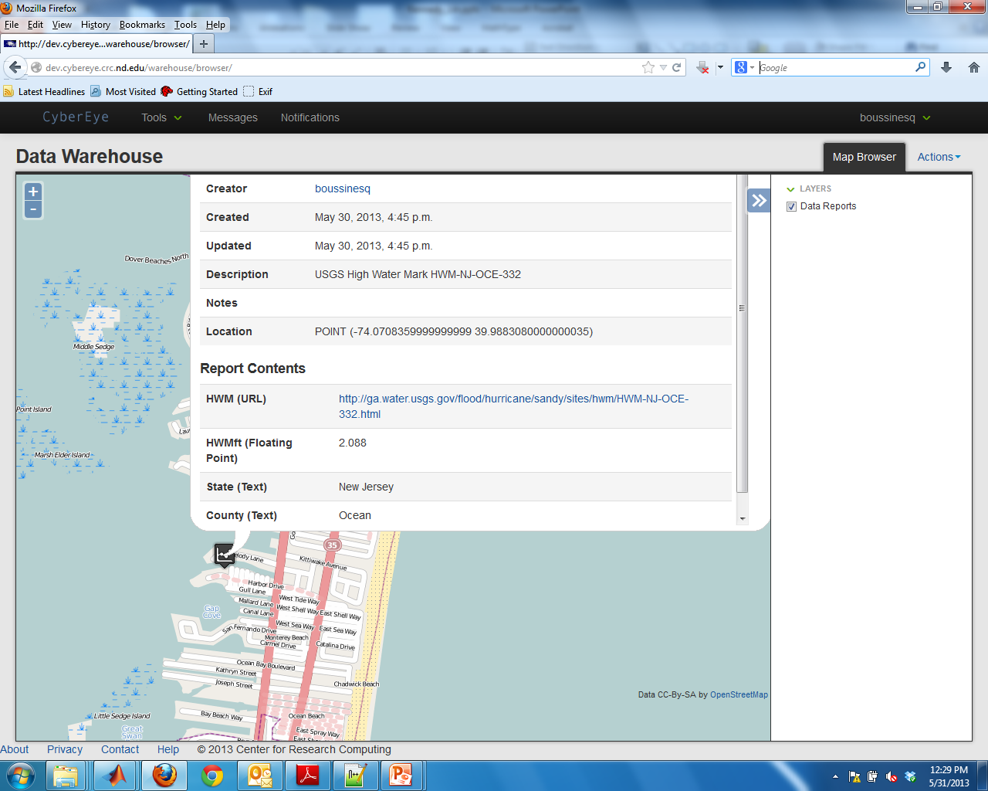
Example of External USGS HWM Data Point

Slide 12
Key Findings so Far
Poor connections on (mostly) older houses leads to house sliding
Also on some newer houses
Major wave damage near shoreline, decreasing inland
Minor wind damage: mostly shingles, a few debris impacts
Dune sheltering of extreme importance
Scattered scour damage in region
Standardization and consistency of damage estimates remains fluid

Slide 13
Continuing Work
Increasing datasets
Mainly survived/failed using satellite data
Hydrodynamic Simulations
SWAN+ADCIRC (Westerink Group)
Problems with lidar elevations post-storm
Integrating Sandy datasets online
Damage reporting standards
Link to other storms: Ike in particular
Fragility Curves
Damage state vs hydrodynamics, building properties, etc.

Slide 14
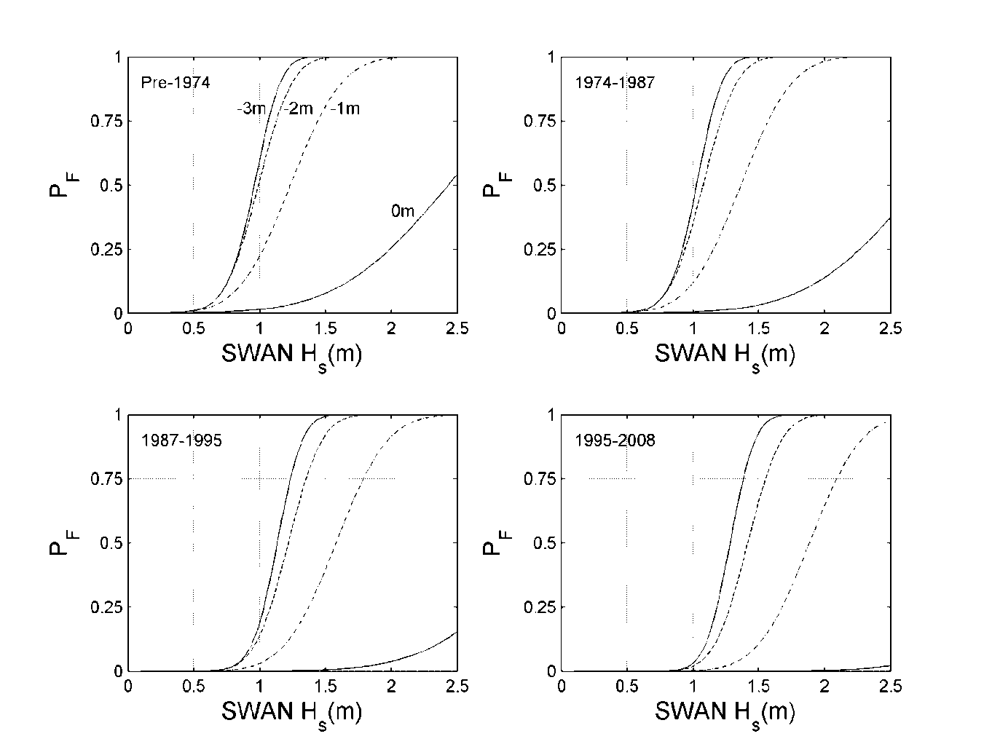
Fragility Example from Hurricane Ike
Lower Elevations
Higher Elevations
Fragility (failure) increases strongly with increasing wave heights
Older houses significantly more fragile
Higher house elevations (higher FB) survive better

Slide 15
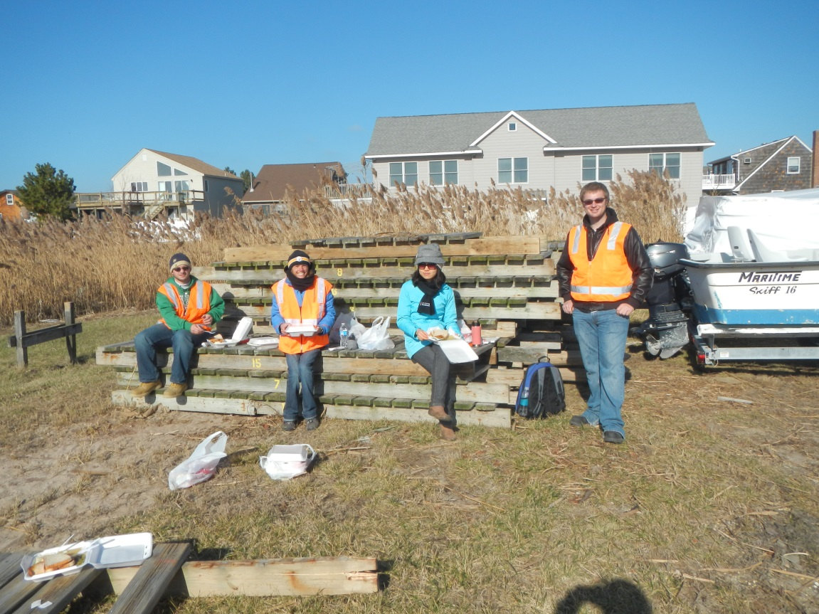
Questions?
Thanks to Tori Tomiczek, Margaret Owensby, Rich Estes, Luca Nagy, Trenton Jackson, Emmi Yonekura, Jonathan Glassman

