Slide 1



RAPID: Aerial Imaging and Ground-based Surveys for Post-Disaster Assessment of Areas Affected by Hurricane Sandy
Anu R. Pradhan, Ivan Bartoli and Antonios Kontsos, S. Ye, S. H.H. Nourzad, P.A. Vanniamparambil, F. Khan, S. Rajaram
Drexel University

Slide 2
Outline
Introduction
Research Vision
Research Questions
Data Management, Analysis and Visualization
Field Experiments

Slide 3
Introduction
Hurricane Sandy affected millions of people living along the east coast of United States.
7.5 million power outages were reported and thousands of people were without power two weeks after the hurricane (Anthony 2012).
Research Objective: Demonstrate the effectiveness multi-level points of observation and sensing for rapid post-disaster condition assessment of critical civil infrastructures.

Slide 4
Research Vision

Slide 5
Research Questions
What is the effectiveness of high-resolution and multi-spectral aerial images acquired by low altitude aerial systems (e.g., drones) to perform rapid infrastructure condition assessment?
How can the above aerial assessment guide rapid and efficient ground-based condition assessment?

Slide 6
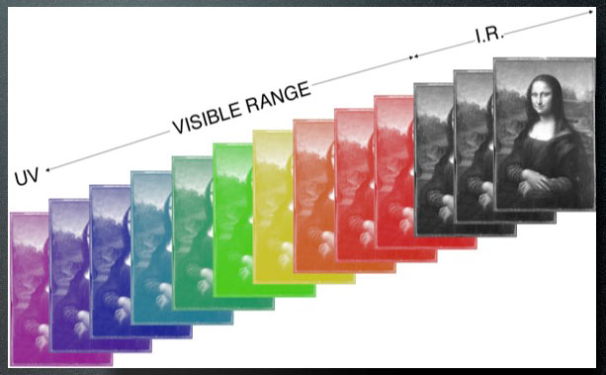
What is a multi-spectral Image?
It captures image data at specific frequencies across the electromagnetic spectrum.
Blue, 450-515..520 nm
Green, 515..520-590..600 nm
Red, 600..630-680..690 nm
Near infrared, 750-900 nm
Mid-infrared, 1550-1750 nm,
Thermal infrared, 10400-12500 nm
Source: http://www.lumiere-technology.com/

Slide 7
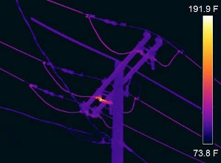
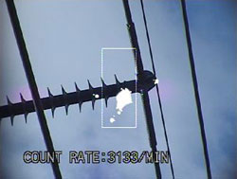
Why Multi-spectral Imaging for Powerlines?
Hot Spot Analysis
Corona Discharge
Source: www.osmoseutilities.com
http://www.powerlinepatrol.com/

Slide 8
Summary of Activities

Slide 9
Study Area and Data Collection
Figure (a) Study area; (b)-(c) Aerial RGB and IR images; (d)-(e) ground based RGB and IR images

Slide 10
Data Management and Visualization Challenges
Store and manage thousands of color, infrared and ultraviolet Images.
Visualize correlated color, infrared and ultraviolet images using an integrated visualization tool
Automatically identify objects of interest (e.g., damaged powerlines) from the images

Slide 11

Data Management Challenge: An Example
For each flight:
Approximately 10GB of Color Images, Infrared and Ultraviolet Images.
Around 19,000 images including Color, Infrared and Ultraviolet for each flight.

Slide 12
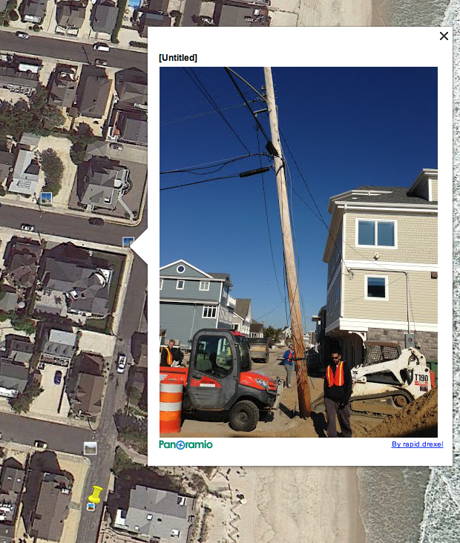
Data Management & Visualization
Geocoded field data (e.g., color and infrared images) are uploaded in Google server.
All geocoded images can be easily exported to any GIS software.
The field data is easily accessible.

Slide 13
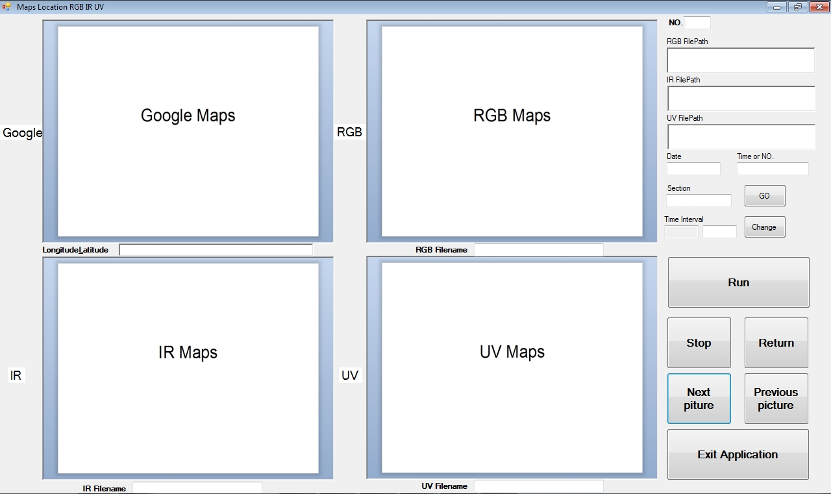
Data Management & Visualization

Slide 14
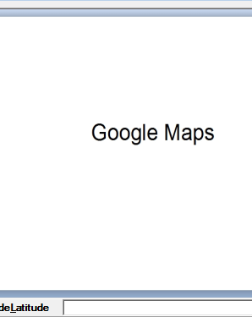
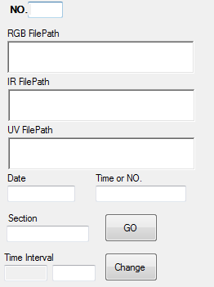
Data Management & Visualization
Show the number of current image
Show the time when the picture was taken
Show the coordinates of the location
Show the time interval
Video

Slide 15
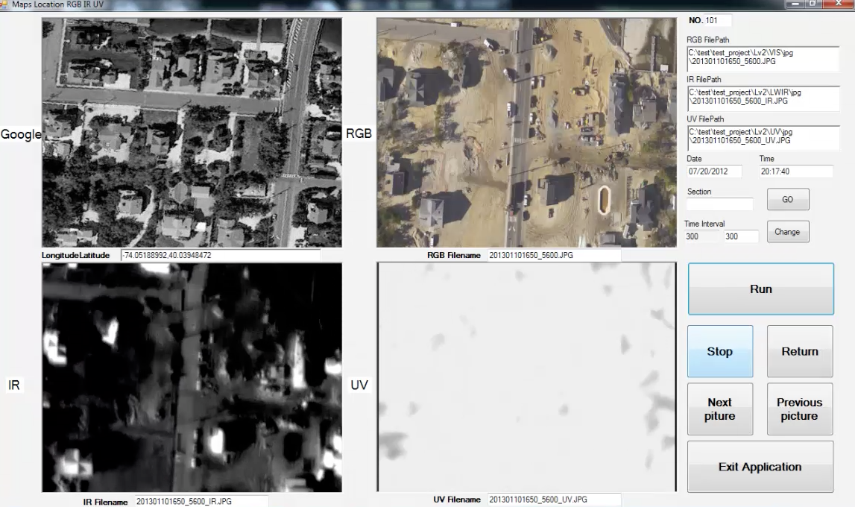
Visualization Tool

Slide 16
Data Processing & Analysis
Image Mosaic and Wrapping (Processing)
  Leveraging existing computer vision algorithms, such as feature detection (Speeded Up Robust Features), RANdom SAmple Consensus (RANSAC) and image wrapping
Object Recognition (Analysis)
  Developing new computer vision algorithms for object recognition using a combination of filters and machine learning algorithms

Slide 17
Data Processing Challenges
Need to create an accurate mosaic image from hundreds of images.
  Image Alignment Issues
Need for computational resources
  Image processing algorithms need to utilize multiple processors. For instance, Microsoft Image Composite Editor leverages multiple processors to create a mosaic image.
Need to develop customized algorithms
  We are currently developing Kalman Filter-based algorithms to compute a transformation matrix.

Slide 18
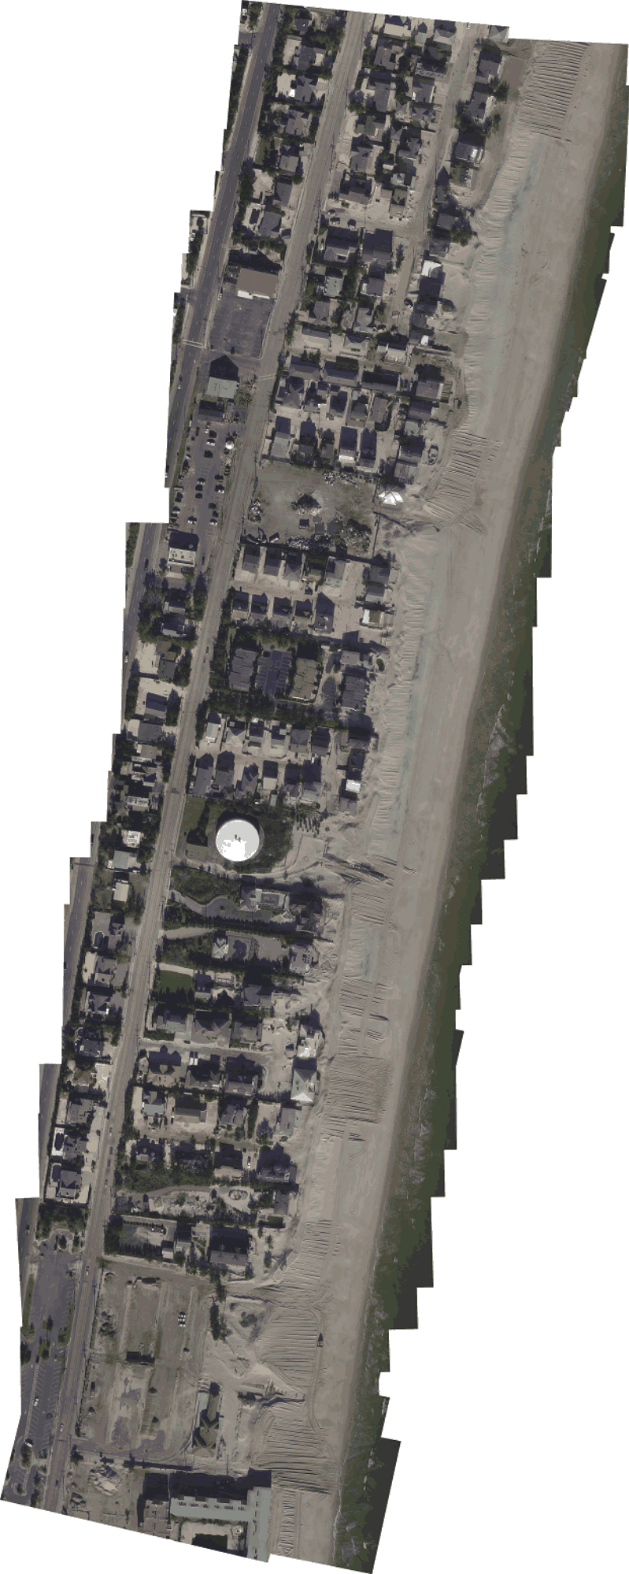
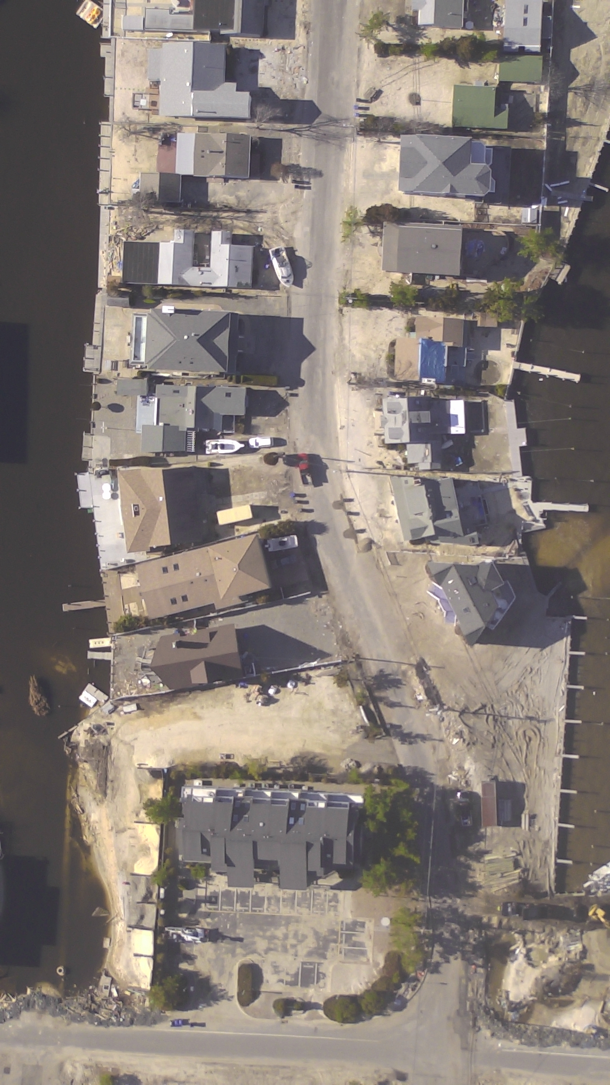
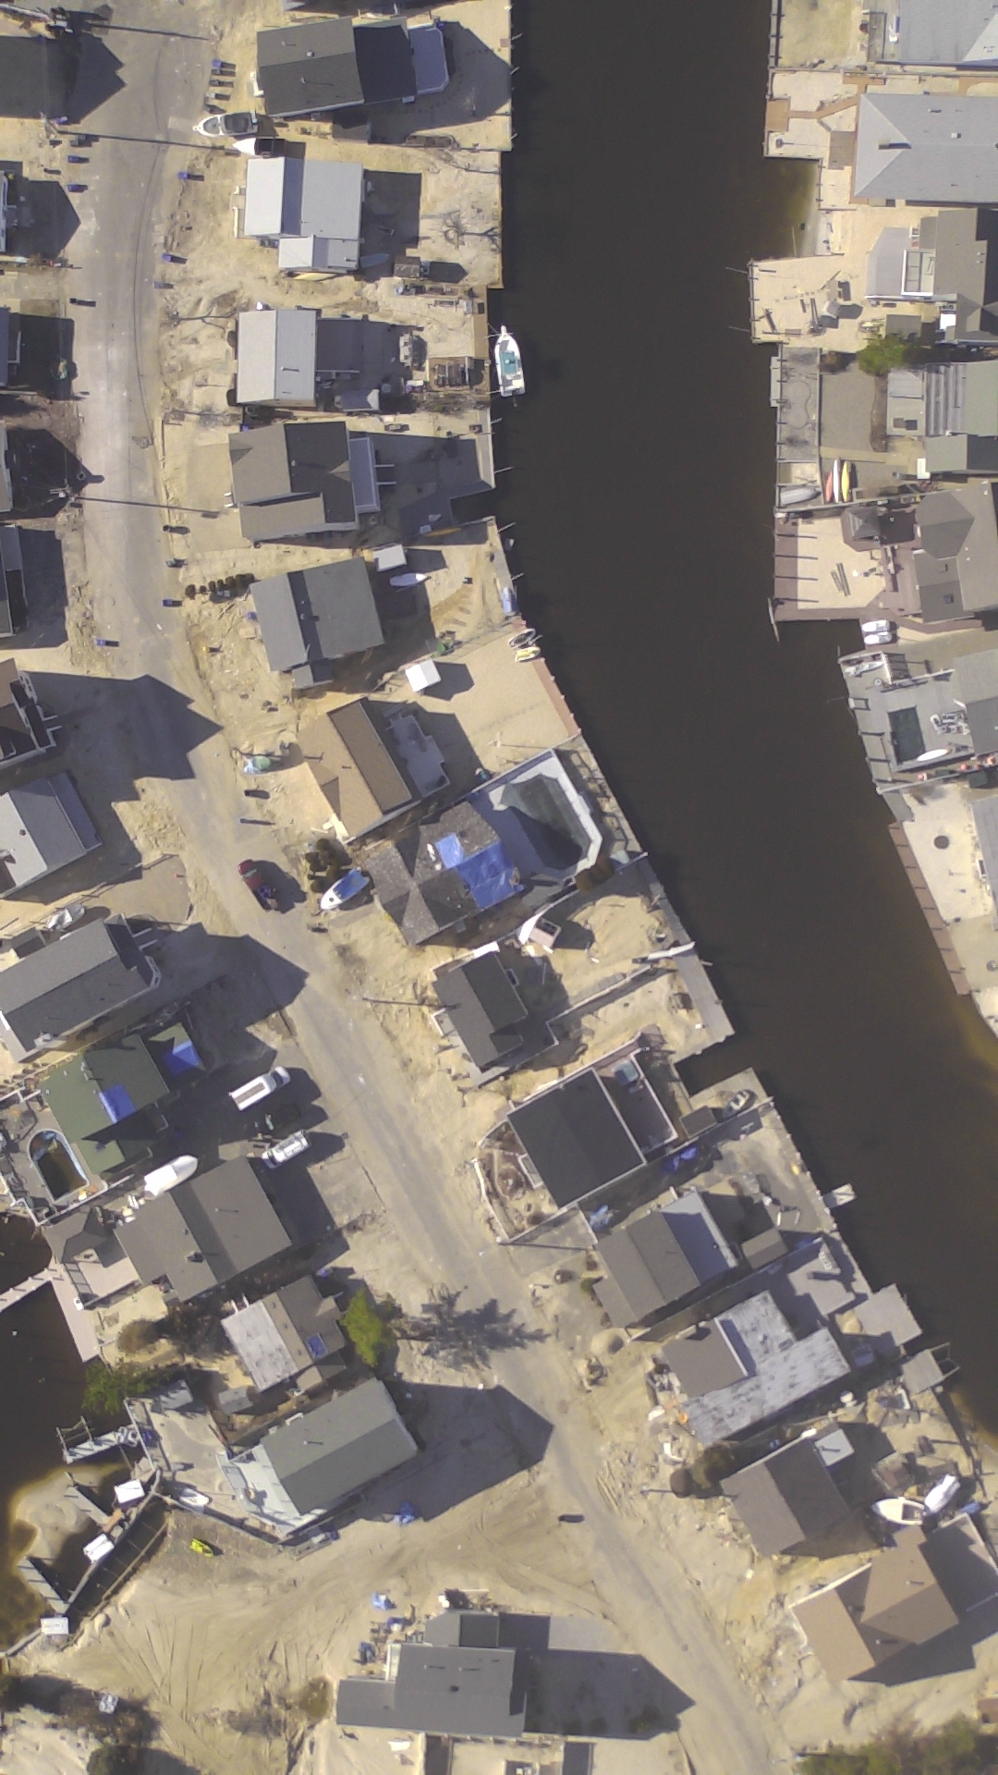
Image Mosaic: An Example
+
+

Slide 19
Image Mosaic Problem: An Example

Slide 20
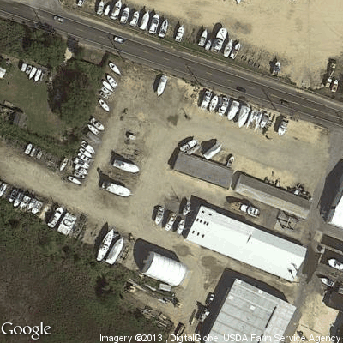
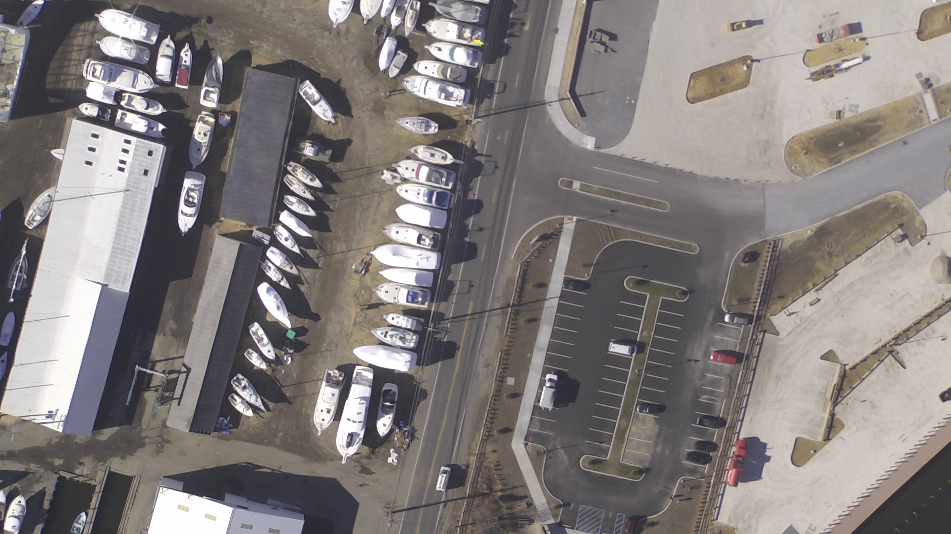
Compute Transformation Matrix for Image Rotation: An Example
Post Sandy Image
Google Image (Pre Sandy)

Slide 21
Compute Transformation Matrix for Image Rotation: An Example
Google Image (Pre Sandy)
Post Sandy Image

Slide 22
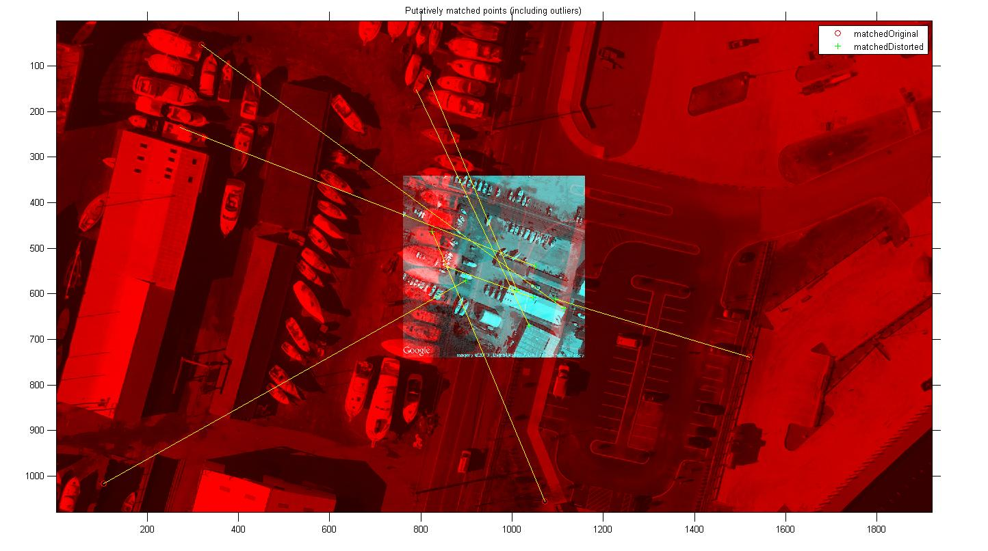
Finding Corresponding Points: An Example

Slide 23
Data Analysis: Object Recognition
Develop computer vision algorithms to identify objects of interest (e.g., electric power lines) from both pre and post Sandy Images.
  Extract “useful” features from original images
  Use extracted features as inputs to different types (e.g., supervised and unsupervised ) of machine learning algorithms.

Slide 24
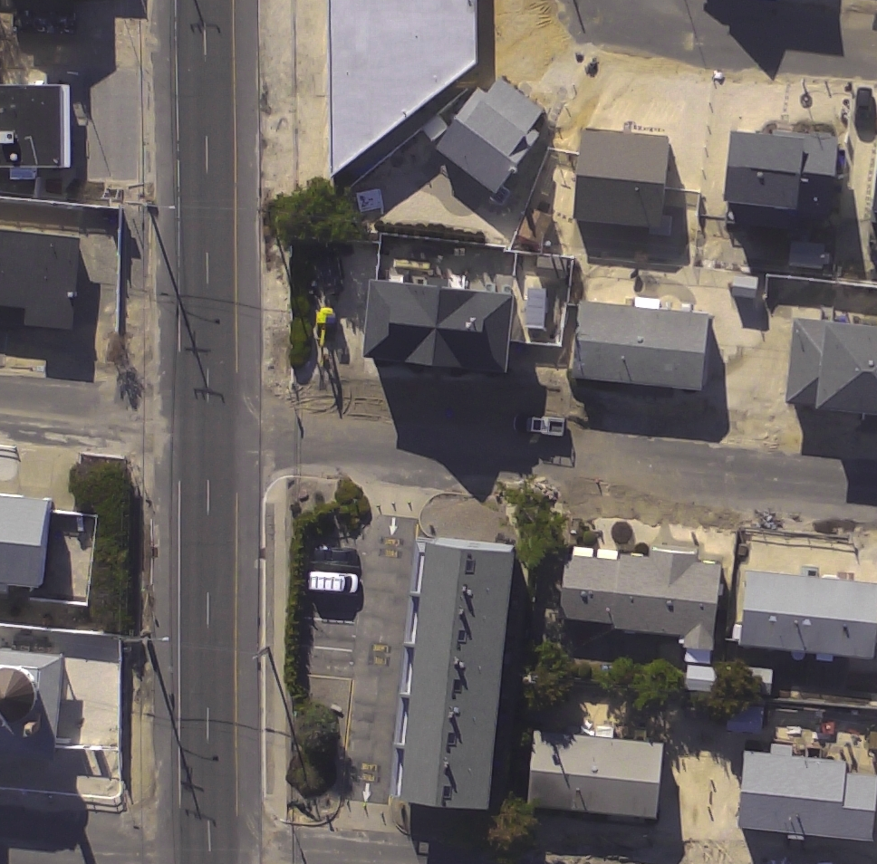
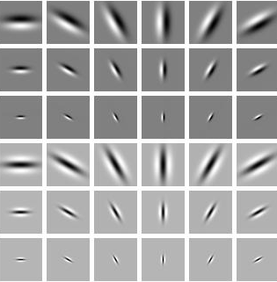

Object Recognition: An Example
Color to Lab Space
Original Image
Gabor Filter Bank

Slide 25
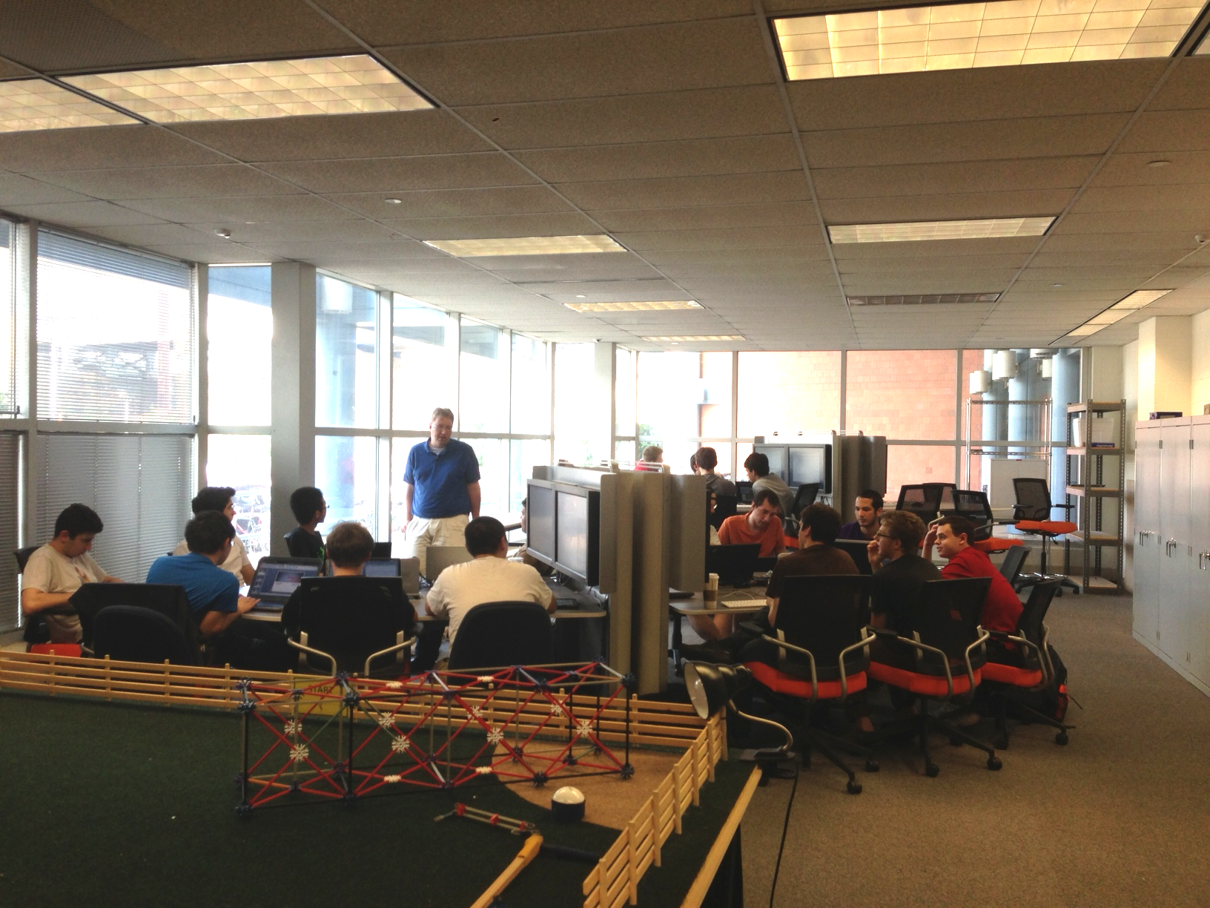
Undergraduate Research Projects: ENGR 103

Slide 26
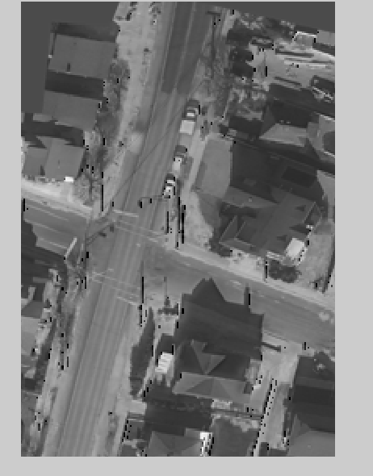
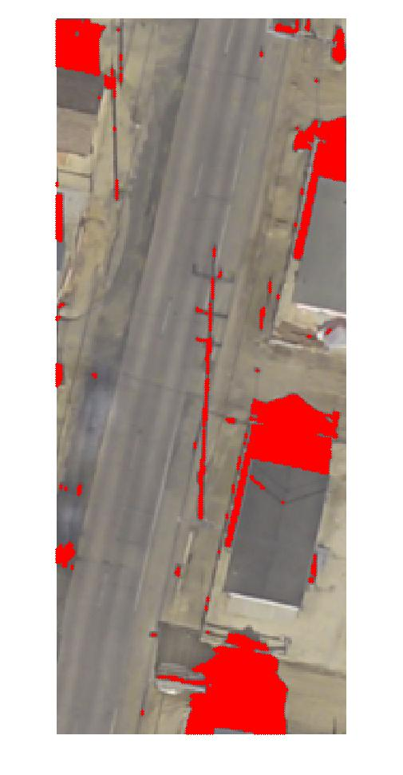
Sample Results

Slide 27
Undergraduate Students’ Research Blogs
1 | http://du2013-grp064-01.blogspot.com/ | Eddie Tang, Louis Rogowski, Dongen Zhou
2 | http://du2013-grp064-02.blogspot.com/ | David Kassie, Andrew Yaros, Noah Black
3 | http://du2013-grp064-03.blogspot.com/ | Jonathan Balsamo, Nick Damraksa, Kenneth Fox, Hashim Hyder
4 | http://du2013-grp064-04.blogspot.com/ | Albert Khodzhayev, Benjamin Share, Christophe Terlizzi, Jingyi Wei
5 | http://du2013-grp064-05.blogspot.com/ | Joshua Cohen, Zachary Bryceland
6 | http://du2013-grp064-06.blogspot.com | Zach Reiziss, Dan Gaughan, Andrew Hochstetter

Slide 28
Field Data Collection Experiments

Slide 29
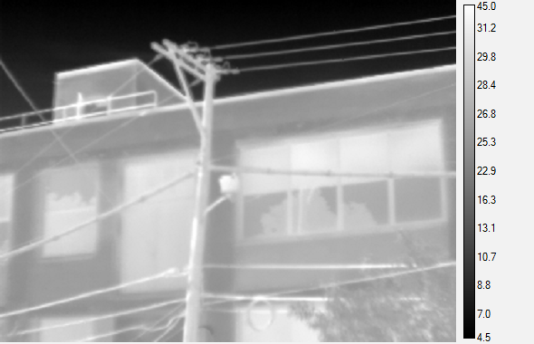
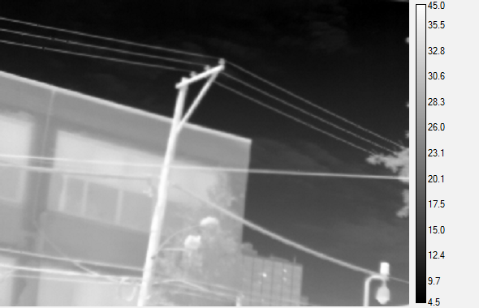
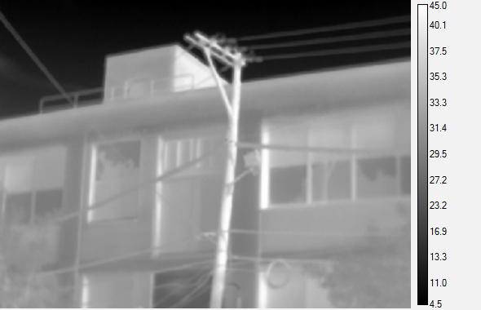
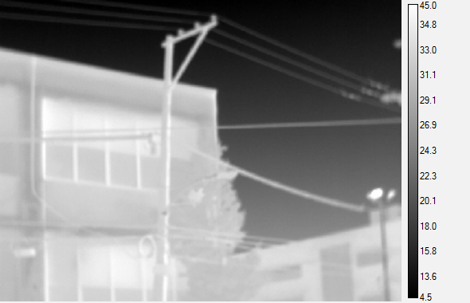
Power Line Monitoring Test Run
Location: Drexel University
Adjacent telephone pole
Time: 11:52
Time: 10:50 am
Sun
Sun
Time: 7 :00 pm
Time: 7:19 pm

Slide 30
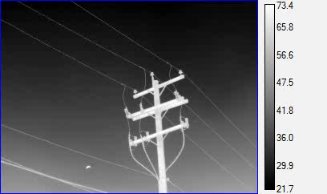
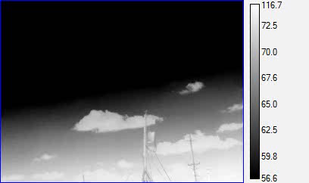
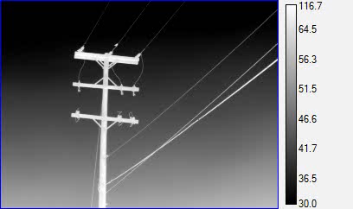
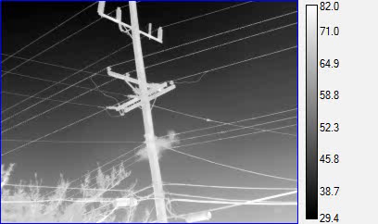
Power Line Monitoring Test Run
Location: New Jersey visiting date: 06.01.2013
Ocean club pole 1
Ocean club pole 2
Ocean club pole 3
Ocean club pole 4
Images in gray

Slide 31
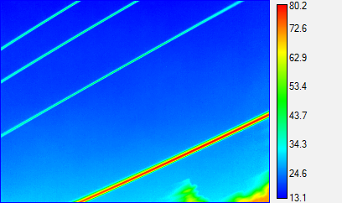
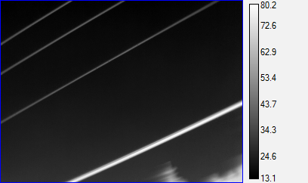
Power Line Monitoring Test Run
Location: New Jersey visiting date: 06.01.2013
Temperature differences between wires shows potential areas of damage

Slide 32
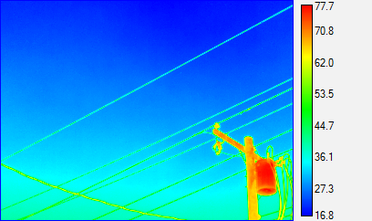
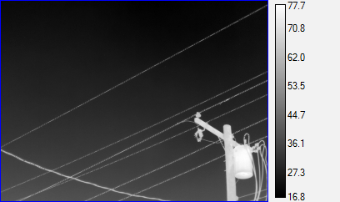
Power Line Monitoring Test Run
Location: New Jersey visiting date: 06.01.2013
Extracted image from moving video 1

Slide 33
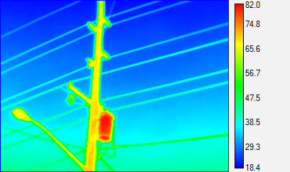
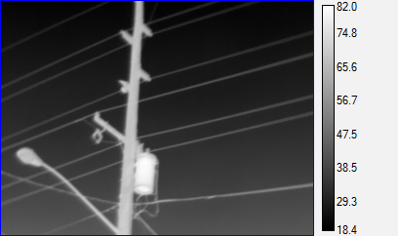
Power Line Monitoring Test Run
Location: New Jersey visiting date: 06.01.2013
Extracted image from moving video 2

Slide 34
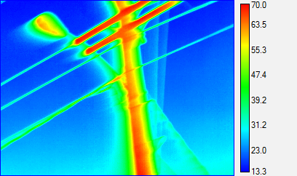
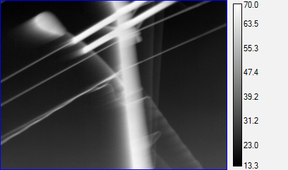
Power Line Monitoring Test Run
Location: New Jersey visiting date: 06.01.2013
Extracted image from moving video 3

Slide 35
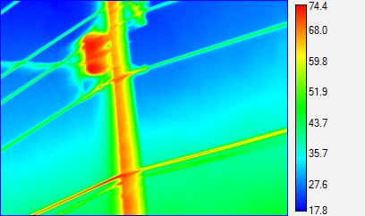
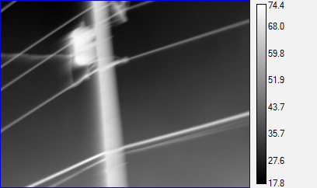
Power Line Monitoring Test Run
Location: New Jersey visiting date: 06.01.2013
Extracted image from moving video 4

Slide 36
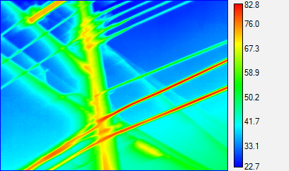
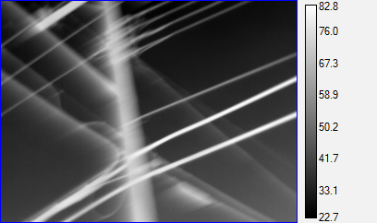
Power Line Monitoring Test Run
Location: New Jersey visiting date: 06.01.2013
Extracted image from moving video 5

Slide 37
Power Line Monitoring Test Run
Location: New Jersey visiting date: 06.01.2013
Extracted image from moving video 5

Slide 38
Preliminary Findings and Plans
Major damages to the distribution lines are caused by debris (e.g., sand and dislocated houses), fire (due to rupture of natural gas power lines), high-wind and scouring.
Most of the distribution powerlines in the affected island are not currently loaded since the island is still uninhabited. We will conduct the IR and UV imaging of power-lines in the summer time when the load in the distribution lines is expected to be 50-70% of the normal loading prior to the hurricane.

Slide 39
Thank You.

