Slide 1

Smart Grid Applications:
Viewpoint of an Electrical Power Engineer
Francisco de Leon
October 2010

Slide 2

Electrical Power Group http://www.poly.edu/power/
Poly is the only school in the NYC Metropolitan area that offers a complete program in electric power systems:
  Generation / Transmission / Distribution
  Drives / Power Electronics / Electromagnetic Propulsion & Design
  Distributed Generation / Smart Grid
Three undergraduate courses
Fifteen graduate courses
Faculty:
  Dariusz Czarkowski (Power Electronics and Systems)
  Francisco de Leon (Power Systems and Machines)
  Zivan Zabar (Power Systems and Drives)
  Leo Birenbaum (emeritus)
Research support has come from DoE, DoT, NSF, Pentagon, EBASCO, NYSERDA, Con Edison, and National Grid

Slide 3
Research In Smart Grid
Universal Controller for Interconnection of Distributed Generators with the Utility Lines
Analysis of Secondary Networks having DG
(What is the maximum amount of DG?)
3G System of the Future (Smart Grid)
Fault Analysis on Distribution Networks Having Distribution Generation (DG) Systems
Phase-Angle as an Additional Indicator of Imminent Voltage Collapse
Active Damping of Power System Oscillations by Unidirectional Control of Distributed Generation Plants

Slide 4
The Grid Before it became Smart

Slide 5
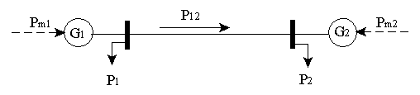

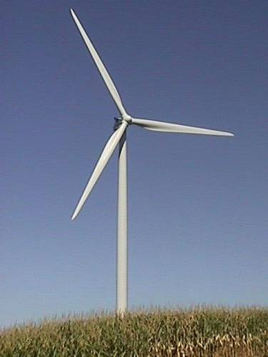
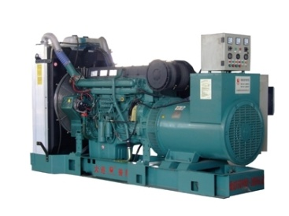
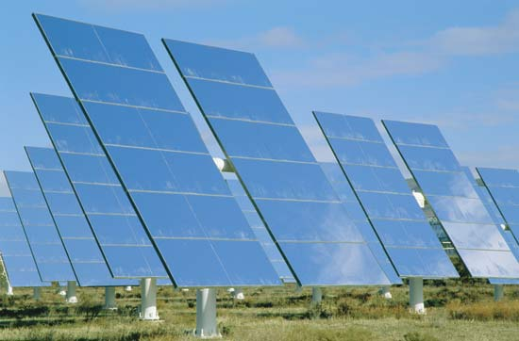
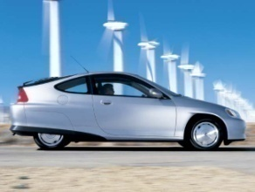
Active Damping of Power System Oscillations by Unidirectional Control of Distributed Generation Plants (1997)
Power System Oscillations
Distributed Generation
Can DG provide damping?
How much DG do we need?
P12

Slide 6
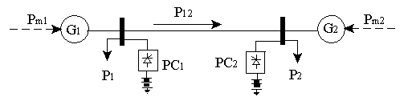
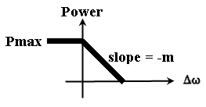
Unidirectional Damping
Most DG’s supply power and cannot absorb power
Damping can be introduced by:
  Controlling power in inverse proportion to Δω
  Unidirectional control
Unidirectional power injections
Δω

Slide 7
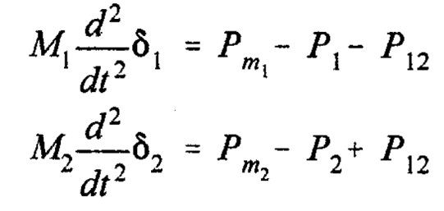
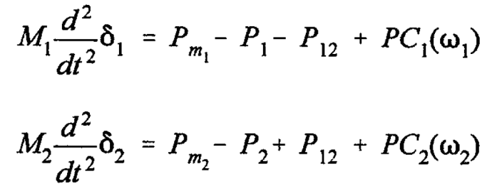
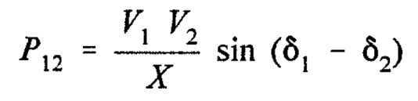

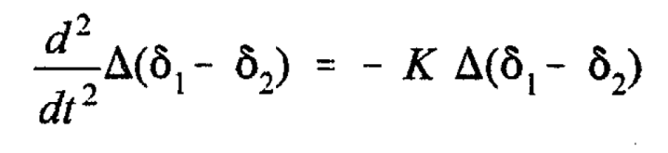
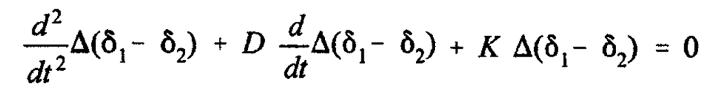
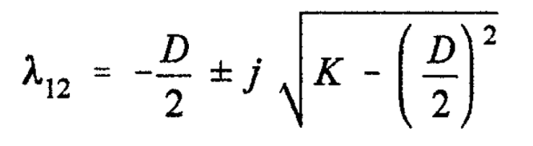

Equations
No controlling DG’s
Controlling DG’s
Swing Equation
Tie Power Flow
Controlling Law
Linearized Dynamic Equations
Eigenvalues
Undamped
Oscillation
Damped Oscillation

Slide 8
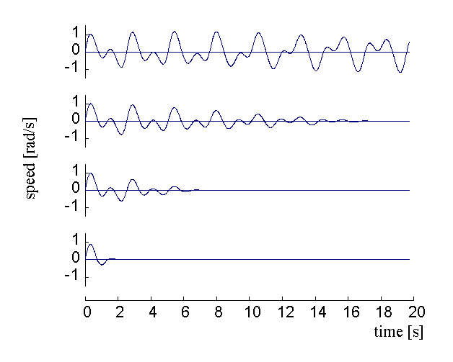
39-Bus System (New England)
39 Busses 6.2 GW Generation
10 Generators 1.6 Gvar
Load busses 10 DG’s
46 Transmission lines and transformers
No DG
4 MW at 10 buses (total 0.64%)
10MW at 10 busses (total 1.6%)
40 MW at 10 busses (total 6.4%)

Slide 9
Conclusions
DG’s can provide damping to electro-mechanic oscillations
Controlling about 2% of total power can provide meaningful damping
Only local signals are needed (frequency)
Damping is more effective when DG’s are near the generation stations (the above 2% is at the load)
The control can be unidirectional (reduced generation reserve)

Slide 10
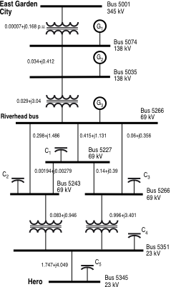
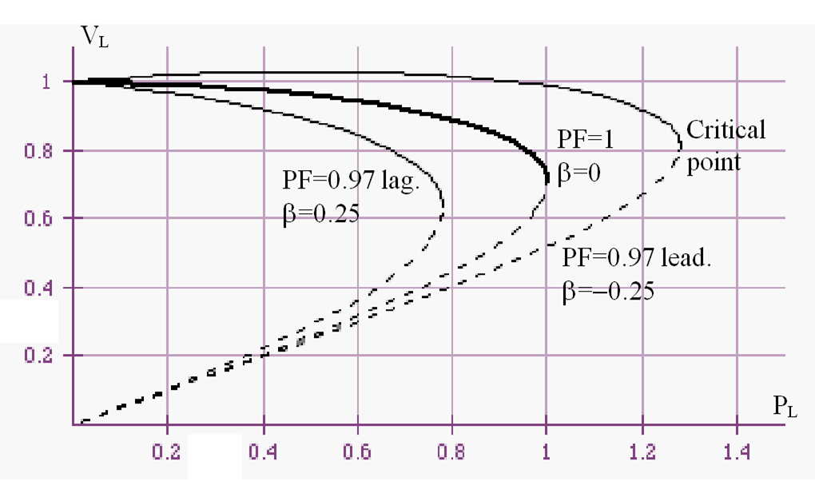
Phase-Angle as an Additional Indicator of Imminent Voltage Collapse
Voltage collapse is a phenomenon that occurs due to lack of reactive power.
Frequently it is difficult to detect from voltage measurements because the system “controls” the voltage.
In today’s (smart grid) terminology this is called Synchrophasor (or AMI).

Slide 11
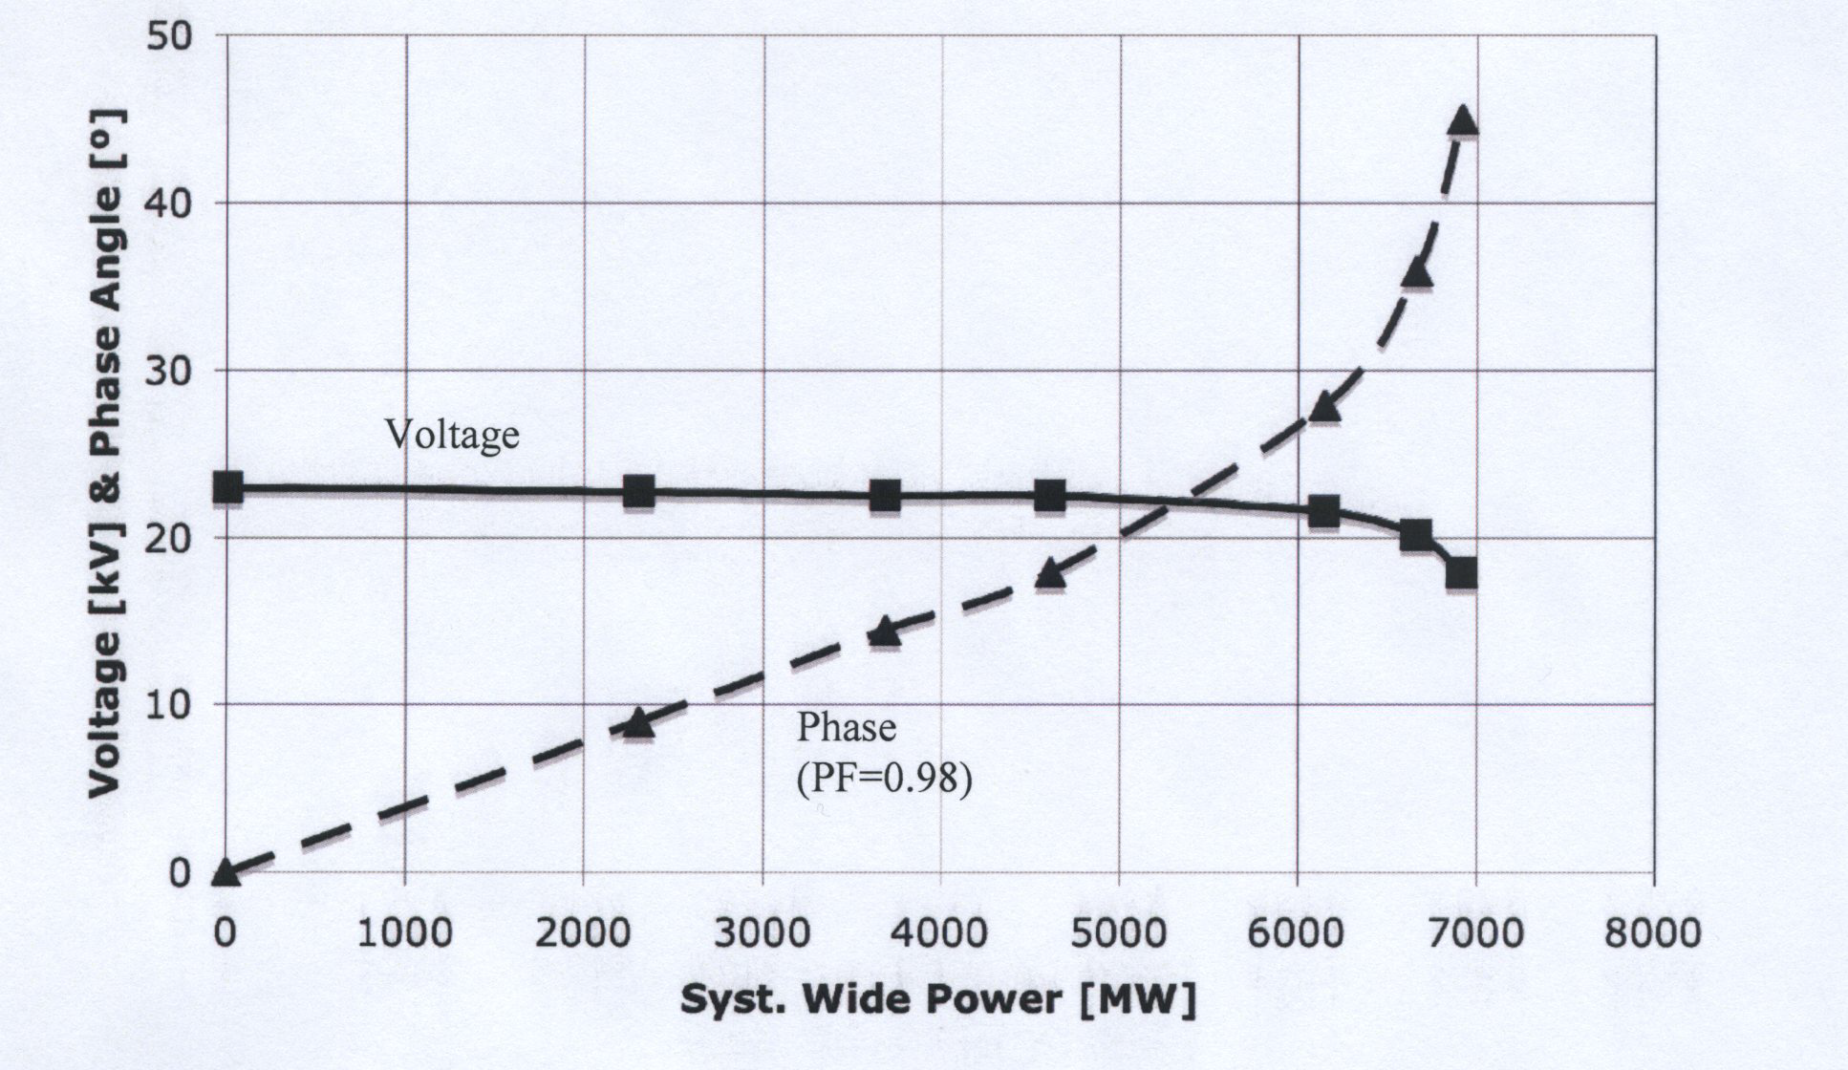
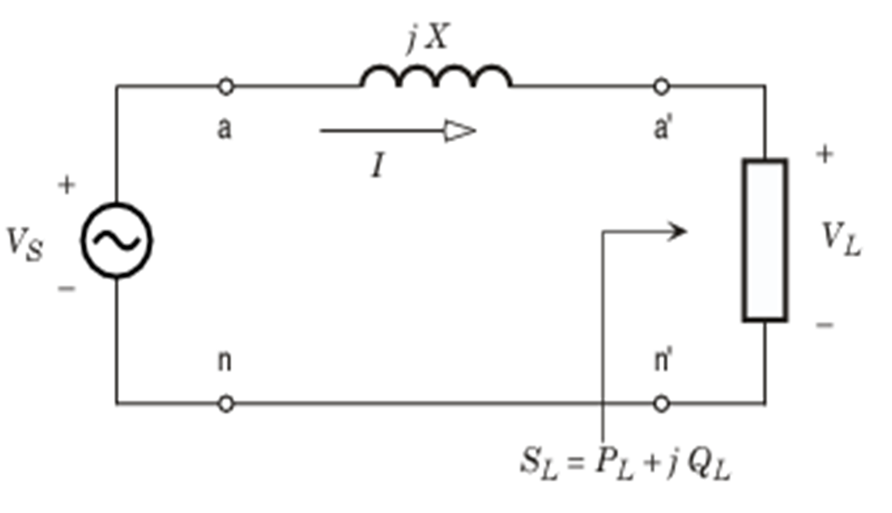
Analysis
The conclusion is that the angle is a very good indicator of how close the system is to voltage collapse

Slide 12
Universal Controller for Interconnection of Distributed Generators with the Utility Lines
Large amounts of DG bring operating problems to power systems
  Voltage
  Frequency
Some systems (networks) do not physically allow for reverse power flow
DG can be random (non-dispatchable)

Slide 13
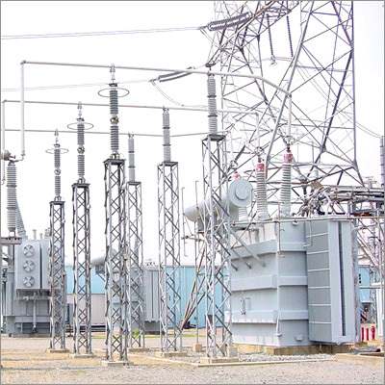
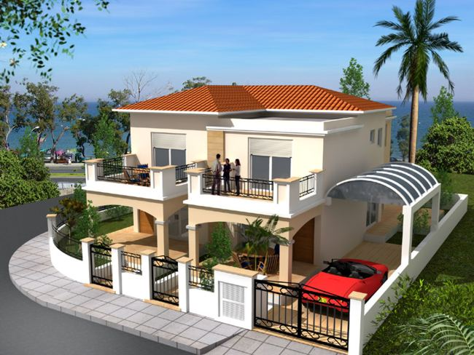
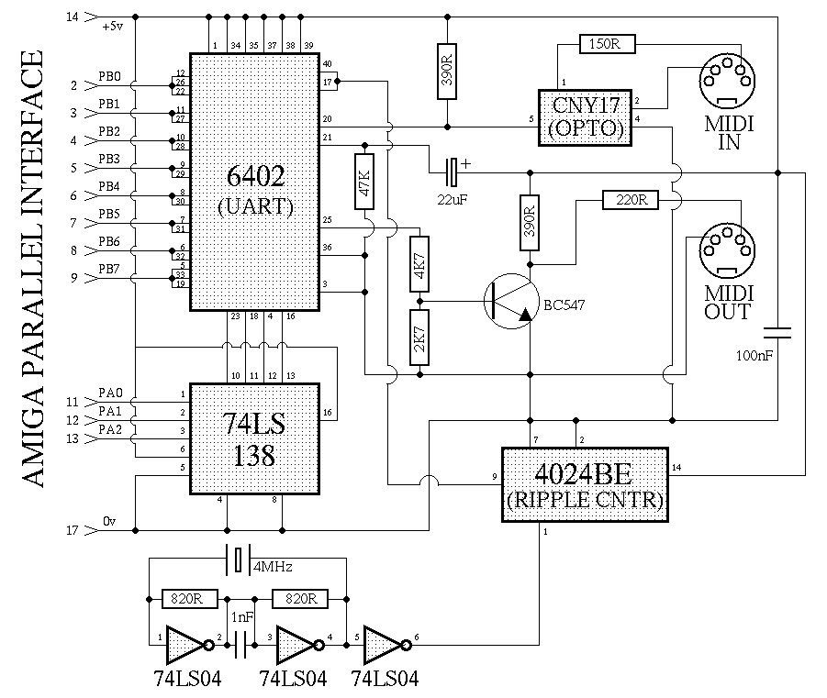
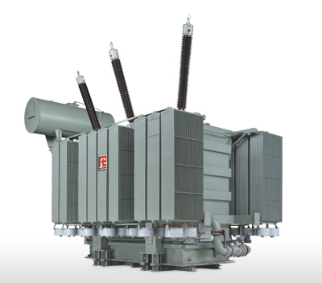
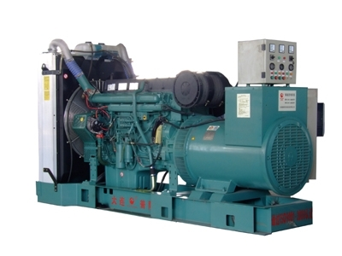
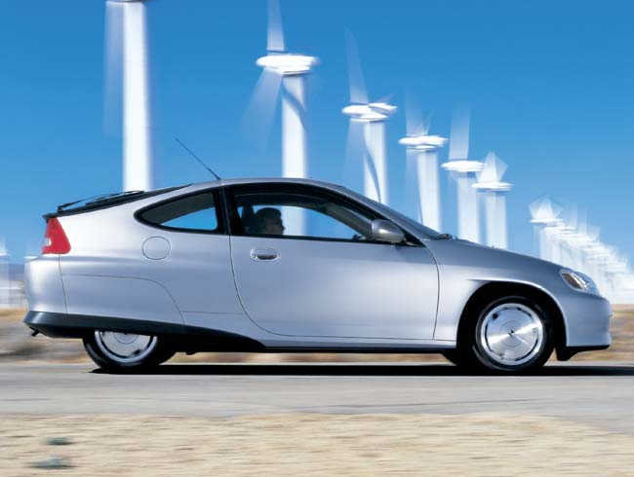
Our universal controller defends the utility from bad side effects caused by DG
Wind
Solar
Co-Gen
The Controller
PI-HEV

Slide 14
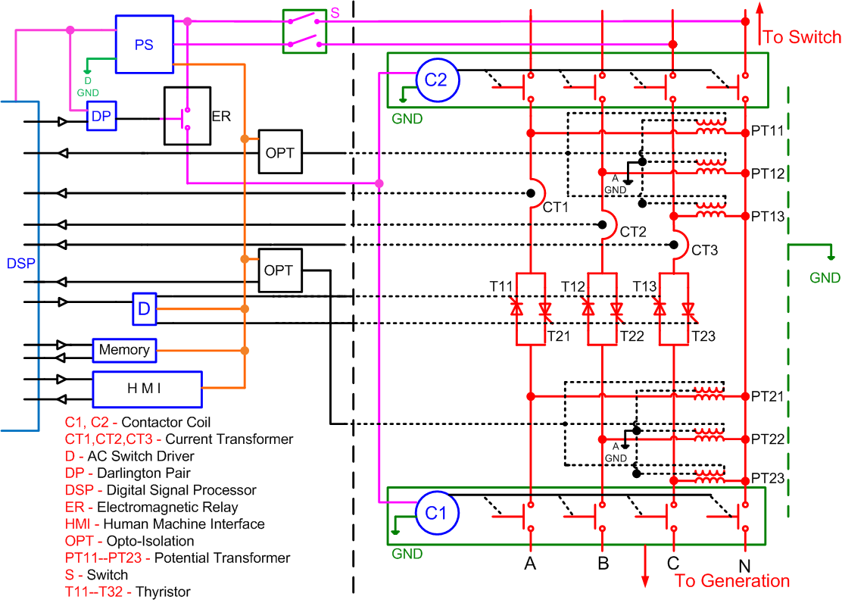
Universal Controller for Interconnection of Distributed Generators with the Utility Lines

Slide 15
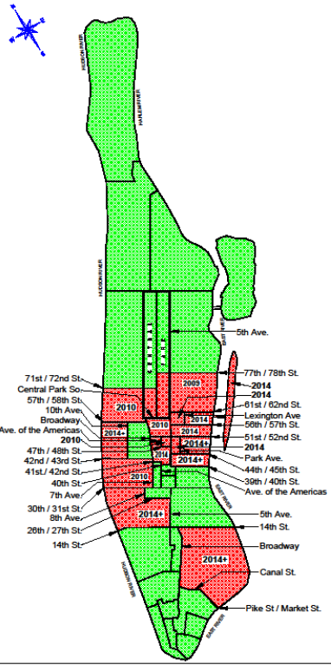
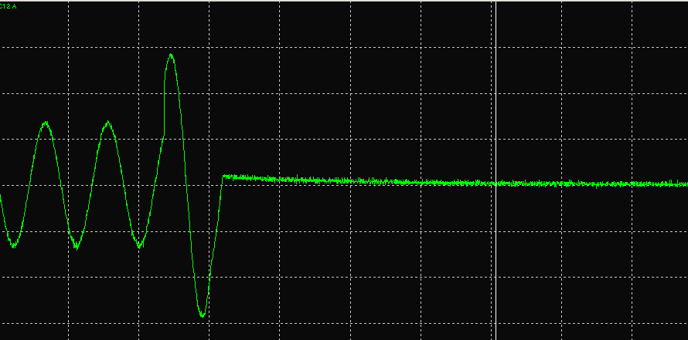
No Short Circuit Contribution

Slide 16
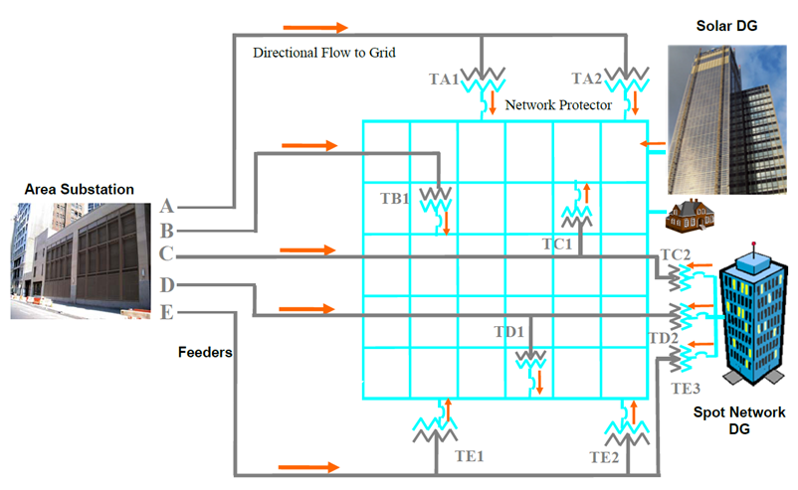
Analysis of Secondary Networks having DG
(What is the maximum amount of DG?)

Slide 17
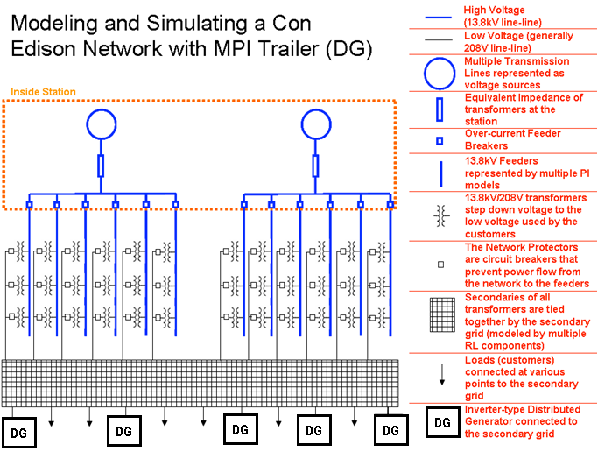
Analysis of Secondary Networks having DG

Slide 18
Analysis of Secondary Networks with DG
In conclusion there is a maximum limit, even under ideal conditions, in the amount of DG that can be connected to a network before voltage regulation problems occur.

Slide 19
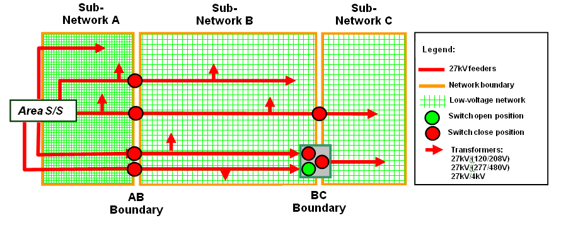
3G System of the Future
(Con Edison)
Transient and steady-state analyses for the
3G Smart Grid concepts

Slide 20
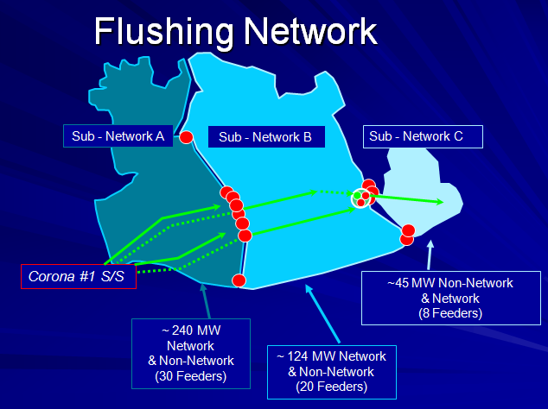
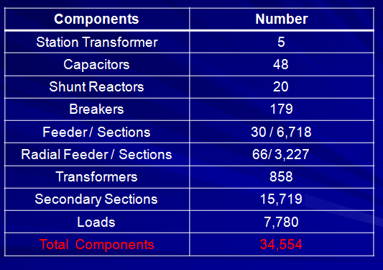

Slide 21
Model Validation
Measured vs. simulated voltage and current during a three-phase short circuit

Slide 22
The Smart Grid Viewpoint of a
Power Systems Engineer
Grid Reliability
Long-duration interruptions (longer than a few minutes) in the supply of electric power do not happen often (not even in small sections).
When they do, these events are very disruptive to people and the economy.
Very short duration disturbances (under a second) can disrupt certain (automatic) industrial processes.
(In my opinion) the first and most important function of a smart grid should be to keep or increase the current levels of reliability

Slide 23
Enhance Reliability
Steady State Operation:
  Any smart grid technology or algorithm needs to respect the fact that the power grid is made of equipment with operating limits.
  There are many limits, but the most important ones are: thermal, voltage drop, and stability margin.
  At present, the thermal status of most power devices is not monitored in real-time. The most detrimental effect to reliability of the system is when equipment is damaged (very long lead times for replacements).

Slide 24
Enhance Reliability
Dynamic Operation:
  The technology to perform real-time thermal monitoring already exists.
  Large generators and transformers already use the information for loading purposes, but most transmission lines, cables and small transformers do not.
  Accurate models are only now being developed for some type of installations, but much works remains to be done.
  Synchrophasors are used to monitor possible power oscillations.

Slide 25
Enhance Reliability
Dynamic Operation:
  The technology to perform real-time thermal monitoring already exists.
  Large generators and transformer already use the information for loading purposes, but most transmission lines, cables and small transformers do not.
  Accurate models are only now being developed for some type of installations, but much works remains to be done.

Slide 26
Enhance Reliability
Short-Circuit:
  Short-circuits are unavoidable events in a power system.
  The installation of distributed generators in the distribution system is increasing the short-circuit currents.
  Techniques are being developed now to limit the short-circuit currents:
    Fast acting power electronic switches
    Superconductive current limiters

Slide 27
Enhance Reliability
Stability:
  Traditional power system stability relies on the spinning generation reserve of large heavy generators.
  A smart grid with substantial non-inertial (and non-dispatchable) distributed generation may present unforeseen stability issues.
  Most DGs are highly controllable with a fast time response. Active damping can be introduced.

Slide 28
Enhance Reliability
Switching Transients:
  With exception of some capacitors, regulators and transformer tap changers, the current operation of the grid does not rely on frequent switching.
  Before implementing smart grid functions that heavily depend on switching and system reconfiguration, attention should be paid to the level and number of stresses (overvoltages and overcurrents) that equipment will be subjected under those conditions.
  Accelerated ageing may be an undesirable side effect.

Slide 29
Conclusions &
Recommendations
Smart grid technologies and algorithms should not negatively affect reliability:
  Account for the limits on equipments
  I propose the use of local (or short distance) communications only for preventive control
I hope reliability will not be scarified for quick profits

Slide 30
Thank You!
Francisco de Leon (Power Systems)
Department of Electrical and Computer Engineering
Polytechnic Institute of NYU
Brooklyn, NY 11201
(718) 260 3961 - fdeleon@poly.edu

