Slide 1
Performance Metrics and Protocols for Data Centers in Multimedia
Muriel Médard MIT

Slide 2
Collaborators
MIT: Szymon Acedański (now University of Warsaw), Flavio du Pin Calmon, Jason Cloud, Supratim Deb (now AT&T), Ulric Ferner, Kerim Fouli, Minji Kim (now Oracle), Qian Long, Asu Ozdaglar, Ali Parandehgheibi (now Plexxi), Marco Pedroso, Leo Urbina (now BitSight), Luis Voloch, Weifei Zeng
Texas A&M: Srinivas Shakkottai,
Alcatel-Lucent Bell Labs: Emina Soljanin
National University of Ireland Maynooth: Doug Leith
University of Aalborg: Frank Fitzek, Daniel E. Lucani, Morten Pedersen
BME Budapest University: Hassan Charaf , Marton Sipos, Aron Szabados,

Slide 3
Overview
Tradeoffs among cost of transmission, cost of storage, and different performance metrics
See Ulric Ferner’s talk for performance metrics using blocking
Three case studies
  Use of coding for trading off use of a costly resource, say a local cache or network with higher cost, with the probability of interruption of a progressive download video and its buffering delay
  Peer-aided edge cache system, where coding is used to provide smooth use of edge cache, peers and data centers
  Use of coding in delivery of video, both when the video is kept uncoded but delivered in a coded fashion, using HTTP over TCP

Slide 4
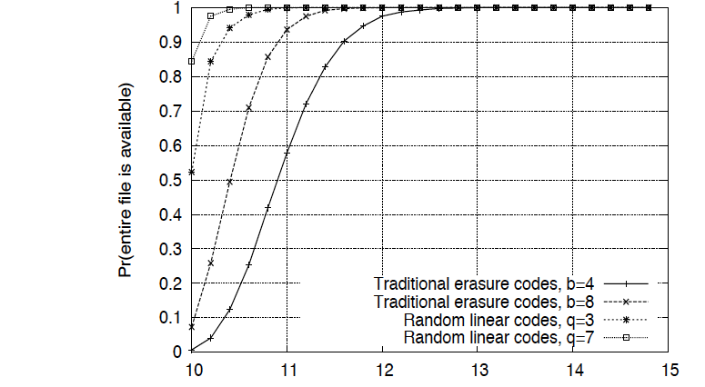
Peer-to-peer with Coding

Slide 5
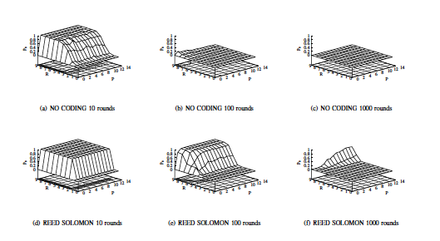
Recoding

Slide 6
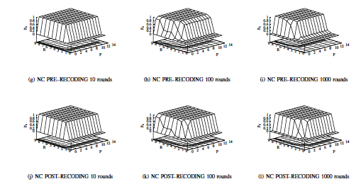
Recoding

Slide 7
Quality of Experience for Media Streaming
Setup: User initially buffers a fraction of the file, then starts the playback
QoE metrics:
  Initial waiting time
  Probability of interruption in
  media playback
Homogeneous access cost ^{[1]}:
Heterogeneous access cost: Design resource allocation policies to minimize the access cost given QoE requirements
Interruptions
in playback
Initial
waiting time
Cost

Slide 8
Problem Formulation and Control Policies
Objective: Find control policy to minimize usage cost, while meeting QoE requirements
Off-line policies (Queue-length not observable)
  Optimal policy is greedy
  Use the costly server only for a certain time
Online policies (Queue-length observable)
  Safe policy:
    Start with costly server until queue-length hits a threshold
    Once hit the threshold, never switch back
  Risky policy:
    Use the costly server only if the queue-length is below a threshold
    The threshold depends on QoE requirements
Costly Server
Free Server
Receiver
Notes:
We have normalized the playback rate to 1 (WLOG)

Slide 9
Problem Formulation and Control Policies
Markov-Decision Process with a probabilistic constraint
Optimal policy characterized by an HJB equation
Off-line policies (Queue-length not observable)
  Optimal policy is greedy
  Use the costly server only for a certain time starting from zero
Online policies (Queue-length observable)
  Safe policy:
    Start by using the costly server until queue-length hits a threshold
    Once hit the threshold, never switch back
  Risky policy:
    Use the costly server if and only if the queue-length below a threshold
    The threshold depends on QoE requirements
    Markov w.r.t the queue-length process (given the initial condition)
    Approximately satisfies the HJB equation
Notes:
We have normalized the playback rate to 1 (WLOG)

Slide 10
Detailed Description of Control Policies
Off-line policy: Use the costly server only for , where
Online policies
  Safe policy:
    Threshold =
    Cost = , for some
  Risky policy:
    Threshold =
    where
    Cost
Notes:
We have normalized the playback rate to 1 (WLOG)

Slide 11
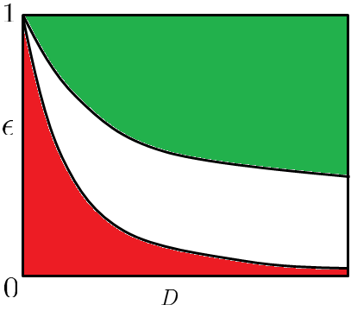

Performance Comparison
Three regimes for QoE metrics
  Zero-cost
  Infeasible (infinite cost)
  Finite-cost
zero-cost
Finite-cost
infeasible
Notes:
We have normalized the playback rate to 1 (WLOG)

Slide 12
CDN and P2P integration
There are several recent efforts to design and analyze hybrid CDN-P2P systems.
Most projects rely on centralized management and coordination of the P2P network and the CDN (e.g. Akamai)
  System perspective: Peer-Aided CDN (PAC) vs CDN aided P2P (CAP)
  Huang et. al ’08, Lu et. al’12, etc.
  No coding and limited analytic insight
Network coding simplifies the integration between the CDN and the P2P network.
Network coding also allows both networks to be operated orthogonally.
CDN
P2P

Slide 13
Distributed storage and network coding
Properties:
Centrally managed.
High reliability.
Brings content closer to the user.
Problems:
High maintenance cost.
Overprovisioning.
Difficult and costly to expand.
CDN
Idea: manage and allocate files to intermediate nodes of the network in order to lower the CDN cost. This approach has been explored previously in the literature.

Slide 14
Distributed Storage and Network Coding
NC can make distributed storage in CDNs simpler.
Some nodes have storage and are usually always connected.
Opportunity for offloading the CDN with distributed caching.
How? Coding & Optimization
CDN
Users
Intermediate nodes (e.g. gateways or users)

Slide 15
Distributed Storage and Network Coding
NC can make distributed storage in CDNs simpler.
Some nodes have storage and are usually always connected.
Opportunity for offloading the CDN with distributed caching.
How? Coding & Optimization
CDN
Users
There are many promising results that show the benefits of coding in similar contexts, such as Jiang et. al’12, Golrezai et. al’11, Ramchandran et. al’11, among others.

Slide 16
P2P and Network Coding
Properties:
Low cost.
Scalable.
No central management required.
P2P
Disadvantages:
Unreliable.
No quality of service guarantees.
Files not always available.
Network coding can significantly improve the performance of P2P systems (e.g. Wang and Li’07)

Slide 17
P2P and Network Coding
Properties:
Low cost.
Scalable.
No central management required.
P2P
Disadvantages:
Unreliable.
No quality of service guarantees.
Files not always available.
Network coding can significantly improve the performance of P2P systems (e.g. Wang and Li’07)
Main idea: Combine P2P and distributed CDN using network coding, allowing the P2P network to operate orthogonally to the CDN.

Slide 18
CDN and P2P Integration Using Coding
Assumptions: the CDN, the intermediate nodes and the P2P network distribute coded versions of files
CDN
Users
P2P

Slide 19
CDN and P2P Integration Using Coding
Goal: optimize file allocation and distribution over intermediate nodes given a demand distribution and restrictions on traffic volume.
CDN
Users
P2P

Slide 20
Problem Modeling - Variables
Content Placement :
CDN
: fraction of file stored at the edge cache
: total storage used at the cache
Hybrid Content Delivery :
: fraction of file to obtain from cache , if users at request file
: fraction of file to obtain from the P2P network, if users at request file
P2P

Slide 21
Problem Modeling - Costs
We want to minimize…
CDN
…Cost of server load.
Users
…Cost of storage at gateways.
Gateways
P2P
…Cost of using P2P network.

Slide 22
Problem Modeling - Costs
CDN
Cost & Constraints at CDN
: cost of unit service volume at the server
: cost of unit storage at each node
: service capacity at node
Costs and Constraints associated with P2P
: cost of obtaining unit volume of file from the P2P networks
: total available fraction of file from the P2P networks
P2P

Slide 23
Basic Formulation
Cost of server load.
Cost of using P2P network.
Cost of storage at gateways.
Amount of file to obtain from server by node
Server load from file
Upload capacity constraint under demand distribution
e.g. Zipf’s Law :

Slide 24
Basic Formulation
Only the number of received packets matters – no tracking of individual packets required.
Amount of file to obtain from server by node
Server load from file
Upload capacity constraint under demand distribution
e.g. Zipf’s Law :

Slide 25
Example
5
1.5
P2P costs inverse proportional to file popularity (Zipf)
File size: 1GB
P2P availability proportional to Zipf distribution (file popularity)
Constraint on total volume of traffic per edge node= 100GB
Zipf,

Slide 26
Server Load Penalty
General form of the problem:
Can be solved using generalized first order methods

Slide 27
Server Load Penalty
General form of the problem:

Slide 28
Network Coding and Reliable Communications Group
Proxy for Coded TCP
TCP is end-to-end, and often requires changes at the source (and sometimes even within the network)
  If a source is not setup/changed, the information not accessible
Using proxies can avoid the problem
  Does not require the source to support CTCP
  TCP: unchanged source ↔ CTCP proxy
  CTCP: CTCP proxy ↔ client
  Successfully tested in accessing Youtube video, websites (e.g. CNN, BBC, etc.) without changing their servers via a proxy in Amazon EC2
unchanged
source
CTCP
proxy
client

Slide 29
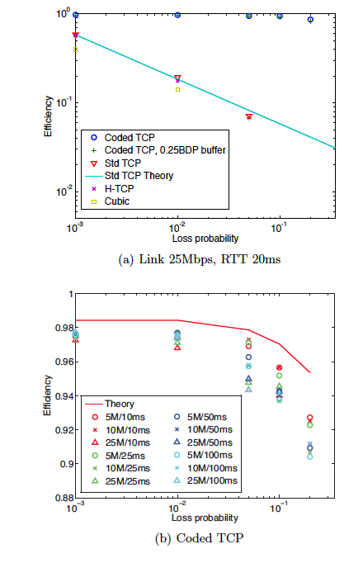
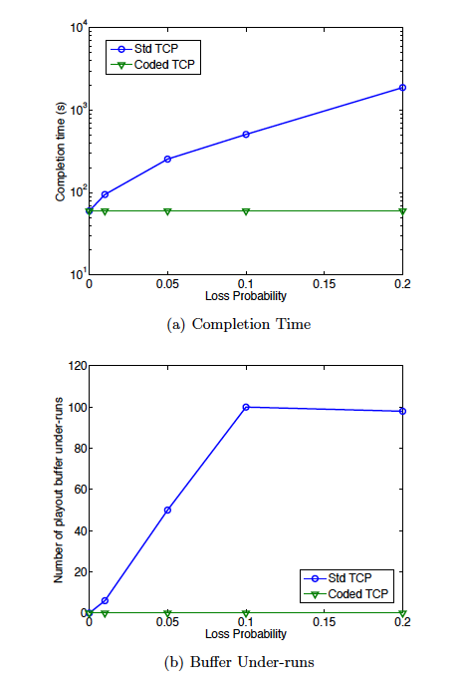
Testbed Measurements
Hamilton Institute

Slide 30
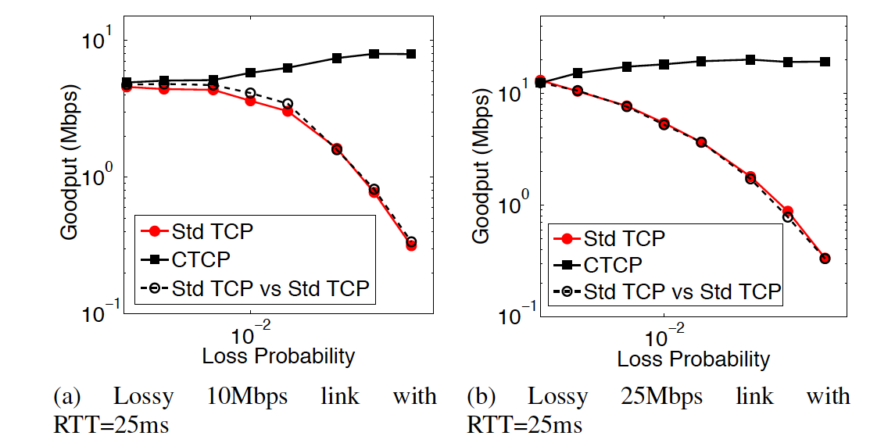
Testbed Measurements

Slide 31
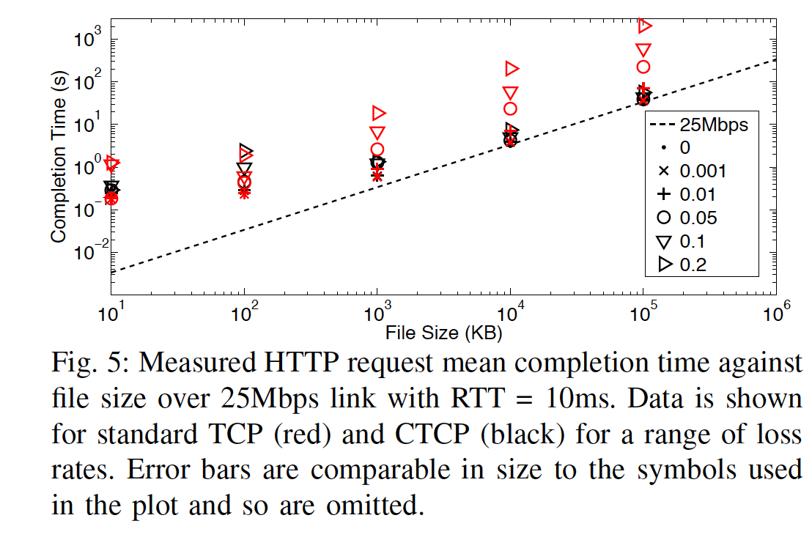
Testbed Measurements

Slide 32
Conclusions
Tradeoffs among cost of transmission, cost of storage, and different performance metrics
Heterogeneity of architectures, types of storage and networks
Application and underlying delivery protocols are important

